Slide 1
Elevation of Privilege:
Drawing Developers into Threat Modeling
Adam Shostack
Microsoft
@adamshostack

Slide 2
Background
15 years of structured security approaches at Microsoft
  Threat modeling (“Threats to our Products”, 1999)
  STRIDE: mnemonic for common threats
    Spoofing, Tampering, Repudiation, Info Disclosure, Denial-of-Service, Elevation of Privilege
  Security Development Lifecycle, 2002
Security experts versus others

Slide 3
Motivation: The game
Observations of threat modeling
  A security expert only activity?
  Smart people not steeped in security…stymied
Goal: a way to do and learn which is
  Non-threatening
  Enticing
  Supportive
Protection Poker

Slide 4
Motivation: This talk
Share the journey
Hope to inform future game designers
“Fortune favors the prepared mind”
– Louis Pasteur

Slide 5
Elevation of Privilege: The Game
Game mechanic borrowed from no-bid Spades
Equipment:
  Card deck, whiteboard
  Cards in 6 suits, based on STRIDE
  Each card has a “hint”
Played in tricks, high card wins
  High card in suit, or in trump suit
CC-BY 3.0 licensing

Slide 6
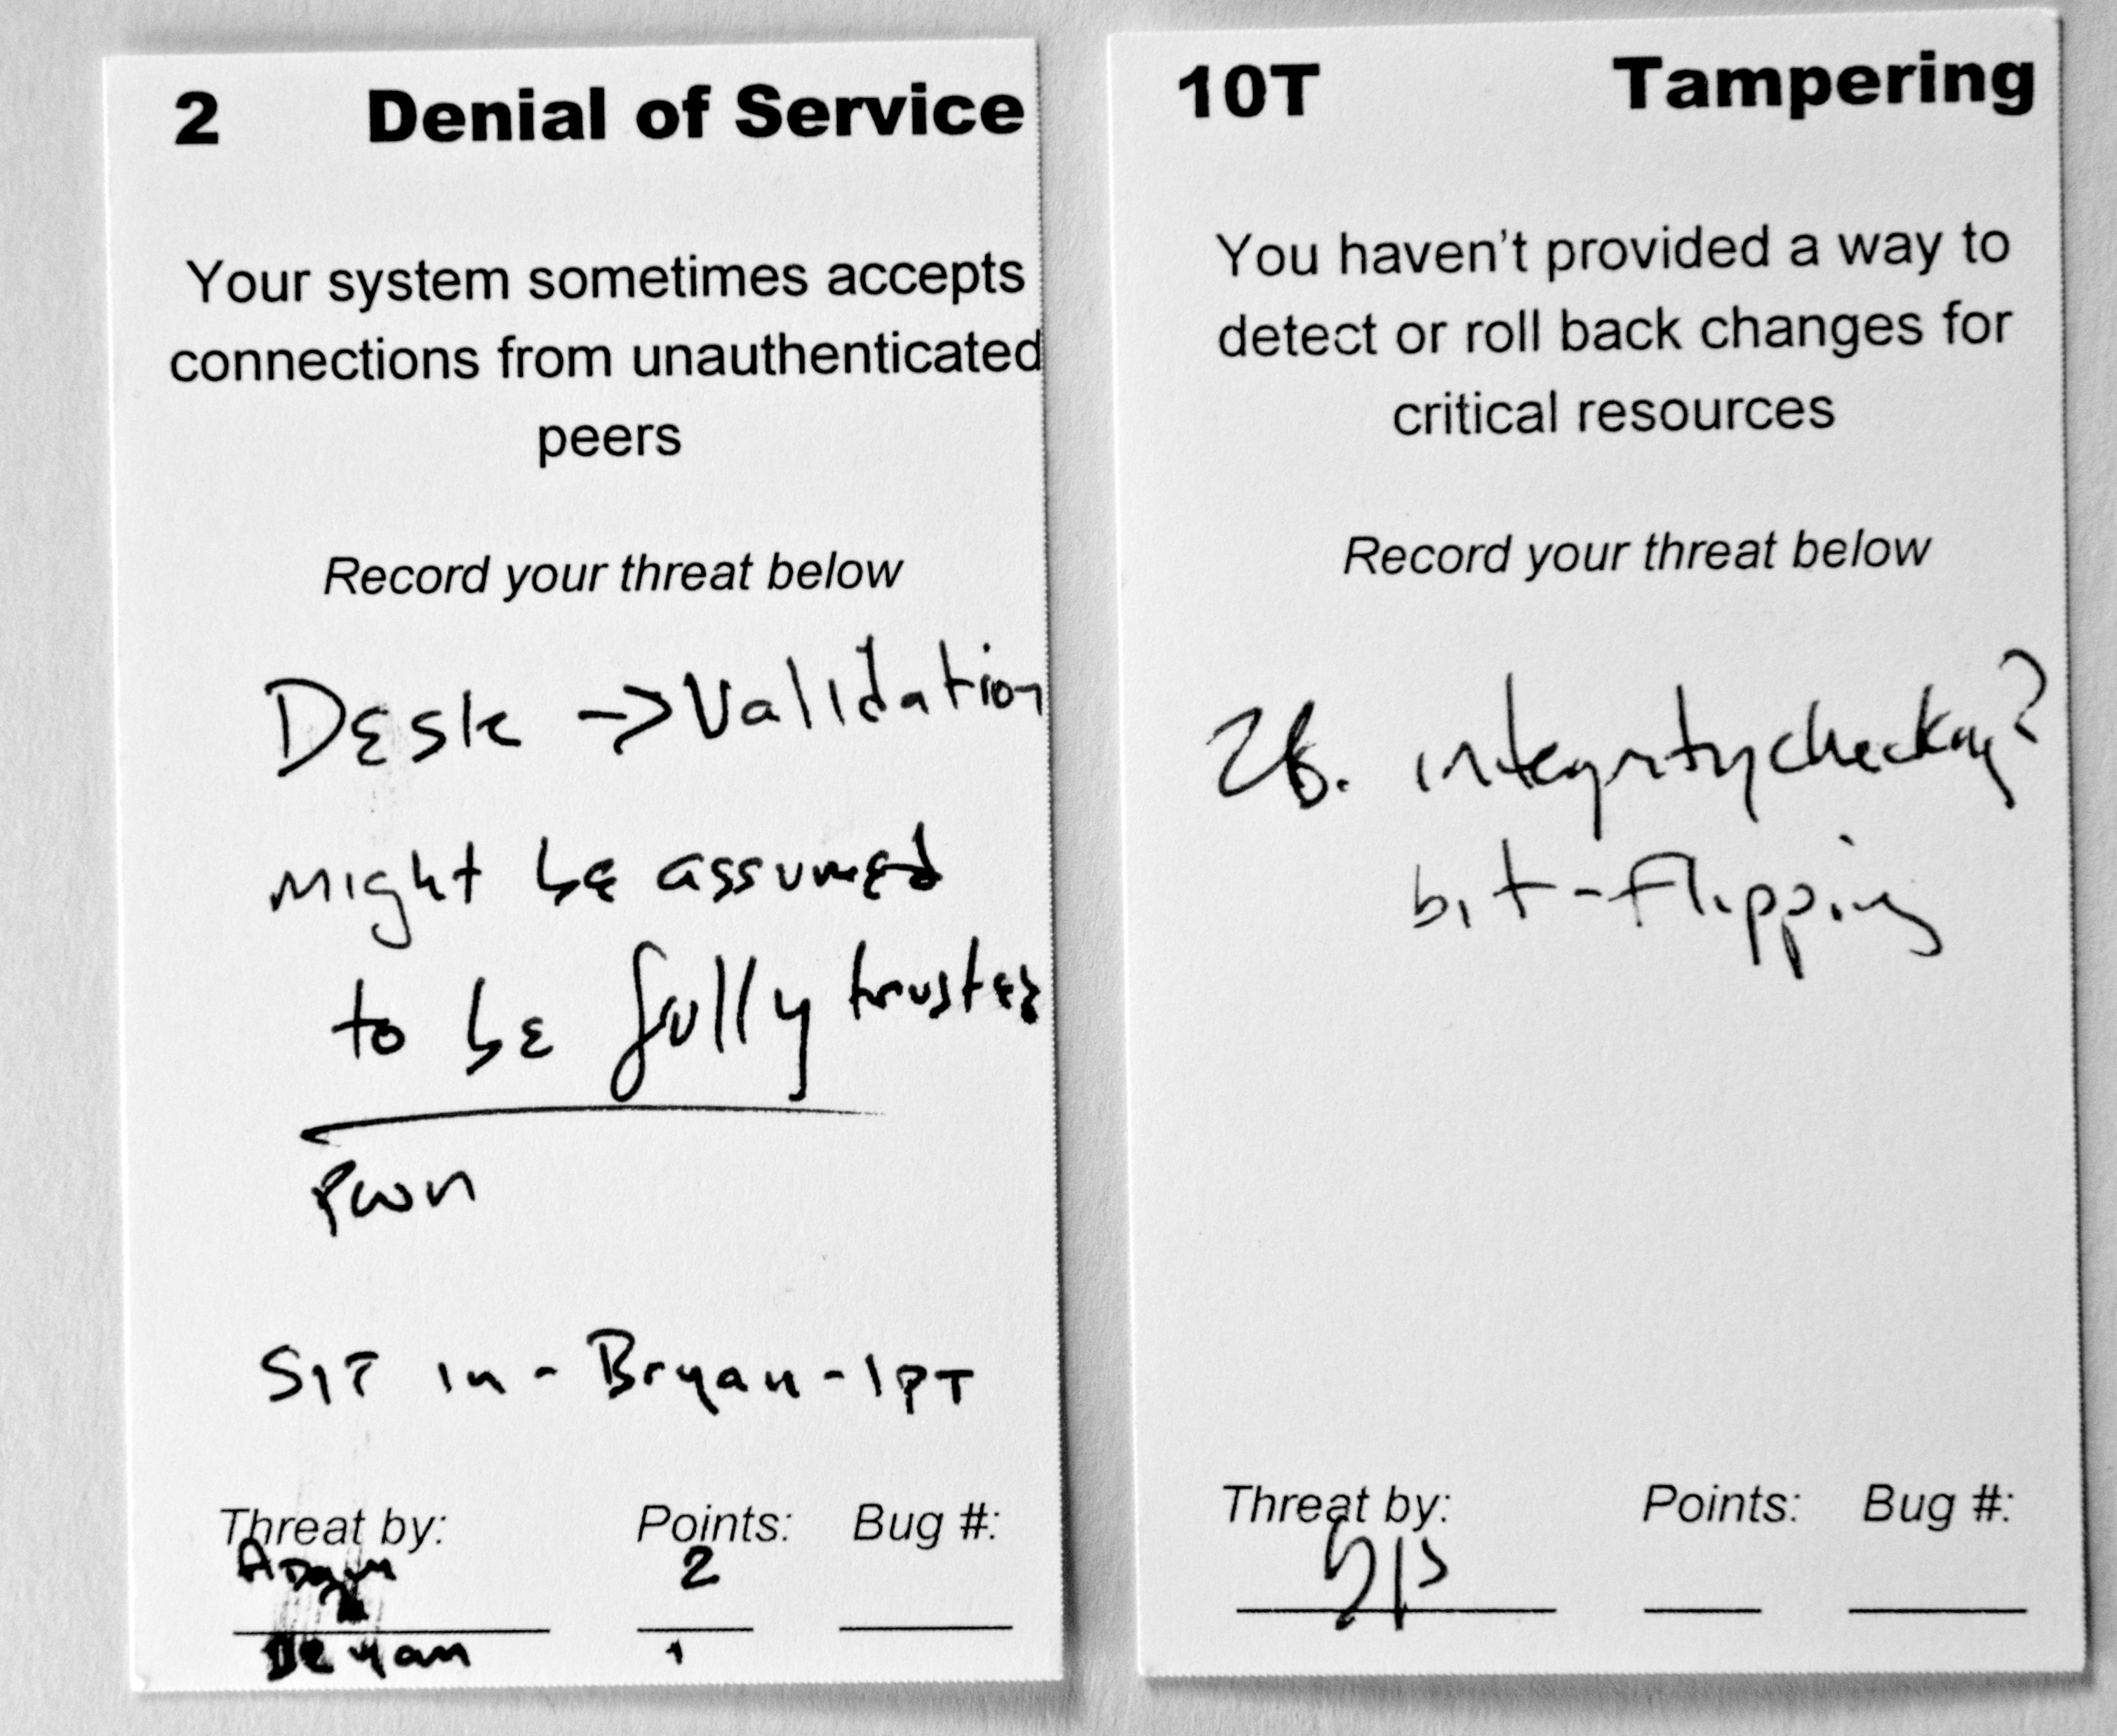
Prototype
Have suit, #, hint
On-card space for recording
I bet you think this threat is about YOU
1 Deck ->
1 Use!
System for “riffing” on threats
Complex scoring

Slide 7
Design Tradeoffs
Card size
Game/Gamification
  Points, Badges, Leaderboards?
  Authenticity
Hint construction
Depth/Breadth
Physical cards?
Graphic design investment

Slide 8
Serendipity
Game more popular outside Microsoft
  Can’t force play
  Ask people to suspend of skepticism
  Learning versus core job skill (see Smith, 2011)
Game results in real threat model
  Learn as you do
  Unusual feature

Slide 9
Resources: http://www.microsoft.com/security/sdl/adopt/eop.aspx
Threat Modeling: Designing for Security (Wiley, 2014)
Questions?
@adamshostack
adam.shostack@microsoft.com

