Slide 1
That was Close! Doing Science with Near Misses
Adam Shostack

Slide 2
Key Takeaways
Experiments are hard for many reasons
Near misses open up new kinds of experiment
Collecting data about near misses is complex

Slide 3
Outline
Science and learning from mistakes
Calls for an “NTSB for Cyber” aren’t working
We can learn from near misses

Slide 4
What science might mean*
* Scientists like arguing about this. For example, Cormac Herley and Paul C. van Oorschot. “SoK: Science, security and the elusive goal of security as a scientific pursuit.” 2017 IEEE Symposium on Security and Privacy.
http://cormac.herley.org//docs/scienceAndSecuritySoK.pdf

Slide 5
Discovering Acknowledging Errors Distinguishes Science
Lets you get rid of bad ideas, improve good ones
Avoids confirmation biases
Notes:
Gleefully pointing out mistakes

Slide 6
Hierarchies of Evidence
Expert opinion
Case studies
Lab experiments, population studies
Double-blind randomized controlled trials
Systematic meta-analyses and reviews

Slide 7
Limits on Experiments
Time
Money
Physics
Ethics
Reward structures
Reproducing experiments doesn’t get you a pwnie

Slide 8
The Knowledge Problem in Cyber
We don’t know how computers are pwned
Money, ethics, physics all inhibit experiments
At a statistical scale
Autorun history
Are 90% of incidents phishing or vulns?

Slide 9
What Causes Incidents?
Sophisticated Attackers!
http://www.veracode.com/sites/default/files/Resources/Whitepapers/how-vulnerabilities-get-into-software-veracode.pdf
https://www.computerworld.com/article/2910316/90-of-security-incidents-trace-back-to-pebkac-and-id10t-errors.html
https://hbr.org/2016/09/the-biggest-cybersecurity-threats-are-inside-your-company

Slide 10
If we don’t know what fails, how do we improve?
Notes:
How do we test our ideas? How do we dispell myths?

Slide 11
Calls For An “NTSB For Cyber”
Learn by investigation!
Oft-repeated:
Computers at Risk, National Academies Press, 1991
The New School of Information Security, 2006
National Cyber Leap Year, 2010
Bellovin & Neumann, 2014
And many more…
Feedback: What would it look like? What would we get?

Slide 12
What is the NTSB?
One of many US Aviation Safety Programs
Investigates accidents in transportation
Control over accident scene
Investigative powers
Accidents are defined by law
Aircraft accident means an occurrence associated with the operation of an aircraft … in which any person suffers death or serious injury, or in which the aircraft receives substantial damage. (49 CFR 830.2)

Slide 13
Comparison
Aviation
Computers
Single regulator, FAA
Accidents defined by law
Accident has physical locus
Hard to hide a plane crash
People die
Industry support
No regulator
No clear scale (PII breaches?)
Often diffuse
Easy to hide a breach
People rarely die
Industry opposition
An “NTSB for cyber” looks very challenging
Notes:
No regulator: industry resistance
No clear scale: PII breaches are not the only interesting fails
We’re motivated to hide breaches

Slide 14
Look To Other Aviation Programs?
ASIAS
Telemetry and data from flights
Inter-operator comparison
ASRS @ NASA
Near miss analysis
Voluntary and incented (“Constructive engagement”)
Gets 100K reports per year
Bob Stratton & Trey Ford have evangelized
Both: Confidential reports, expert anonymization

Slide 15
Near Misses
A near miss is when a subset of controls fail
Maybe a good story, at least not so embarrassing
Lower risk of lawsuits
Controls includes
Everything you expect will stop the problem
Technical, human
Accidents only happen when all controls fail

Slide 16
If some controls fail, maybe we can learn from that

Slide 17
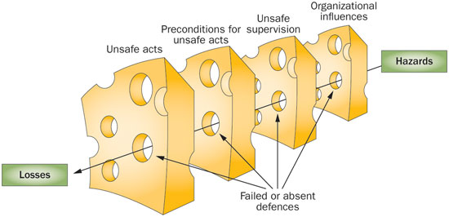
From “Safety in the operating theatre — a transition to systems based care”
The 'Swiss Cheese' model proposed by James Reason demonstrates how gaps in culture, defenses, barriers, and safeguards align and permit errors to propagate unchecked, leading to harm.
Notes:
http://www.nature.com/nrurol/journal/v10/n3/fig_tab/nrurol.2013.13_F2.html

Slide 18
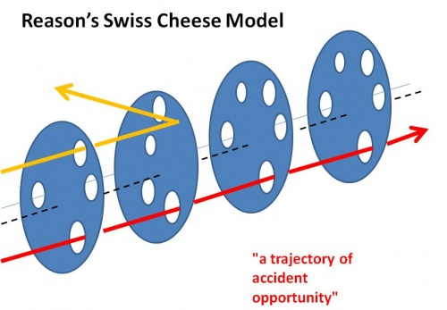
Near Misses Are Studied
Medicine
Aviation
Nuclear
…Not in security…yet
Notes:
https://www.skybrary.aero/index.php/James_Reason_HF_Model

Slide 19
Near Misses May Show What Works
“Glad the URL re-writer caught the phishing link!”
Evidence that link re-writing may be helpful
Not direct evidence SMTP filters are not helpful
New categories of experiments and evidence
Opens new types of scientific questions

Slide 20
Reward Reporting of Cybersecurity Near-Misses
Jonathan Bair
Steven M. Bellovin
Andrew Manley
Blake E. Reid
Adam Shostack
Forthcoming in Colorado Technology Law Journal 16.2
Draft: https://papers.ssrn.com/sol3/papers.cfm?abstract_id=3081216

Slide 21
Paper Summary
Legal concerns make discussing incidents hard
Let’s talk about near-misses instead
Incentivize disclosure like aviation

Slide 22
Steps to Take
Regulatory specifics
Better information sharing & analysis benefits all
Define accident
Experiments with reporting?
Near misses: a new, non-partisan opportunity

Slide 23
Scope Regulatory Specifics
Explicit support from regulators
Include in judgement, under existing authority
Participation as “constructive engagement”
“Avert our eyes,” not pursue near miss data
Inter-agency cooperation
No benefit for breaches, negligence and ??
Who needs what?
Notes:
Averting eyes is an existing and sensible public policy choice, and is committed to in a MOU between NASA and the FAA for aviation data.
It’s no worse for regulators, and better for everyone else. It’s no worse because today, the data does not exist, and cannot be pursued. Without such a commitment, the data may not exist, and will not exist to the same degree. So there’s no loss to the regulator compared to the days before they commit to avert their eyes. So without the commitment, the public will not get the benefit of learning from near misses.

Slide 24
Define Accident/Incident
Aircraft accidents out of scope for near miss
What’s the analogy to an accident in cyber?
Breach?
Incident?
A “violation or imminent threat of violation of computer security policies, acceptable use policies, or standard security practices?” (US-CERT)
US-CERT mentioned only as an example of breadth of definitions
Notes:
https://www.us-cert.gov/about-us

Slide 25
Define accident (2)
We may need precision
“Do we report this?”
We may not
Averting of eyes means over-reporting may be ok
Crisper definitions will increase comfort

Slide 26
Experiment with Reporting
How many reports might we get?
What would be in them?
What would processing entail or require?
Develop confidence in report anonymization

Slide 27
Available Collateral
The proposal is based on research & prototypes
We’ve created and can share:
Sample reporting form
Sample interagency MOU
Sample “Cyber Safety Reporting System” report showing what we might learn

Slide 28
Key Takeaways
Experiments are hard for many reasons
Near misses open up new kinds of experiment
Near-miss science will be tricky but worthwhile

Slide 29
Please Help
Spread the word!
Help us answer the regulatory & definition questions: blog about it!
Warm intros to people who can help
Fill out adam.shostack.org/nearmiss/

Slide 30
Thank you
Questions?

Slide 31
The Cyber Near Miss Experiment
Shostack, Bellovin, Reid + Colorado Law Clinic
Let’s see
What we can collect
What we can learn from it
We stole were inspired by ASRS form
We want to see what data we can get

Slide 32
Details
Your answers are private
All questions are optional
Data stored in Google Forms for the experiment

Slide 33
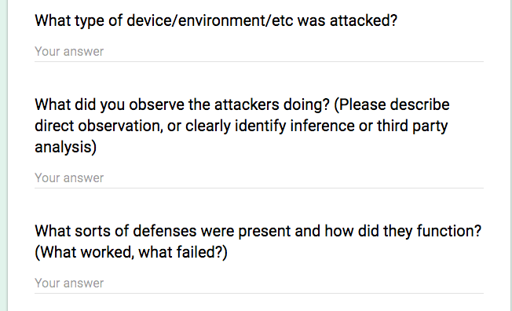
The Form: Narrative
Questions
Generalized advice
For the chain of events, you might describe:
• How the problem arose
• Contributing factors
• How it was discovered
• Corrective action
If you think people's actions had an important impact, you might describe human performance considerations such as:
• Perceptions, judgements, decisions
• Actions or inactions (personal or organizational)
• Factors affecting the quality of human
performance

Slide 34
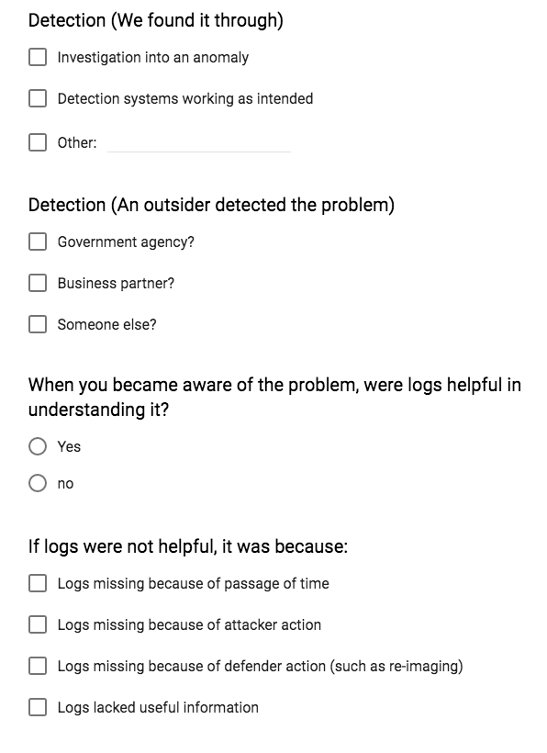
The Form: Questions we have

Slide 35
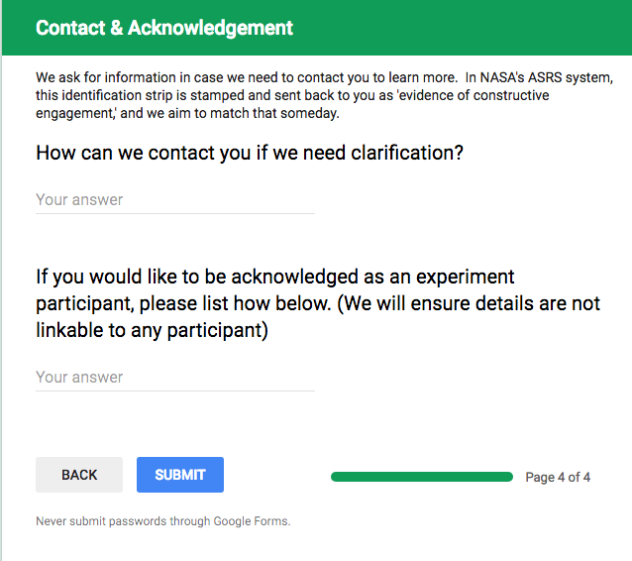
The Form: Contact & Acks

Slide 36
The Promises
We will not talk about you in any way we think might be identifiable
We will aggregate data
We will share what we learn
We might make our jobs easier

Slide 37
Call to action
Participate!
Visit https://adam.shostack.org/nearmiss.html

