Slide 1
Cyber Public Health and Cyber Hard Problems
Adam Shostack
National Academies Meeting
July 18 2024

Slide 2
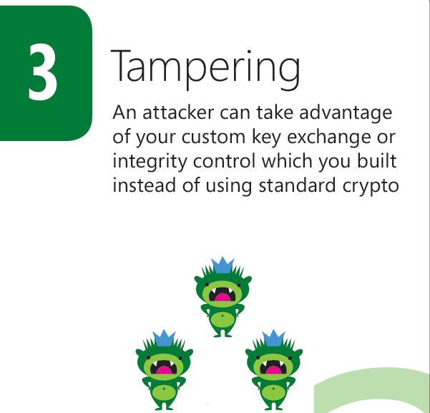
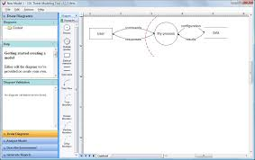
About Adam Shostack
CyberGreen

Slide 3
Terminology
Medicine: focused on individual patients
Public health: focused on the health of a population
Cybersecurity: focused on individual people/businesses
Cyber Public Health (CPH): focused on populations
(Short definitions for convenience)
Public health is the science of protecting and improving the health of people and their communities. This work is achieved by promoting healthy lifestyles, researching disease and injury prevention, and detecting, preventing and responding to infectious diseases. (CDC Foundation)

Slide 4
Don’t we already have this metaphor?
Yes (computer viruses, cyber hygiene, etc)
Going beyond the NTSB metaphor led to Cyber Safety Review Board
Idea first formalized Computers at Risk (NRC, 1991)
Learning from Cyber Incidents: Adapting Aviation Safety Models to Cybersecurity (Knake, Shostack, Wheeler, 2021)
Executive Order 14028, Improving the Nation's Cybersecurity, 2021
Inaugural Workshop On Cyber Public Health
Held in Jan, workshop report at https://cybergreen.net/news/

Slide 5
Hard Problem for “The List”
Defining and measuring the expected lifetimes of a population, and quantifying the factors that lead to “deaths.”
The population might be:
The US Census Bureau
The Federal Government
The US Critical Infrastructure Sectors
Americans living under the poverty line
Quantifying the factors includes what happens, and to what fraction of the population

Slide 6
CPH has two subproblems, both important
CPH involves hard science
Ontologies for populations, vectors, harms (next slides)
Interdisciplinary work is hard to fund, do, publish
A Bureau of Cyber Public Health will help future cyber hard problems work
Many PH institutions from city public health depts to NIH, CDC, WHO
Detect, quantify hard problems which are causing cyber harm
Enable evaluating cyber interventions at scale
Help answer (for example) Jay Healey’s “Are we winning”

Slide 7
Hard problem: Measuring population (1/2)
Physical devices are countable (Computers, phones, IoT)
Not every device is sold, powered on
Lifetimes are hard to estimate
Microsoft doesn’t know how many Windows machines there are
(At least while I worked there)
Licenses sold? — not all are turned on
Windows Update? A subset of home machines, businesses use other tools
Virtual machines are complicated

Slide 8
Hard problem: Measuring population (2/2)
Accounts are an important population measure
Right way(s) to count are less obvious
My work accounts include @uw.edu, @cybergreen.net (both Google) and @Shostack.org (independent)
Lots of inter-relationships: federation, login with Google/MS/Apple/etc, backup/”multi-factor” authN
Harms are complex
Data like email history, photos irreversibly disclosed
Ongoing access can be remediated

Slide 9
Hard problem: Vectors
Vectors includes “root cause”, contributing factors, etc
Vectors are hidden/unknown, reasons include:
Long “dwell times”
No biz incentive to see what happened
Lawyers will tell you to not look, analyze, report
Descriptions are fuzzy
Phishing means both cred theft, messages carrying docs with exploits
Do we count “docs with exploits” as human-error root cause?

Slide 10
Hard problem: Harms
Bullying, deepfake abuse
Impact on “Digital Activities of Daily Living”
What’s “death”?
A powered off phone in the closet?
A VM never pulled from artifactory?
How do we think about harms via authN chains?
Abuse of recovery mechanisms
Abuse of SSO/keychains/pw managers

Slide 11
Beyond “The List”
CPH offers a way to discover hard problems + assess solutions
It may be good to include both
One or more CPH questions (“How many deaths and what caused them”)
Further investigation/investment in CPH to enable future science

Slide 12
Backup: CPH ties to questions from Cormac’s session
“How do we find the questions to ask” (William Scherlis)
What are the leading causes of death?
Are our interventions working?
What tools from public health can we borrow? (belief models, activities of daily living, there are almost certainly more)
“What disciplines can we use” (Stefan Savage)

Slide 13
Interdisciplinary work (backup)
Known hard problem
Hard to fund
Hard to find peer reviewers
Venues tend to be less prestigious
Not today’s focus – flagging known challenges

Slide 14
Institution building (backup)
Data gathering, analysis and publication is powerful
Not controversy-free (“With covid”, HIV, suicide on death certs)
Public health leverages licensing
Doctors, labs, hospitals and more are licensed
Don’t report one of 20+ reportable diseases, gunshots? Lose your license.

Slide 15
Thank you!

Slide 16
Questions?
Now or
adam@shostack.org

