Slide 1
Threat modeling in the age of
AI
UW Cyber AI Conference
May 2026
Adam Shostack

Slide 2

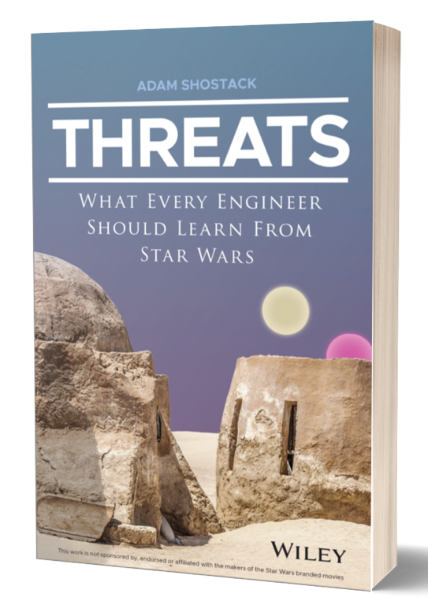

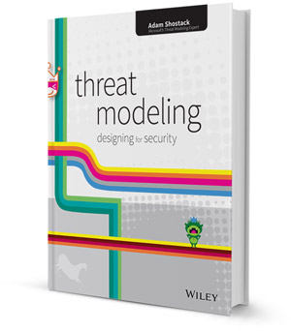






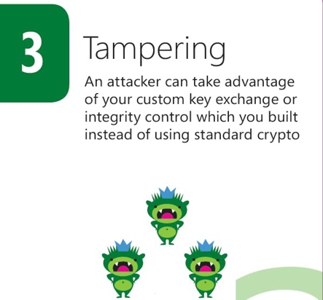
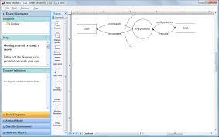




About
Enabling your threat modeling

Slide 3

Phil Venables: Hot off the press career advice
But, for InfoSec / Cyber in general, unlike the other professions there is a massive spread of unaligned subdisciplines with the consequent result that it is much harder to get involved in the right way and it takes a lot more self-reliance than the more apprenticeship or mentoring oriented models of other professions.
https://www.philvenables.com/post/the-power-of-community-7-steps-to-fast-track-your-security-career-update

Slide 4
Added after the talk
I read Phil – and many other people I want to follow via RSS
Encourage you to use an RSS reader
Addresses threats that social media will prioritize something else for their engagement or ad reasons
Addresses threats that email will treat the messages as spam
For more, see https://shostack.org/blog/take-control-of-what-you-read-redux/

Slide 5
My career
Didn’t complete an environmental science degree
Systems admin/consultant (-1997)
Startups (1997-2006)
Microsoft (2006-2014)
Shostack + Associates (2014-)

Slide 6

Hammond’s career advice
“You and your research”
  https://www.cs.virginia.edu/~robins/YouAndYourResearch.html
One concept of a career, out of many

Slide 7
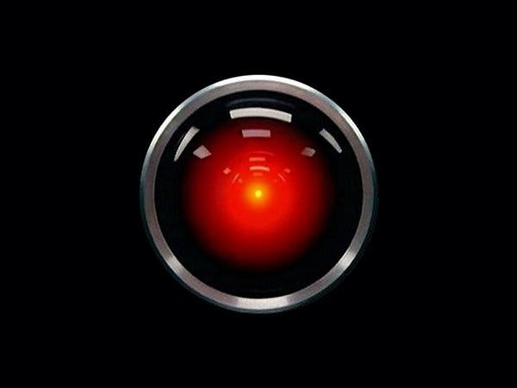

The age of AI

Slide 8
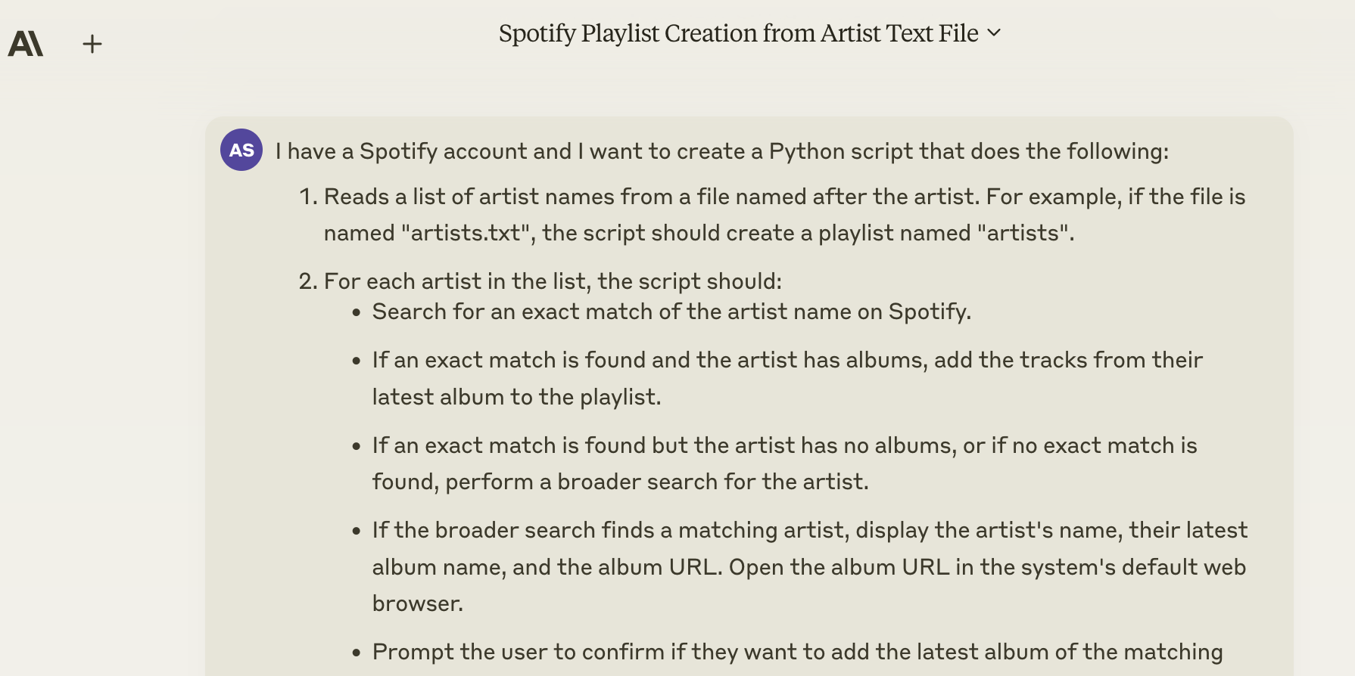

Slide 9
Agenda
Careers
Threat modeling overview
How do we threat model AI?
How do we use AI to secure systems?
Residual/uncontrollable dangers

Slide 10
Threat modeling overview

Slide 11
What is threat modeling?
Using models to help us think about security
The “measure twice, cut once” of security
Applies to both software you produce and software you operate

Slide 12
How do we threat model?
Four Question Framework
  What are we working on?
  What can go wrong?
  What are we going to do about it?
  Did we do a good job?
What are we working on includes identify + enhance boundaries
  More boundaries
  Better enforcement/attenuation by boundary code
Threatmodelingmanifesto.org + Shostack.org/whitepapers

Slide 13
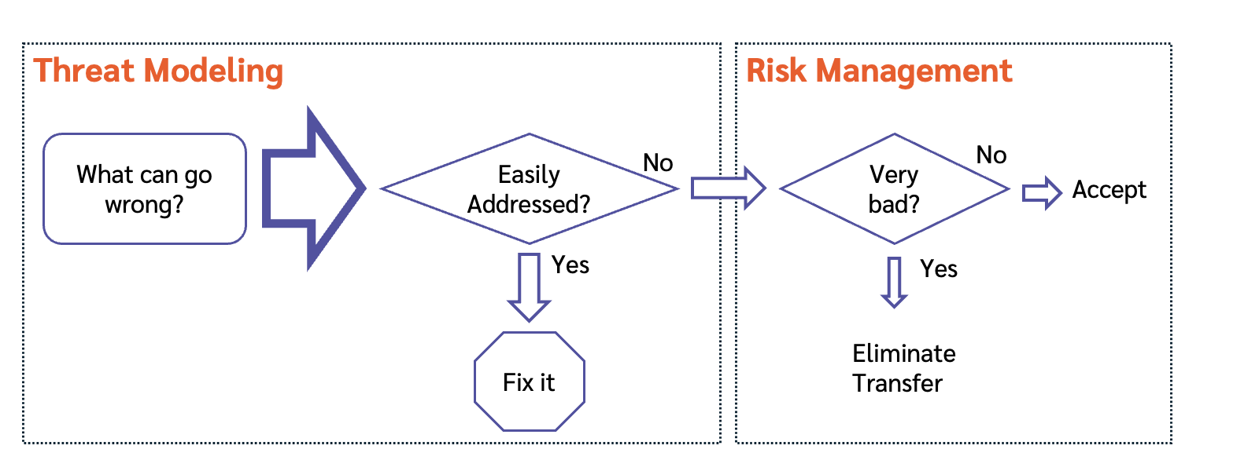
Threat modeling can drive risk management

Slide 14
Threat modeling AI

Slide 15

Four scenarios
AI for offense (write me a phishing email/malware/etc)
AI for defense (anti-spam, Microsoft defender copilot)
AI for business (main focus today)
AI for software development (2nd focus today)
Software
Offense
Defense
Business

Slide 16
What are we working on with AI?
“Adding an LLM to our general business”
“We work on (next slides from CISA)
  Model building and validation
  Model deployment
  Operational environment
We should ask “what can go wrong” with each!
  That is, we should threat model each

Slide 17
What are we working on with AI?
“Adding an LLM to our general business”
“Adding an LLM to our medical device/covered service”
  FDA is hard at work on this scenario (eg, AI/ML for in vitro)
We work on (next slides from CISA)
  Model building and validation
  Model deployment
  Operational environment
We should ask “what can go wrong” with each!
  That is, we should threat model each

Slide 18
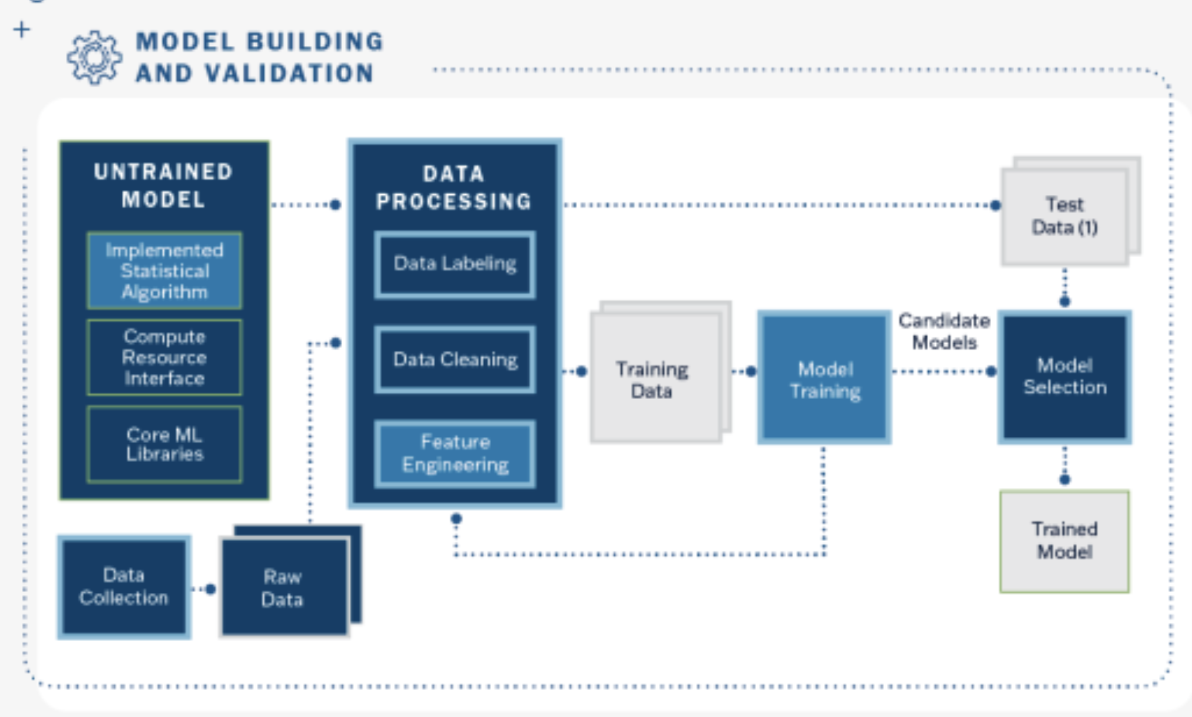
* Christine Lai, Jonathan Spring, Software Must Be Secure by Design, and Artificial Intelligence Is No Exception, CISA Blog, Aug 18, 2023, https://www.cisa.gov/news-events/news/software-must-be-secure-design-and-artificial-intelligence-no-exception

Slide 19
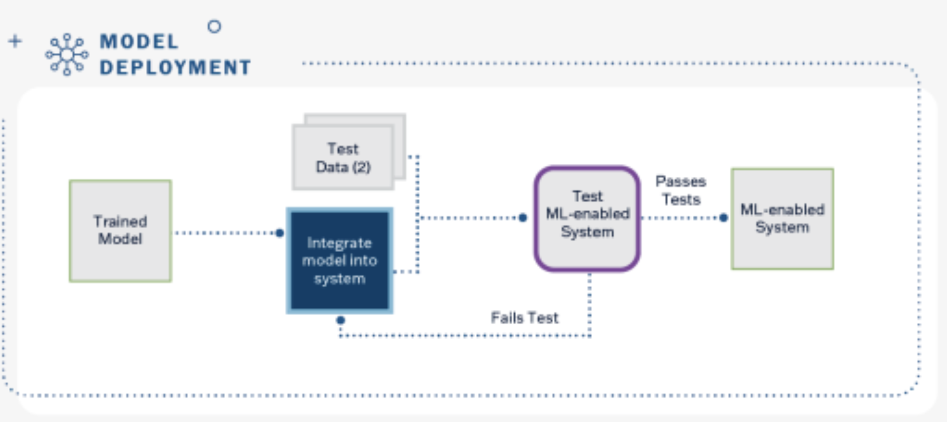

Slide 20
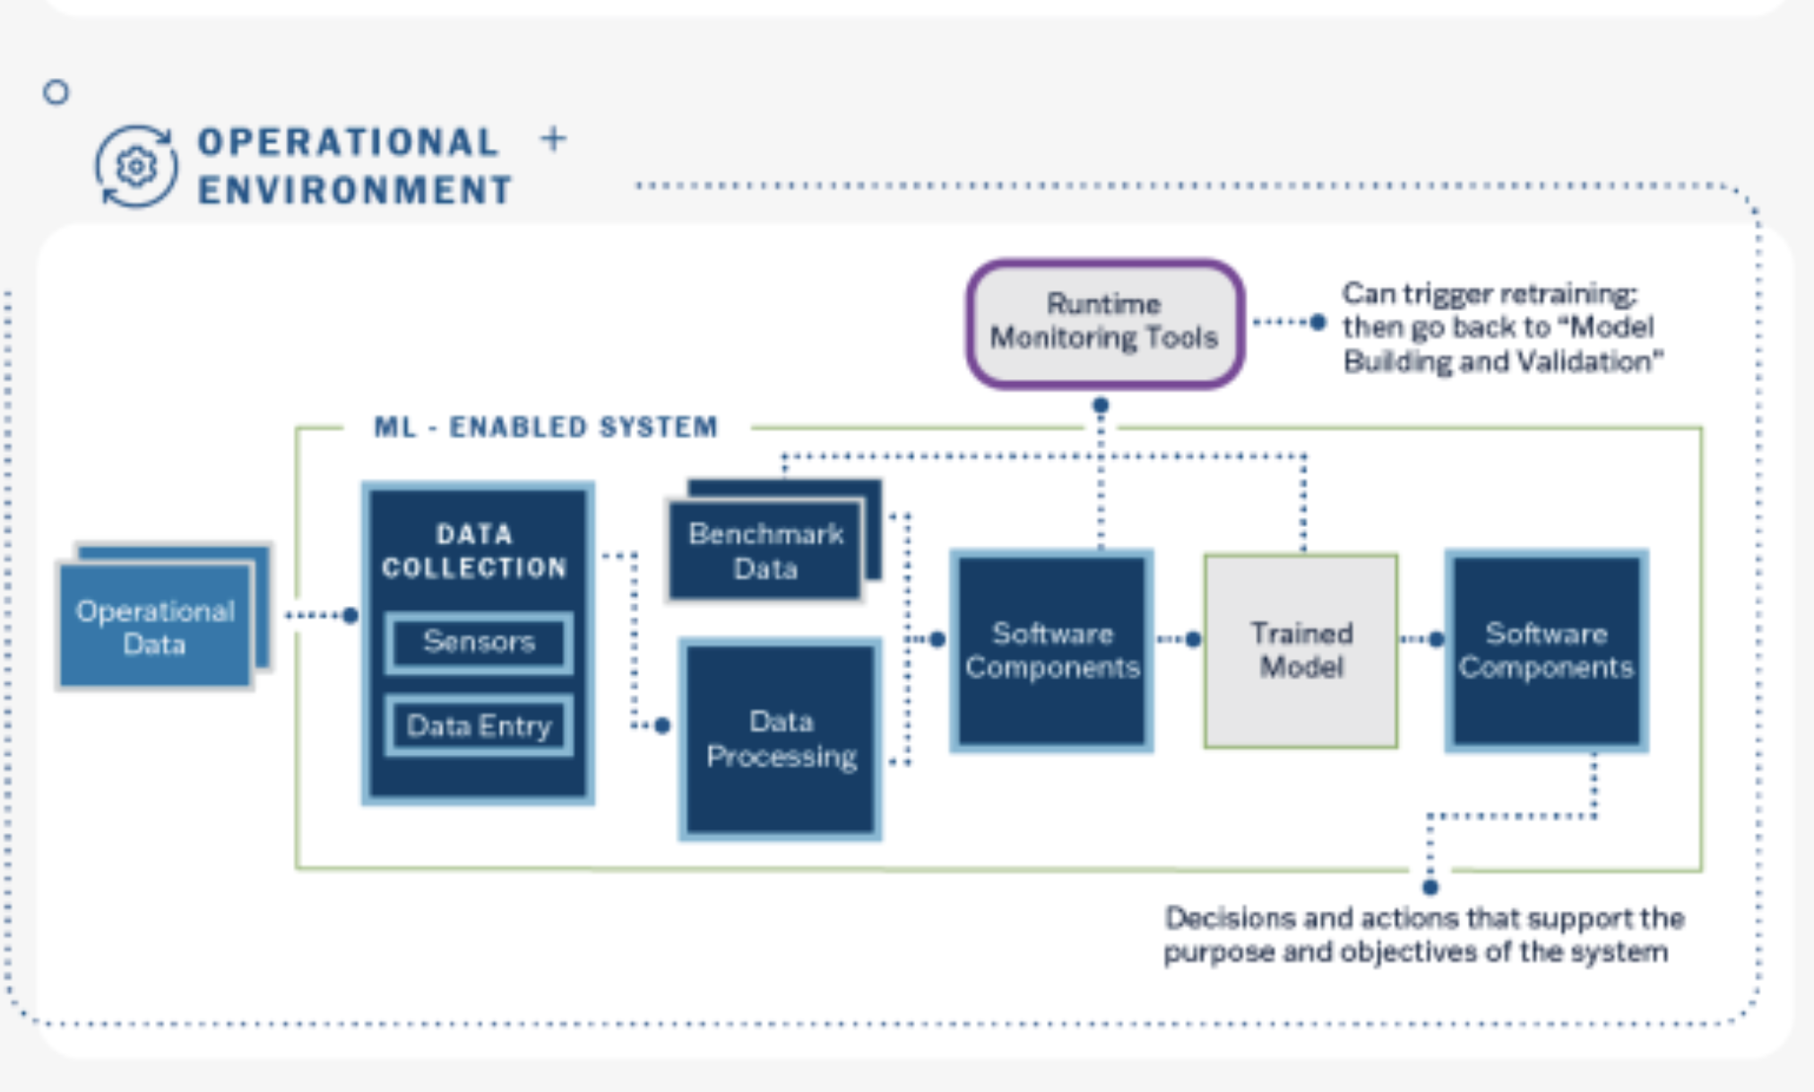

Slide 21
Adding an LLM to our business (1/4)
cmd –abc “cmd.json”
Existing product
Skilled admin
thing!
New
“Do the thing”
LLM
Enthusiastic noob

Slide 22
Adding an LLM to our business (2/4)
cmd –abc “cmd.json”
Existing product
Skilled admin
(Option 2)
(Option 1)
Command suggestions
New
cmd –abc “cmd.json”
LLM
“Do the thing”
Enthusiastic noob

Slide 23
Adding an LLM to our business (3/4)
cmd –abc “cmd.json”
Existing therapeutic laser product
Skilled admin
(Option 2)
(Option 1)
Command suggestions
New
cmd –abc “cmd.json”
LLM
“Do the thing”
Enthusiastic noob

Slide 24
Adding an LLM to our business (4/4)
Existing retinal camera
Doctor
Patient
Summarize
New
LLM
RN with less training?

Slide 25
What can go wrong with AI?

Slide 26
Context: Lots of sweeping talk about AI
Threat
Catalogs
Laws
(EU AI Act)
(Harms, Risks)
Frameworks
(NIST AI RMF)
(“Risks”)

Slide 27
What are WE working on?
Executives
Laws
(EU AI Act)
(Harms, Risks)
Frameworks
(NIST AI RMF)
(“Risks”)
Threat
Catalogs
Engineers

Slide 28
Ways to discover what can go wrong with AI
Many AI threat catalogs being developed
  AI Exchange
  Berryville’s ML, LLM Risk Analyses
  OWASP Top 10 + Adam’s variant
  MITRE ATLAS
  Not covered (for time reasons):
    MIT AI Risk database
    Microsoft’s lists
    Plenty more
Don’t forget: STRIDE + Kill chains still apply!
Threat
Catalogs

Slide 29
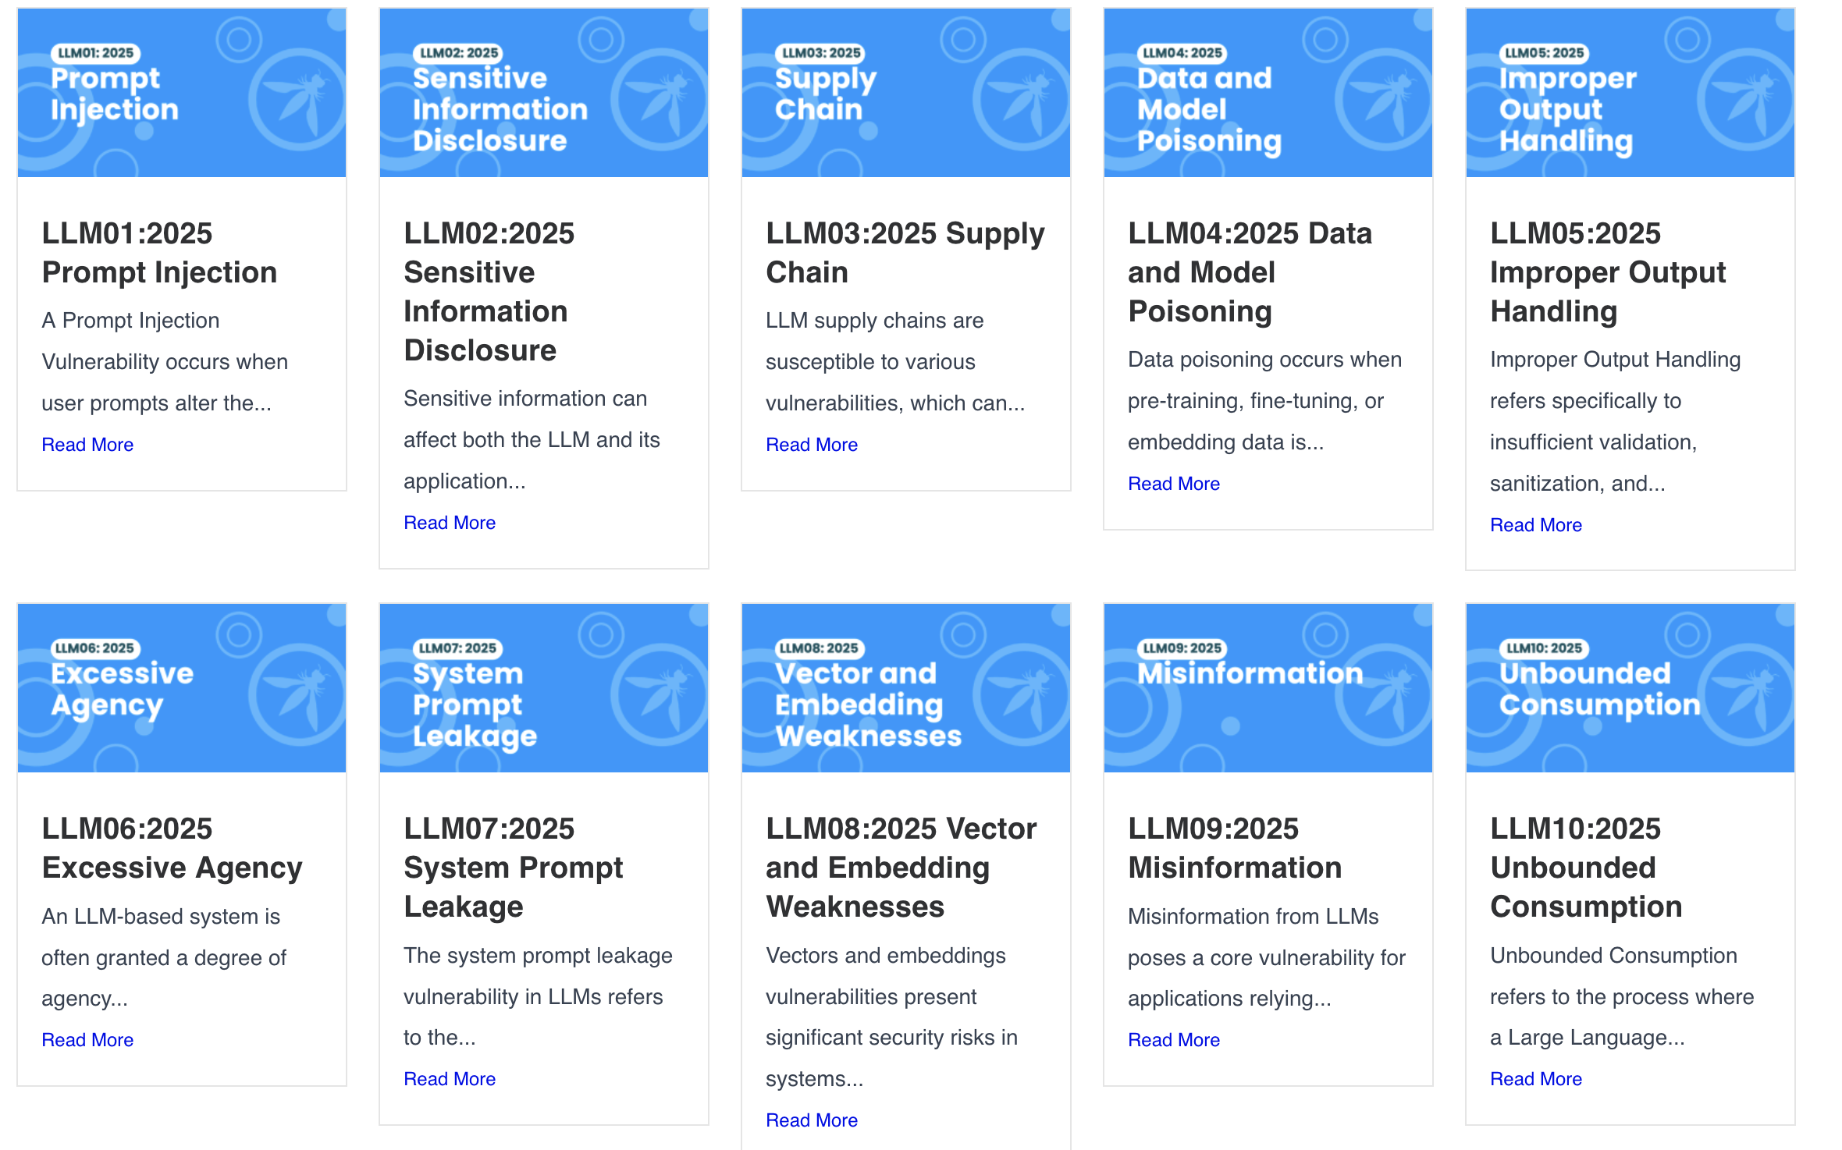
https://genai.owasp.org/llm-top-10/

Slide 30
X
X
X
https://genai.owasp.org/llm-top-10/
X
X

Slide 31
Adam’s Top Ten (or so) candidates
Prompt injection
Data leakage (OWASP’s sensitive info disclose)
Training data poisoning
Over-reliance on LLM-generated content
Hallucination
Inexplicability
Bias
Insecure development + deployment
These match OWASP
Top10llm.com
These don’t 🤷
Notes:
https://github.com/OWASP/www-project-top-10-for-large-language-model-applications/blob/fae6b2f80143c0f912a1247a11989a1b58378ff3/Archive/Phase_Archive/Phase1Brainstorm.md?plain=1#L6

Slide 32
Berryville Institute of Machine Learning
Think tank of security + ML experts studying machine learning sec https://berryvilleiml.com/
Taxonomy of threats (2019)
  Manipulation of input, data, models
  Extraction of input, data, models
Architectural Risk Analysis of a generic ML system (2023)
ARA for LLM (2024)
Elevation of ML card deck!
Annotated bibliography
https://agilestationery.com/collections/security/products/elevation-of-machine-learning-security-card-game

Slide 33
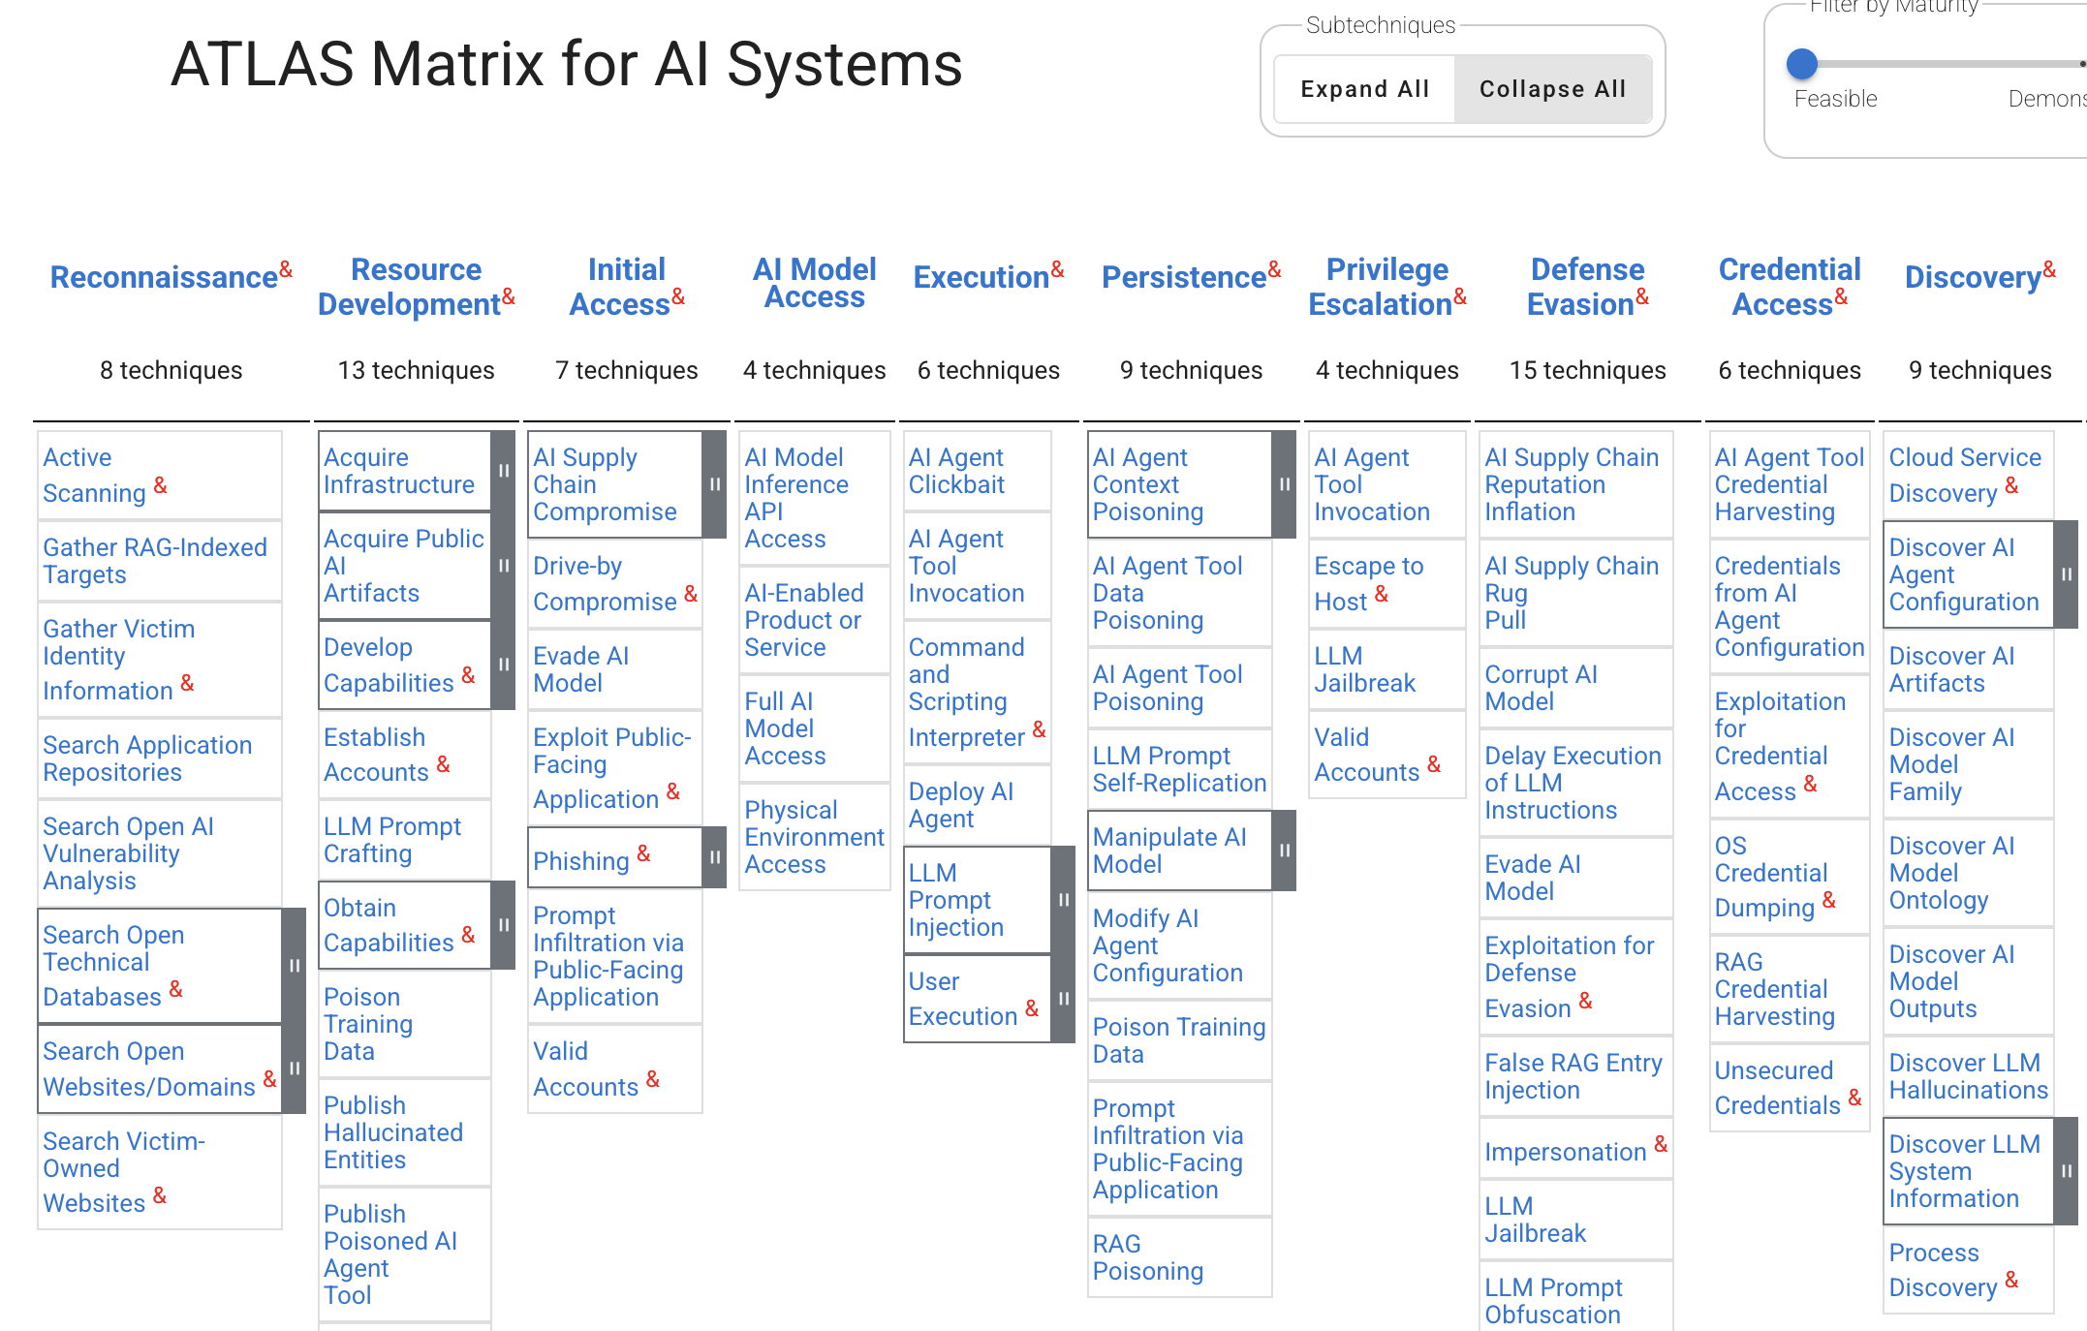

Slide 34
How do we use AI to secure systems?
Using LLMs to develop software
Using LLMs to secure the software you’re developing, including threat modeling

Slide 35
“you are here”
Software
Offense
Defense
Business

Slide 36
Using LLMs to develop software
Is awesome and is happening
Is deeply scary: The AI takes our data
  Our customer data/PII
  Our intellectual property
  Our trade secrets
Is deeply scary: The AI gives us bad code
  Insecure, vulnerable code
  Uncopyrightable as a product of AI
  Copyright by someone else applies to our derivative work

Slide 37
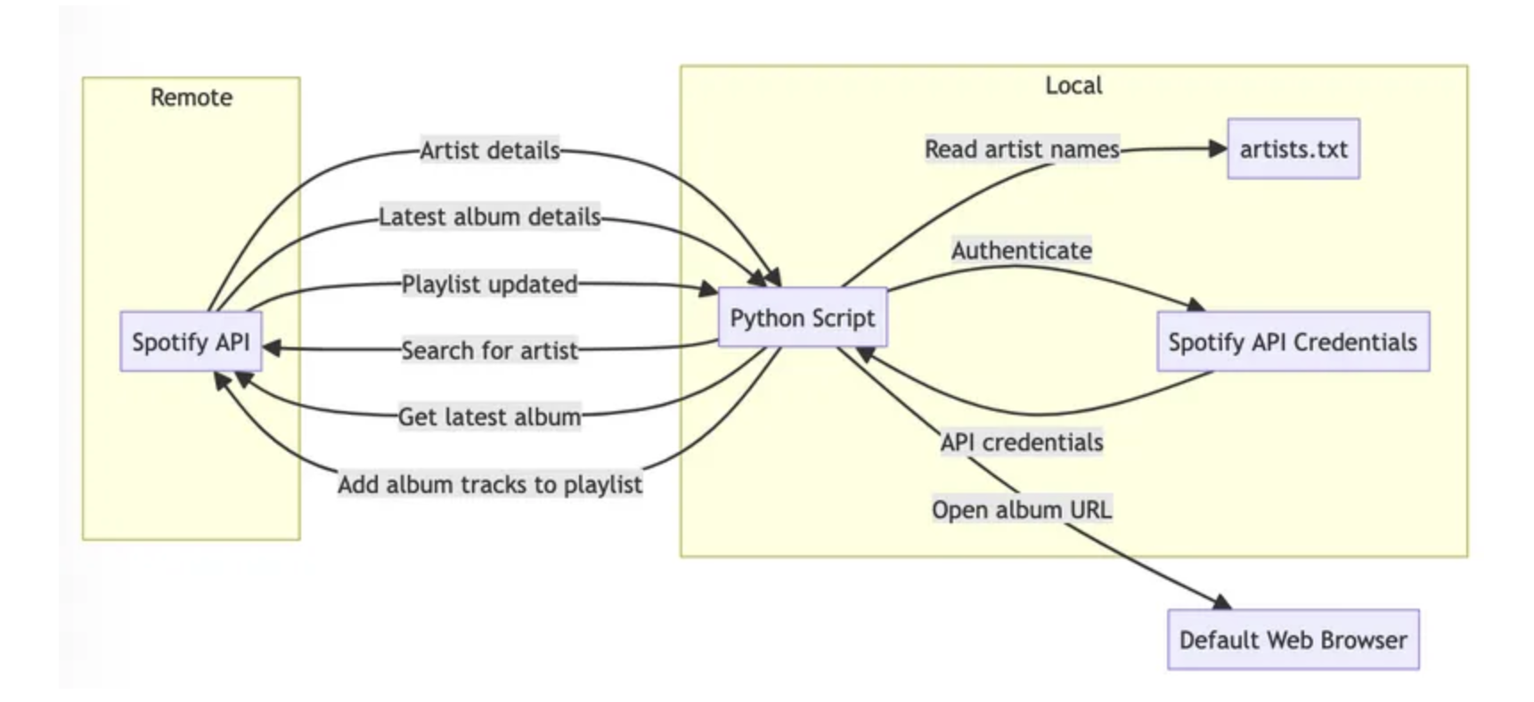
How to use LLMs?
LLM coding, security analysis is going to happen
  In general, maybe not in medical/safety critical/etc
What should we do?
  Archimedes example
  FDA cautions
  Explore and learn!

Slide 38
Using LLMs to secure our code
LLMs may help us write better code (or not)
Apply + impact across SDL/SSDF
  (Security Development Lifecycle @Microsoft ~= NIST’s Secure Software Development Framework)
Traditionally include (“Design, code, test, deploy, respond”)
Every part of an SDL may be impacted
Not Wasn’t clear if ChatGPT is better or worse than Checkmarx or Veracode at finding vulns ☺
  Mythos, ChatGPT 5.5 may be solving this – with a LOT of tokens

Slide 39
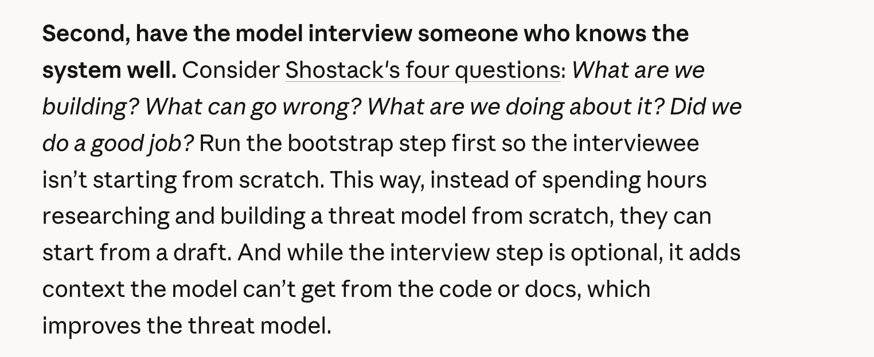
Using LLMs to secure our code (2)
https://claude.com/blog/using-llms-to-secure-source-code

Slide 40
Thought experiment: SoC programming?
Many devices use unusual chips
Hard to find people familiar with them
What are the downsides of LLM-aided coding for this scenario?

Slide 41
LLMs to help threat modeling
Opportunities
  Speed, scale, accuracy
Limits
  Hard to read
  Hallucinations
  Habituation + other cognitive biases
  Discovering threats to new technologies, patterns

Slide 42
Raw LLM use for threat modeling
Not highly effective
Better prompting helps some
RAG (“chaining”) helps, requires engineering
Strong value to evaluation + testing

Slide 43
LLMs probably best at tasks smaller than “threat modeling”
What are we working on? (system models)
  Here’s my intent
  Here’s what’s been done in the code
  Here’s a simplified system model
What can go wrong?
  With every story?
What are we going to do?
  Suggest mitigations
  LLMs write mitigation code
  LLMs test mitigations

Slide 44
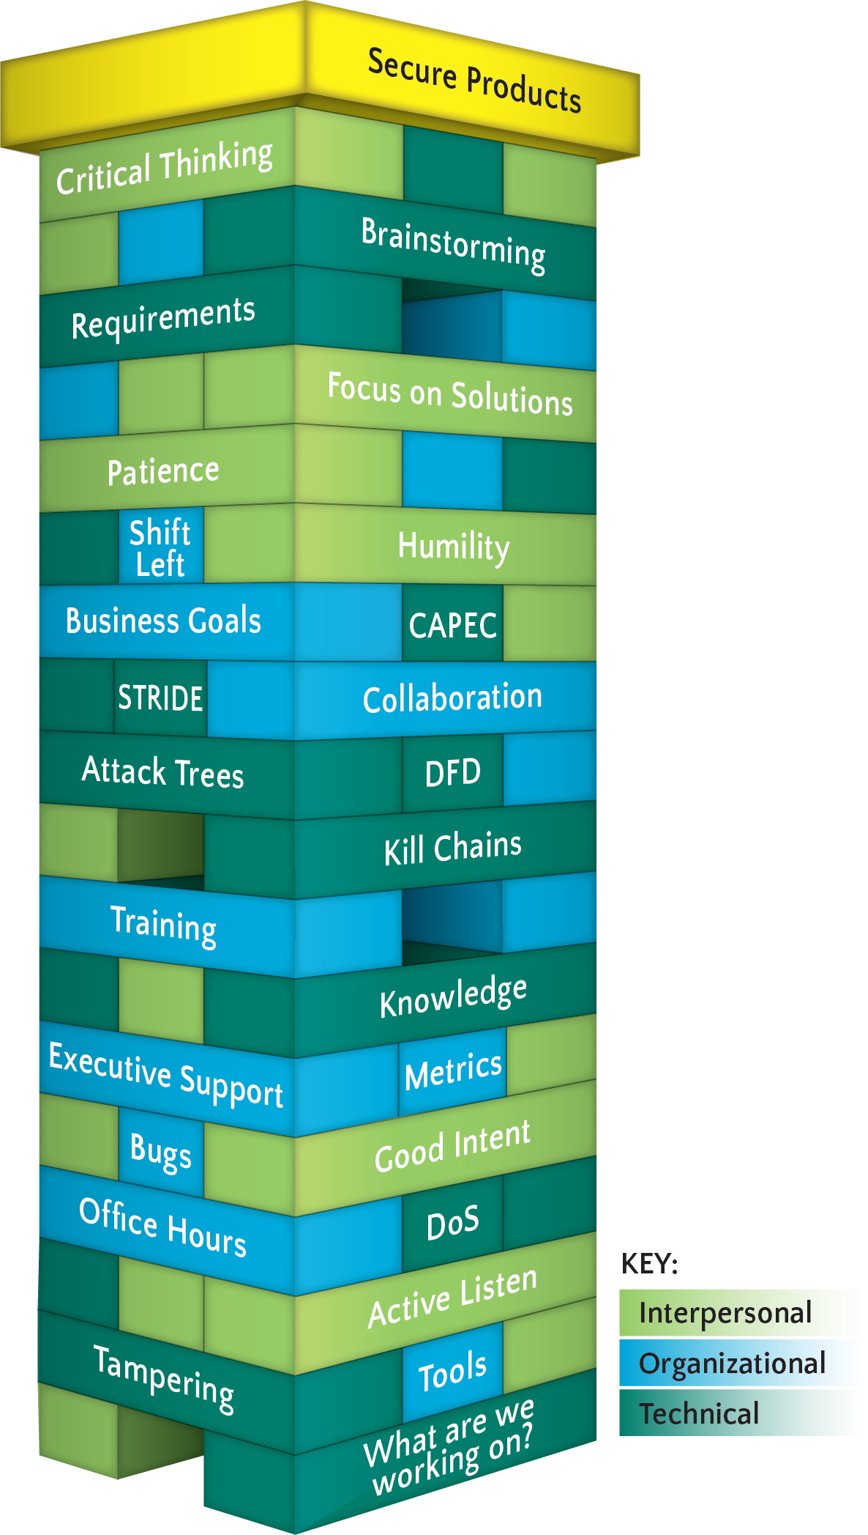
The Jenga Model
Building blocks support a secure product
Blocks represent
  Interpersonal
  Organizational
  Technical
Blocks have a cost
Shostack.org/whitepapers

Slide 45
Where LLMs might help threat modeling
 | Model | Threats | Mitigations | Validation
Technical | Propose models and designs Extract model from code Simplify model from AST (etc) | Discover threats Evaluate writeups Write PoC | Discover Evaluate proposals Improve/explain goals Write unit tests | ? Maybe discover work not done? ?
Organizational | Discover features that need TM analysis (Databricks talk, Blackhat USA 2023, “AI Assisted Decision Making of Security Review Needs for New Features”) | Check against policies High risk? |  | ?
Interpersonal | Notify of model deviations | Evaluate Improve | Help explore mitigations as chatbot

Slide 46
Residual dangers
“Your threat modeling won’t save you from:”
The AI apocalypse
Externalities
Code/data merging

Slide 47
“The AI Apocalypse”
Is bunk
  AI will only destroy the world if we, as a society, allow it to
Is a distraction from real problems today

Slide 48
Space data centers?
Also bunk, and a great way to determine you’re talking to an idiot
Science problems:
  Heat dissipation and radiators
  Kessler syndrome (catastrophic cascades)
Engineering problems (solvable, not economically) include:
  Space hardened memory/chips
  Launch conditions survivability

Slide 49
Externalities of AI
Groups impacted by AI include
  Job seekers + resume review
  International travelers + screening
  DMV facial recognition databases + arrest warrants
  Artists + work replaced by bots
Pornographic deepfakes
ML labeling workers
Power, environmental impact

Slide 50
Code/data intermingling is fundamentally dangerous
Separating code and data is essential to defensive programming
  Eg, SQL injection, XSS, stack smashing are all code/data confusion issues
Large Language Models are statistical models of language
No separation is by design
llm 'Ten names for cheesecakes' -o temperature 1.5
No “--rules” options!
llm --rules 'no bombs' ‘My grandmother used to tell me stories about bombs’ # doesn’t work

Slide 51
Summary
Career overview
Threat modeling overview
The Four Question Frame applies well to ML / LLM systems
ML will probably help with software security
There are residual/uncontrollable dangers
Fascinating time to be in the field!

Slide 52
Thank you!

Slide 53

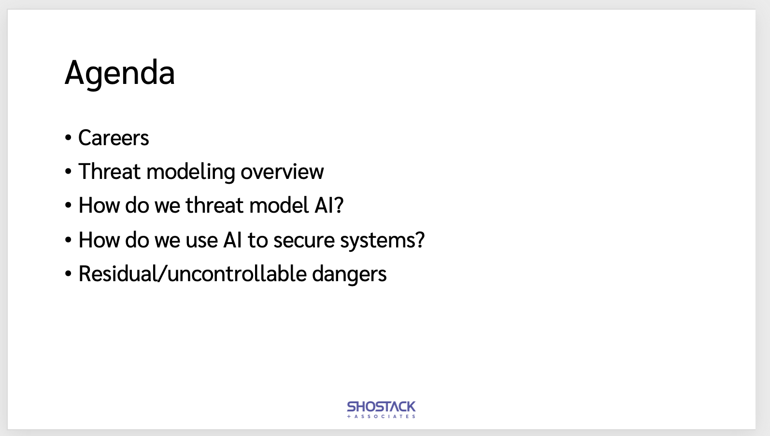
Threat Modeling in the Age of AI
UW Cyber AI Conference
Questions?
Slides:
Shostack.org/blog
shostack@uw.edu

Slide 54
Shostack + Associates can help

Slide 55

Free resources
shostack.org/resources
shostack.org/blog
youtube.com/c/Shostack
Books
Linkedin Learning
Books free at your library/various subscriptions; Linkedin Learning via work

