Slide 1
Publish your threat models!
Adam Shostack and Loren Kohnfelder
May 2025
Notes:
Version of May 23: Latest addition, OWASP TM Library

Slide 2
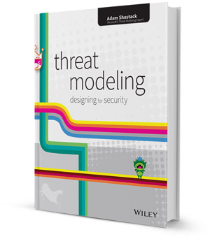
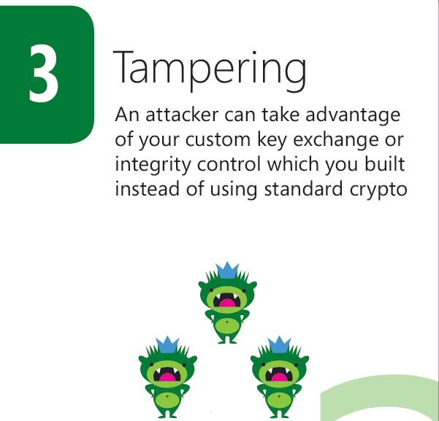
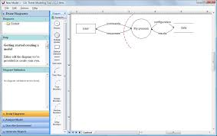
About Adam Shostack

Slide 3
About Loren Kohnfelder
Secure design, threat modeling, public encryption, privacy, and more
Digital certificates (Towards a practical public-key cryptosystem, 1977)
STRIDE (Threats to our Products, 1999)
Designing Secure Software (No Starch Press, 2021)

Slide 4
Our core argument: Publish!
Threat modeling has been a norm for a long time
Crucial to good engineering
TMs explain your security understanding, decisions and properties
Crucial to customers
Aligns with “secure by design” + “secure by demand”
So: Publish your threat models!

Slide 5
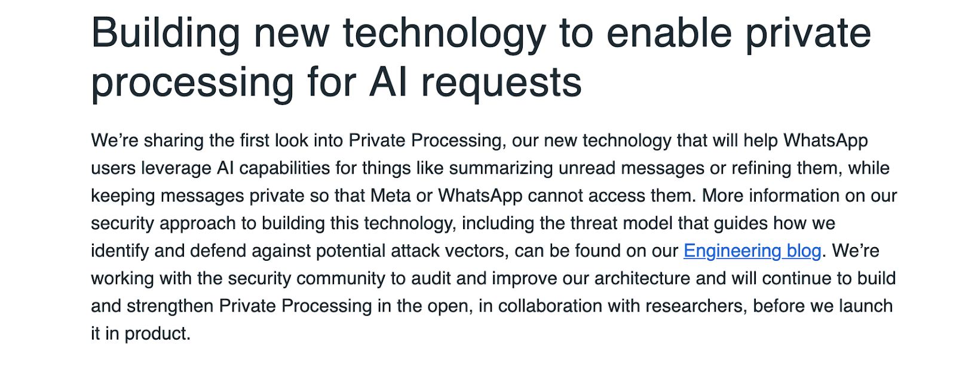
But no one would ever do that!?!
https://ai.meta.com/blog/ai-defenders-program-llama-protection-tools

Slide 6
Not just saying “you” should publish
https://shostack.org/files /zks/zeroknowledgewhitepapers/Freedom_Security2-1.pdf

Slide 7
Agenda
Benefits of publishing threat models
Dangers of publishing
Practicalities

Slide 8
Quick context: What is a TM doc?
The primary engineering record of security analysis + decisions
Often left informal or kept secret
Sometimes integrated into design docs (when those exist)
May discuss known failings or issues
Threat models are the best way to talk
about the security of your system

Slide 9
Benefits of publishing threat models

Slide 10
Transparency demands are growing
Software Bills of Materials
Software Composition Analysis
Third party risk management
Secure by Design/Secure by Demand
Attestations
OMB 22-18
CMMC

Slide 11
Security isn’t “one size fits all”
Example 1
Working on: MySQL storing transaction IDs vs SSNs
What can go wrong: info disclosure
But the situations are visibly different!
Example 2
The database is internet-facing
The database is localhost only
Both show the same in an SBOM
So: Context and intent matter

Slide 12
Threat Models are worth a thousand words
Diagrams are great communication tools
A threat model (diagram, analysis, mitigations) communicates security goals and intent
Shows both threats considered and protections
Enables a conversation about appropriateness
Truckloads better than TPRM Questionaries filled out by an LLM!

Slide 13
Publishing serves providers
Demonstrate thoughtfulness and commitment to security
Demonstrate pride in engineering
Demonstrate leadership (in the near term, anyway)
Like public pricing, /security page, helps customers evaluate alignment
Leads to more productive customer discussions
Published TM are a sales tool — even for open source projects

Slide 14
Publishing serves buyers
“Does this meet my security needs?”
Select the right providers
Analyze their security commitment + decisions
Do we need “compensating controls”?
Can we skip extraneous controls because of provider choices?
Hard to do when the TM is secret
Leads to a lot of low value conversations where neither side’s satisfied
Are obvious threats missing?

Slide 15
Publishing serves people beyond customers
A patient using a medical device, prescribed by a doctor, paid for by an insurer is not a “customer”
A person whose resume is scored by an LLM is not an “end user”
These sorts of cases are increasingly important
Adding security documentation should reassure them
If it doesn’t, whose fault is that?

Slide 16
Publishing serves the world
Benefits to
Industry analysts
Pen testers + vuln researchers (this was huge to us at Zero-Knowledge)
People learning security
Like open source, open threat models will
Create economic value
Encourage great engineering
Open source doesn’t facilitate security analysis
Design choices are often implicit
Lots of work to read the code, reconstruct analysis
Operational process/expectations not in code
Goals may not be understood, leading to “bug reports” that aren’t bugs

Slide 17
Publishing serves providers, redux
Benefits include
Brand benefits of transparency
Hiring benefits: I want to work there
Education: (“Where do I find good examples”)
Secure by Demand programs
JPMorganChase’s Pat Optel’s open letter
Signals higher quality products
The absence of a threat model will become a signal
https://shostack.org/blog/category/threat-model-thursday
https://www.jpmorgan.com/technology/technology-blog/open-letter-to-our-suppliers

Slide 18
Dangers of publishing threat models
A/K/A: “What can go wrong?”

Slide 19
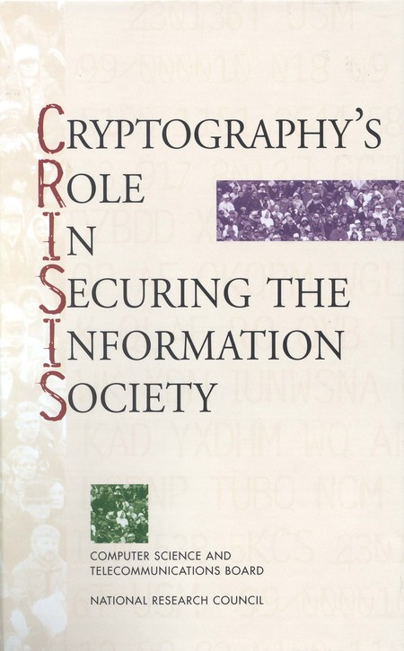
Strong emotional responses
Some people respond vehemently
We’re open to a conversation
You may have specific reasons for secrecy that aren’t well known
We can talk about the reasons without the exact details (NAS CRISIS report)
That people respond strongly is not an argument
But it’s a reality…
The same response to SBOMs, breach disclosure…
We expect the market will sort it out

Slide 20
Publishing has costs
Even if you have great TM(s) you might need to
Review and edit it
Add context for outsiders
Remove internal links/references
Add corporate branding or fancy graphics
Answer customer questions
If you don’t have great TM(s)
You might need to create them
A good idea, even if you don’t intend to publish them

Slide 21
What could go wrong? (Meta edition)
Omit a real threat*
Mitigations not good enough*
Give attackers a roadmap
Redaction can call attention to things
Help the competition
* These matter even if you’re not publishing,
but they often get brought up in the publishing context

Slide 22
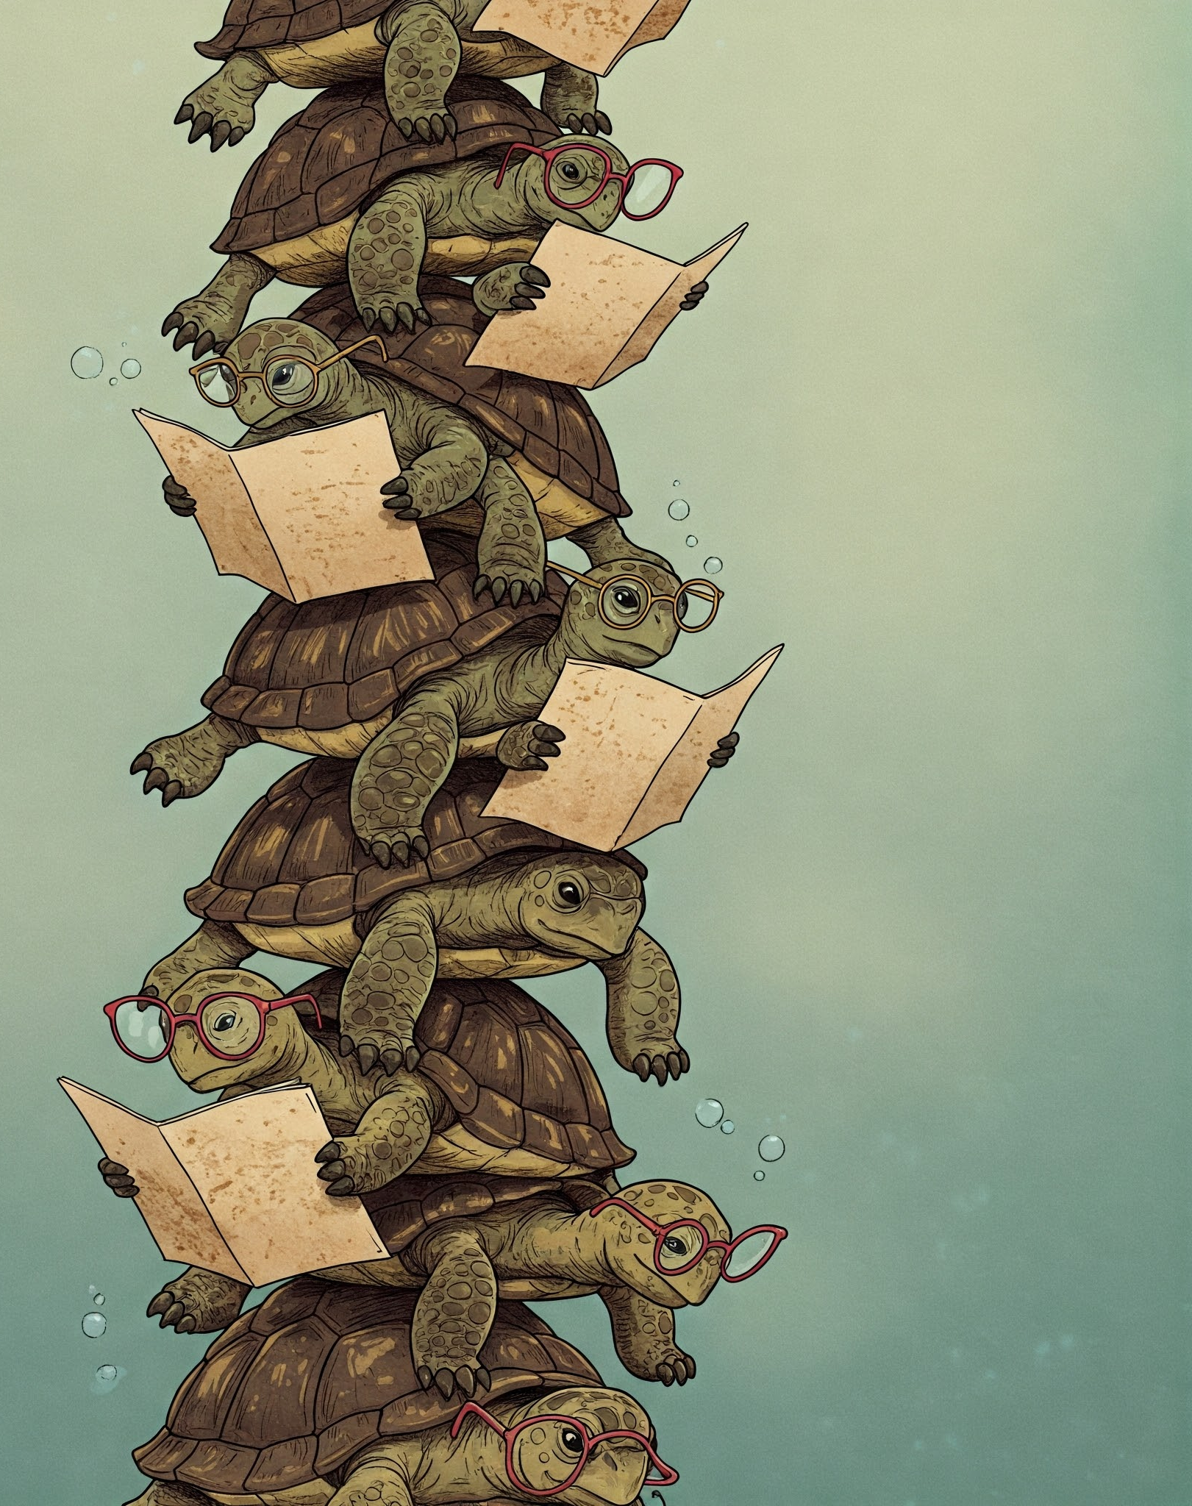
Differentiated threats may abound
Much of the concern is about our unique risks
So… threat model publishing our threat models!
What are we working on?
Publishing a threat model
What can go wrong for our business?

Slide 23
Mitigating the Dangers
A/K/A: What are we going to do about it?

Slide 24
Publishing safely (1/2)
The better your threat models, the smaller the dangers
Poor threat models lead to many problems
Discussing publication may help you solve that
You’re already telling customers “your security is important to us”
You’re answering TPRM risk questions
Is resistance to publishing a sign of “security by obscurity?”
Attackers are doing just fine without roadmaps

Slide 25
Publishing safely (2/2)
Clean it up
Editorial
Reasonable secrets (Eg, “Loren signed off on this risk” ➟“Management accepted the risk.”)
Check completeness, effectiveness
Limit information on mitigations
Information disclosure prevented by Magic Security Dust™

Slide 26
Do we need full transparency? Models
Published threat models may reasonably be a subset of the internal
System models (diagrams and explanations)
Might focus on the internet-facing parts (aka “Attack surface”)
Internet surface is often one of many boundaries
Simplify — “All models are wrong”
Deep internal details may confuse, rather than illuminate
Omit the internal details

Slide 27
Do we need full transparency? Threats
Threats relative to the model
Show all the threats!
Show the mitigated threats to show you’ve addressed them + how
Demonstrates your thought process, responsibility
Things you expect operators to manage
Things that are “by design” accepted
How do “some threats” and “security by obscurity” differ?

Slide 28
A publication rubric (not yet tested)
Is the security of the system important?
Does a model exist?
How valuable would a published TM be to provider? To customers? Prospects?
Will an existing model work?
Are all mitigations implemented and tested?
Does it portray security accurately?

Slide 29
Did we do a good job?
Does the TM document provide customers with confidence?
Security
Thought process
Attention to detail
Does publication drive quality up?
Are customers happier and safer?

Slide 30
If you’re not convinced…
If you think it’s an awful idea
Get specific about the dangers
If you want to but aren’t sure
Try the rubric
Let us help you make better threat models
Build lists or other resources for publishers
Give us feedback https://is.gd/publishthreatmodels_tmcon

Slide 31
Build lists or other resources…

Slide 32
Call to action
Demand threat models from suppliers
Make it a norm
Publish your threat models!
Good for you
Good for your customers
Good for the discipline

Slide 33
Thank you!
Also thanks for reviewing drafts:
Zoe Braiterman
Matt Coles
Christopher Gates
Bill Hansen
Robert Hurlbut
Takaharu Osaga
Izar Tarandach

Slide 34
Questions?
Now or
adam@shostack.org

