Slide 1
Threat Modeling:
Engineering and Science
Adam Shostack
JPL
Nov 19, 2024

Slide 2
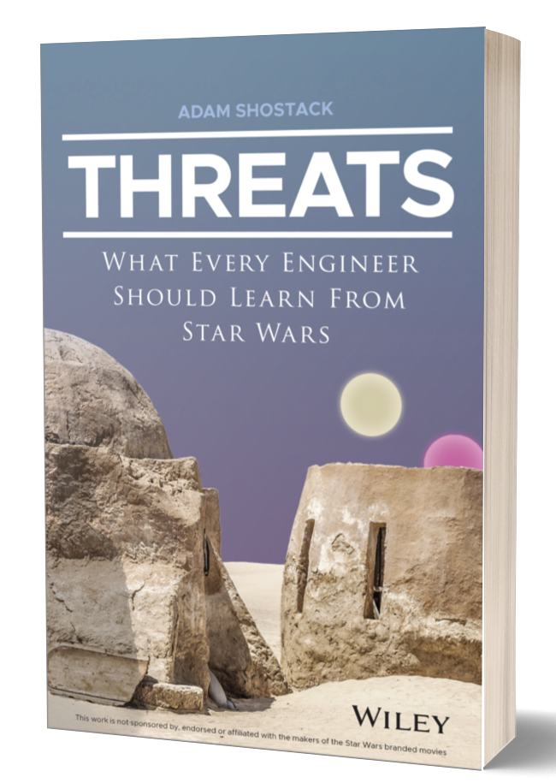
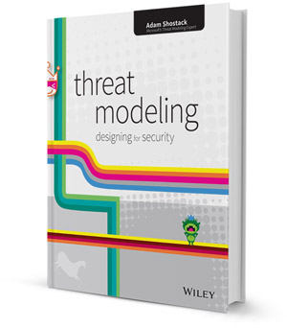
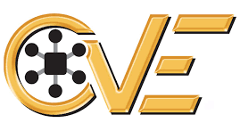


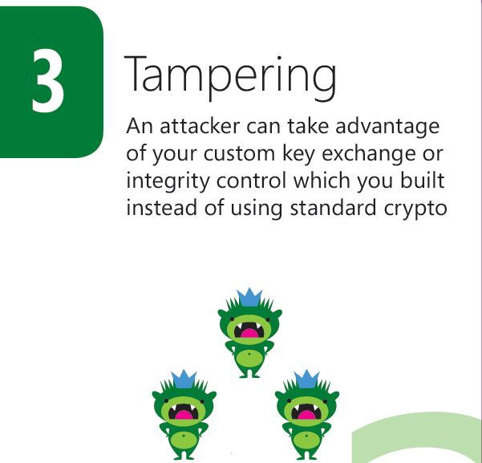
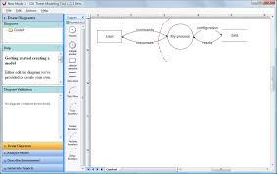


About Adam Shostack

Slide 3
Today
Building secure systems
  Overview and context
  Threat modeling tools and techniques
Risk
  Risk as a tool and frame
  How do we measure risk?
Where does that lead us?
This entire talk focuses on cybersecurity risk, abbreviated “risk”

Slide 4
Disclaimer
Here to explore ideas, not suggest immediate revisions to any process or any deviation from lab standards

Slide 5
Building secure systems

Slide 6
What does that mean?
“Secure” isn’t like “lift 1000 kg to LEO” or even“1000 bits per second”
Doesn’t get hacked!
Is that preparation by defenders, or just luck?

Slide 7
Common frames/definitions of security
“A condition that results from the establishment and maintenance of protective measures that enable an organization to perform its mission or critical functions despite risks posed by threats to its use of systems.”
“Protection against intentional subversion or forced failure.”
Resilient in the face of attack
Doesn’t surprise its creator

Slide 8
Common frames/definitions of security
“A condition that results from the establishment and maintenance of protective measures that enable an organization to perform its mission or critical functions despite risks posed by threats to its use of systems.”
“Protection against intentional subversion or forced failure.”
“A system which has not been specified cannot be buggy, merely surprising” (and other formalist ideas)
Resilient in the face of attack
Doesn’t surprise its creator

Slide 9
Analysis of NIST 800-53 definition
“A condition that results from the establishment and maintenance of protective measures that enable an organization to perform its mission or critical functions despite risks posed by threats to its use of systems.” (NIST 800-53 and others)
“What do I need to do?
  What are those risks? Which ones matter?
  Which threats matter? (Threats, in the sense of threat actors)
  Where’s the list so I can be complete?
What’s involved in a “mission” for a business?
What about cascade issues (“Can’t get incident response work done because Slack is down because a botnet crashed Dyn, a DNS provider”?)

Slide 10
Definition issues aren’t an excuse
We know insecurity when we see it
Akin’s laws of engineering apply to security
  Many laws apply surprisingly well
  “Design is based on requirements. There's no justification for designing something one bit ‘better’ than the requirements dictate.”
Security requirements are not crisp
  Specific, measurable
  What’s “enough”?

Slide 11
Why is “building secure systems” hard?
We lack a crisp definition of “secure”
We have a lot of standards and rules to comply with
  Compliance helps avoid insecurity
  At a cost…
The standards lack a “germ theory”
  Are most breaches caused by phishing or a lack of patching?

Slide 12
My building secure systems context
25+ years in application security
Industry consultant and trainer
“Nothing” is “good enough” is often true
Focus on lightweight methods

Slide 13
Threat modeling

Slide 14
What is threat modeling?
Using models to help us think about security
Threats meaning possible future problems
TM applies to both systems you produce and systems you deploy
The “measure twice, cut once” of security
“You can fix it on the drawing board with an eraser, or on the job site with a sledgehammer”

Slide 15
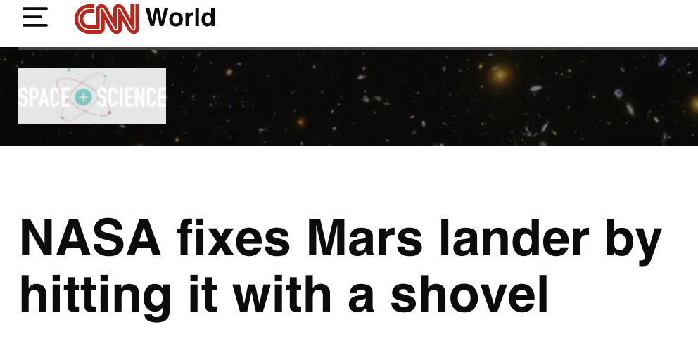
Sometimes you have to fix it onsite

Slide 16
How do we threat model?
Four Question Framework
  What are we working on?
  What can go wrong?
  What are we going to do about it?
  Did we do a good job?
Threatmodelingmanifesto.org

Slide 17
How do we threat model?
Four exceptionally simple questions
Enable
  Scenario specific ways of answering the questions (next slide)
  Appropriate alignment to engineering processes
  Common language
Identify, enhance boundaries
  More boundaries (isolation)
  Better enforcement/attenuation by boundary code

Slide 18
Example ways to answer each question
What are we working on?
  Whiteboard diagrams
  Lego models
  Data flow diagrams
What can go wrong?
  Brainstorming
  STRIDE (mnemonic for Spoofing, Tampering, Repudiation, Info disclose, Denial of service, Expansion of authority
  Kill chains such as MITRE ATT&CK

Slide 19
Example ways to answer each question (2)
What are we going to do about it?
  Address problems
    Code defensively
    Add barriers (Run in several accounts)
    Add technical controls like ID/Access Management or firewalls
When those mitigation approaches don’t work easily
  Make tradeoffs (usability, compatibility)
  Use risk management strategies (Eliminate, Accept, Transfer)
We often want to use likelihood to help prioritize
  Sounds like risk, again!

Slide 20
Risk in context
(Bhudia, et al, A Review of the General Risk Cyber Quantification Landscape, RISCS TR-D1, 2024, https://riscs.org.uk/cyber-risk-quantification-reports/)
There are over 200 risk management standards (!)
NASA has an very mature approach
  Continuous Risk Management, Risk Informed Decision Making
  Also NASA Risk Management Handbook:
    “While there will probably always be vigorous debate
    over the details of what comprises
    the best approach to managing risk,
    few will disagree that effective risk management
    is critical to program and project success and affordability.”

Slide 21
A few questions (focused on cyber)
“While there will probably always be vigorous debate
over … the best approach to managing risk,
few will disagree that effective risk management
is critical to program and project success and affordability.”
If we can’t agree on how, to what are we agreeing?
Is risk management being treated as axiomatic? Why?
Are we improving project/program/mission success rates?
Are we achieving affordability?

Slide 22
What is risk, anyway?
(This section reflects collaboration with Shannon Lantzy and papers under submission)

Slide 23
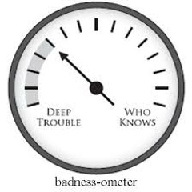
Initial thoughts
Risk is not a physical property
  There is no “risk-o-meter”
Risk doesn’t derive from physical units
  (In the sense of f=ma)
  Physical objects like bridges have risk of collapse
  Constructs like investment portfolios have risk
Risk is a concept that we use
  But remember, 200 different standards!

Slide 24
Risk, the word
From the old Italian “riscare”, to dare, venture or gamble
  “chi non risica non rosica” (nothing ventured, nothing gained)
Often means a danger, eg, “…despite risks posed by threats to its use of systems…”
Often implies quantification
  “A risk is a threat with quantified likelihood and impact” (me)

Slide 25
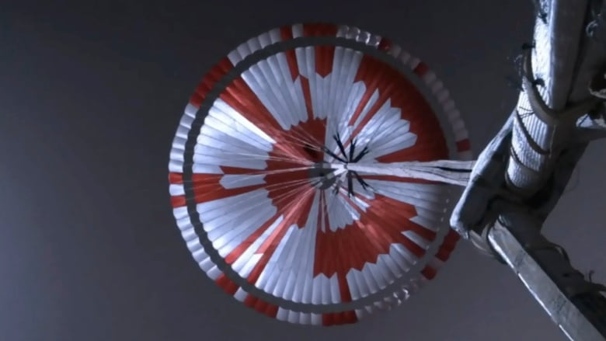

Slide 26
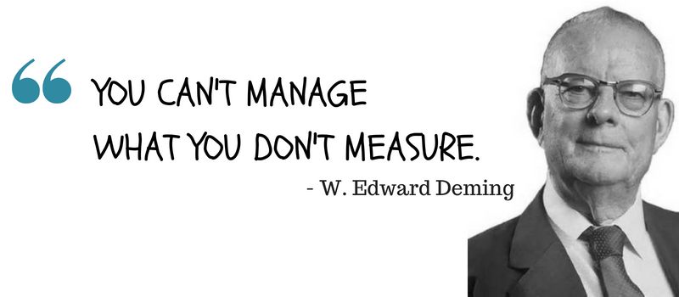
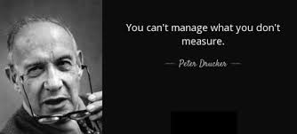
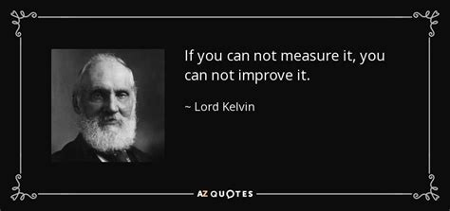
Does managing risk depend on measuring risk?

Slide 27
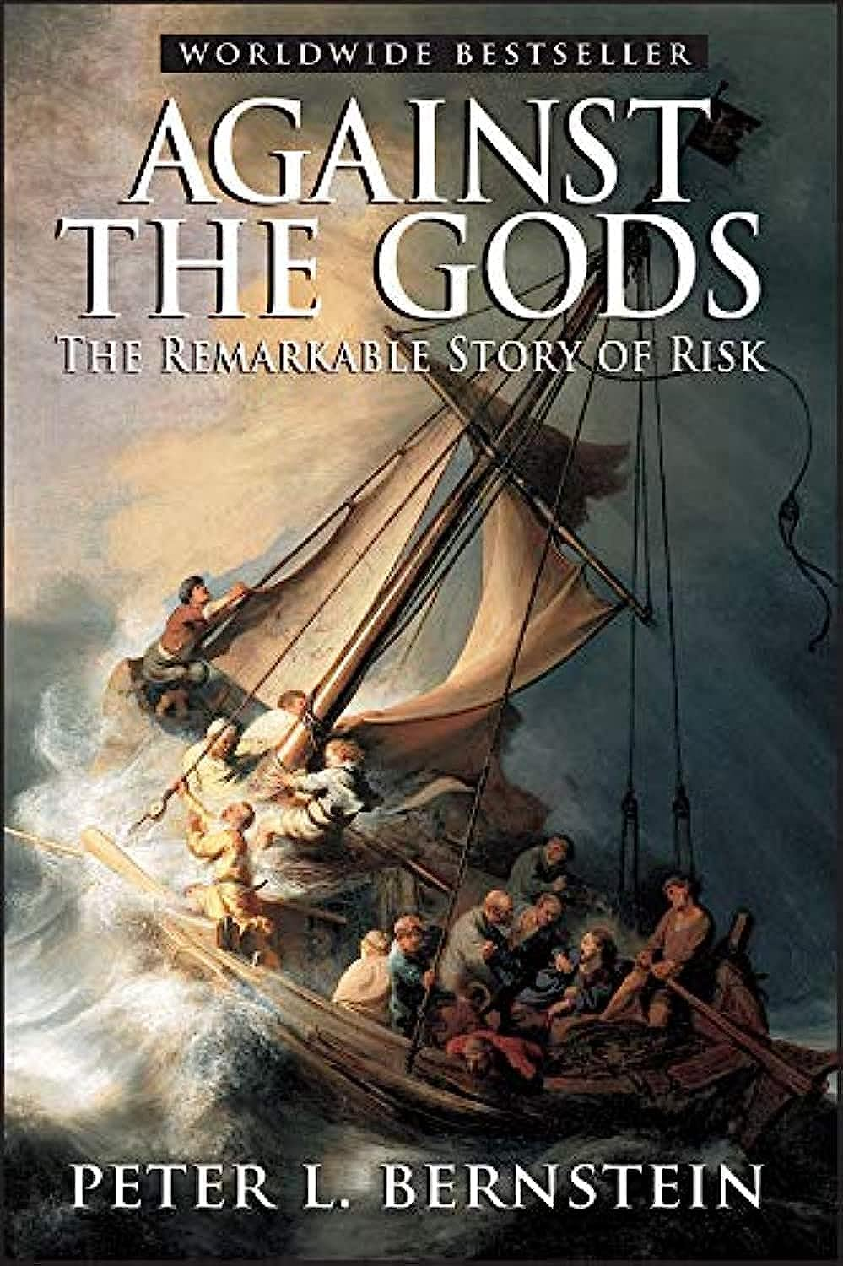
Risk measurement history
Insurance for ships
Gambling!
  Pascal + Fermat and the interrupted game
Annuities/pension plans
Stock portfolios

Slide 28
Risk management history @ NASA (1)
Design vs statistics debate
  Bell, Trudy E., and Karl Esch. “The Challenger Disaster: A Case of Subjective Engineering”, IEEE Spec (Online) 1986 https://spectrum.ieee.org/the-space-shuttle-a-case-of-subjective-engineering
  Feynman, Richard, “Personal Observations on Reliability of Shuttle”, Report of the PRESIDENTIAL COMMISSION on the Space Shuttle Challenger Accident, Volume 2, 1986, https://www.nasa.gov/history/rogersrep/v2appf.htm
FMEA, STAMP, etc
Tech Readiness (next slide)
(Grant Tremblay)
https://www.granttremblay.com/blog/trls

Slide 29
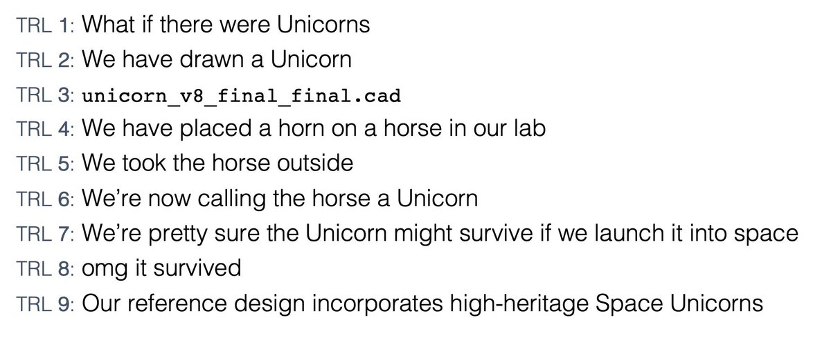
Risk management history @NASA (2)
Tech Readiness Levels
NASA, 1970s
(Grant Tremblay)
https://www.granttremblay.com/blog/trls

Slide 30
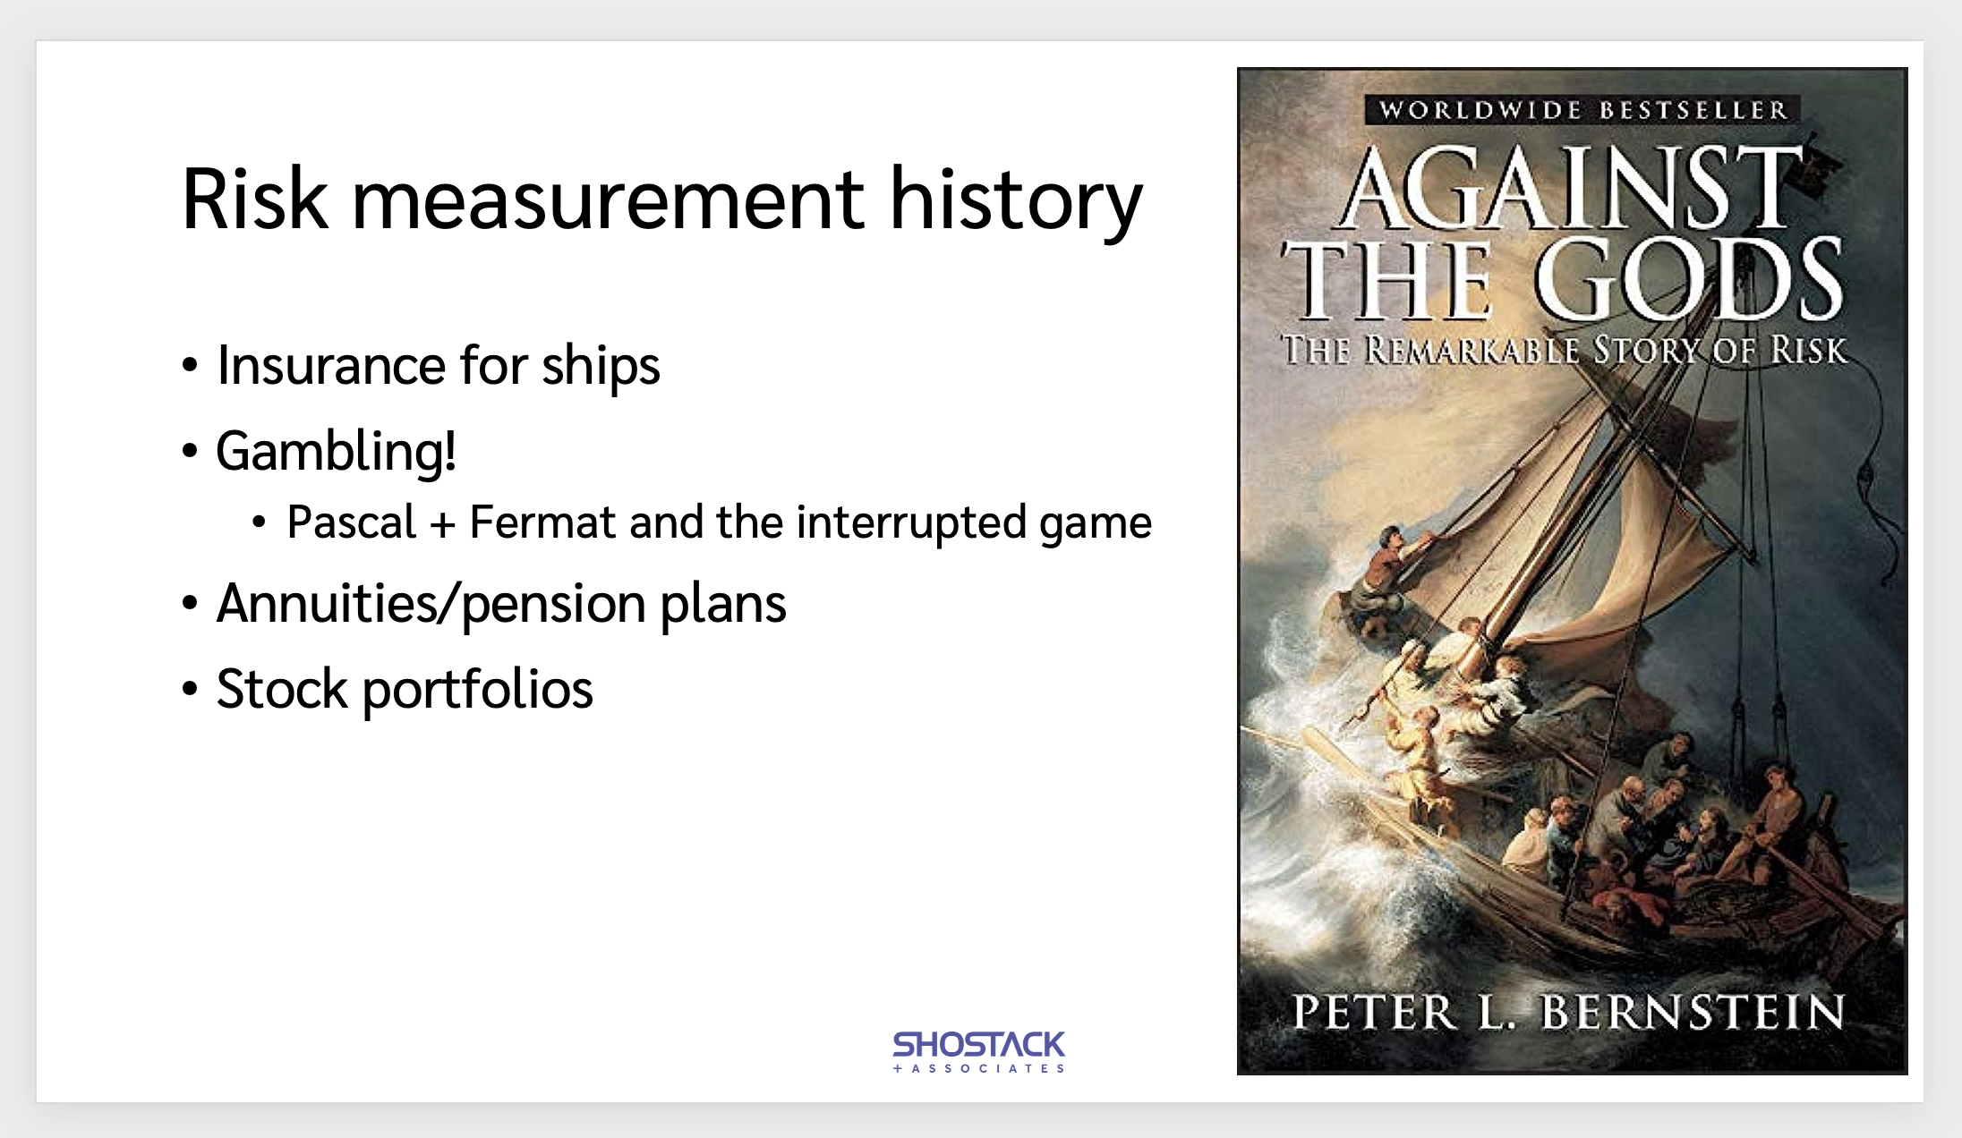
Risk measurement general history (again)
Risk measurement easiest with iterations
TRL are empirical

Slide 31
Risk measurement (1): Sky Crane
What was the risk of mission failure due to the Sky Crane?
  Please don’t shout out the approved answer ☺
  Mission: Land the rover safely
Possible answers, August 1, 2012
  Between 0 .. 1 (inclusive)
Possible answers, Aug 31, 2012
  Between 0 .. .99

Slide 32
Risk measurement (2): Europa Clipper
What was the additional risk from the mosfet issues?
How does the canary box impact risk?
  “The manufacturer is working with the mission team to support ongoing radiation test and analysis efforts in order to better understand the risk of using these parts on the Europa Clipper spacecraft.” (NASA official blog, July 11, emphasis added)
Is mission risk changed by the canary box?
  Heating and annealing to extend life seems like risk mitigation
  Seem very hard to quantify without the canary box, maybe even with it

Slide 33
Risk measurement challenges
Risk is not a physical property
Risk doesn’t derive from physical units
  (In the sense of f=ma)
  Physical objects like bridges have risk of collapse
Iteration is common to measuring risk
  1 Skycrane landing is … ?

Slide 34
Properties of risk management techniques

Slide 35
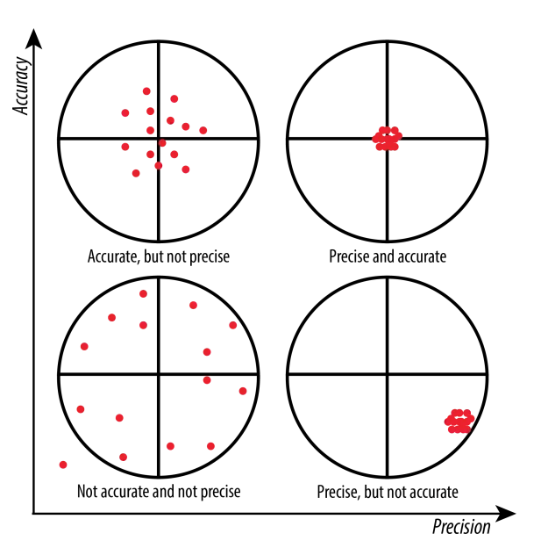
Accuracy + precision
Accuracy: how close measures are to truth
Precision: how close they are to each other
Image originally from https://wp.stolaf.edu/it/gis-precision-accuracy/

Slide 36
Measurement strategies
Precision
  Have many people quantify some risk
  Measure reliability (inter-, intra-rate), meaure spread
  Differences may not be independent and so not show a normal distribution
  Can be measured without knowing “the” real value
Accuracy
  Requires(?) iterations
  Every failure gives you data
  Failures may be really costly
  Near misses give us data

Slide 37
Cost as a property of risk management
Doing work has a cost
Includes
  Effort to produce the measurement
  Justification + record keeping
  Vigorous debate
  (The debate may add value)
Cost relates to “return on investment”
  “Return” may be hard to measure

Slide 38
Managing cost
If work is expensive or unreliable, do it once
Acceptable answer tables
  Do the work once, and write down the answers
  For example, what’s an acceptable rate of phishing test failures?
    This is a question for NIST or Sector Risk Management Agencies
    Consulting experience: every company is trying to answer it for themselves
The table will be wrong
  Methodological transparency lets us ask: Do we have better data than those who created it?
  If not, use the table of wrong, but accepted, answers

Slide 39
Where does that lead us?
Better mission support?

Slide 40
One possible approach to evaluating risk management approaches
Measure precision + cost?
Seems unsatisfying?
Are we comparing real systems to aspirational ones?

Slide 41
Another approach
Stop treating “risk management” as axiomatic, at least in cyber
Start treating it as hypotheses
  The Green approach will result in
    precision > 85%
    cost of $5000 per estimation
    a three year retrospective predictive accuracy of at least 25%.
  The Red approach will result in
    precision > 60%
    cost of $1000 per estimation
    three year retrospective predictive accuracy of 15%
(I don’t think we have clear ways to measure accuracy yet)

Slide 42
A possible strategy
Can we treat “(cyber) risk management” as a tech, subject to TRL?
Variant A: Each specific approach (red, green) has a readiness level
Variant B: The idea of risk management can be subjected to TRL
  Tested under these conditions, not under those

Slide 43

In conclusion
Is risk management a high heritage space unicorn?
  Maybe it’s still a horse with a horn tied to it’s head?
Threat modeling techniques like the Four Question Frame are designed to help either way

Slide 44
Thank you!

Slide 45
Questions?
Now or
adam@shostack.org

Slide 46
A few references
Shostack.org/blog (lots on threat modeling)
https://shostack.org/resources/lessons (including near misses)
https://shostack.org/resources/cyber-public-health
  (There’s a lot there that may not apply super-well to the flying side of missions, but might be helpful for the ground side, so I left it out of this talk)

Slide 47
Akin’s laws that apply well to security
To design a system right takes an infinite amount of effort. This is why it's a good idea to design them to operate when some things are wrong.
Design is an iterative process. The necessary number of iterations is at least one more than the number you have currently done. This is true at any point in time.
The fact that an analysis appears in print has no relationship to the likelihood of its being correct.
Cyberspace is a completely unforgiving environment.
There is never a single right solution. There are always multiple wrong ones, though.

