Slide 1

Layering Defenses: A New Hope?
Adam Shostack February 2026
Notes:
United we secure; conversation

Slide 2



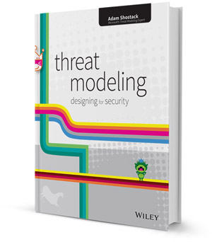






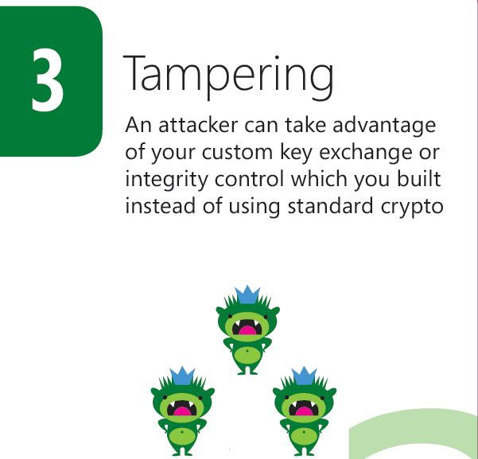
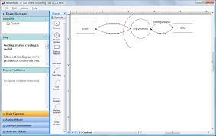




About
Enabling your threat modeling

Slide 3
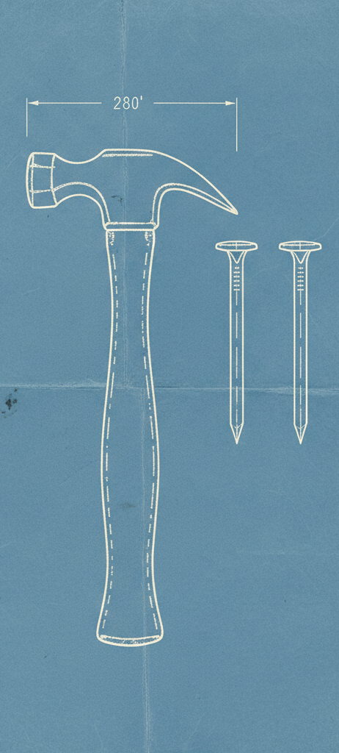
Thesis statements
Most defenders have a small toolkit
Defender’s choices have clusters
Expanding toolboxes gives us new hopes
How to talk about that toolkit isn’t clear
Notes:
A person’s background and experience
Their company’s position in the tech supply chain
The platform a system runs on
The age of the system

Slide 4
Agenda
Very brief intro to TM
Origin story
Analysis
Current working set
Possible models

Slide 5
Threat modeling overview

Slide 6
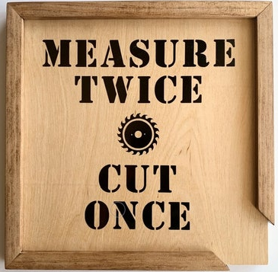
What is threat modeling?
Using models to help us think about security
The “measure twice, cut once” of security
Applies to technology you produce and technology you operate

Slide 7
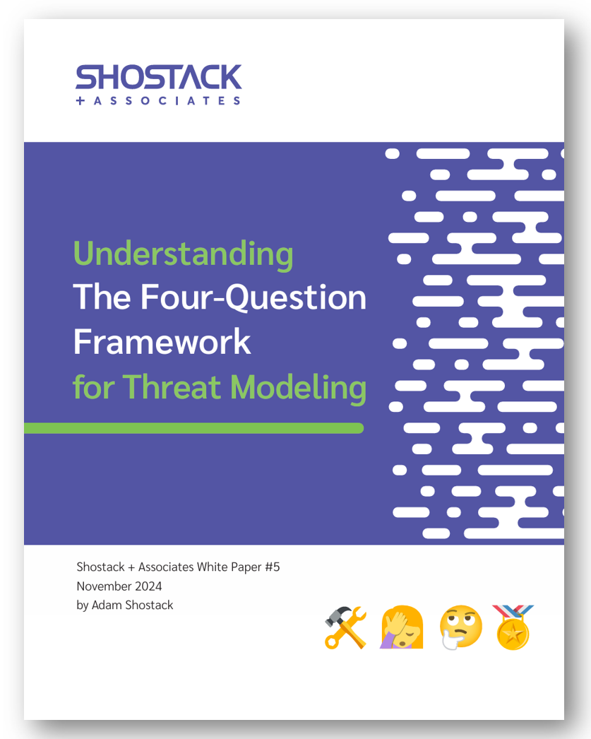
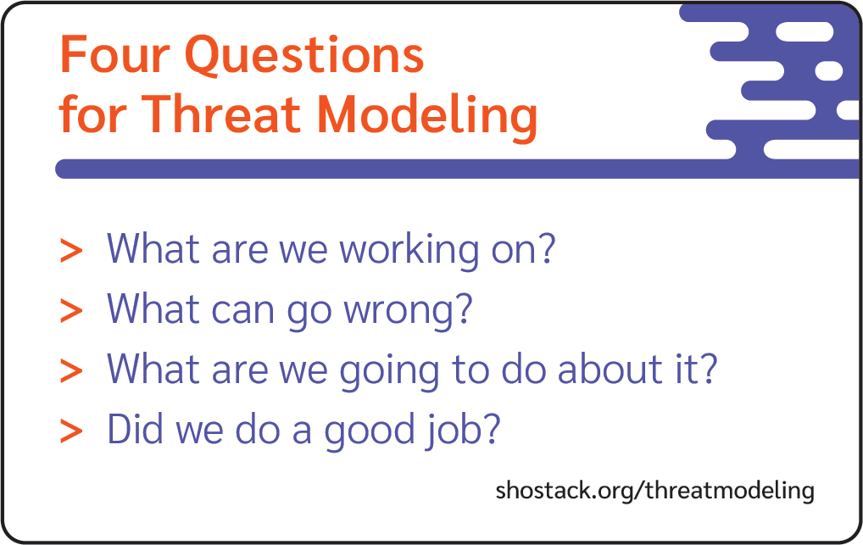
How do we threat model?
Threatmodelingmanifesto.org
Shostack.org/whitepapers

Slide 8
Boundaries are often missed
Threat modeling to identify, enhance boundaries
More boundaries
Better enforcement/attenuation by boundary code

Slide 9
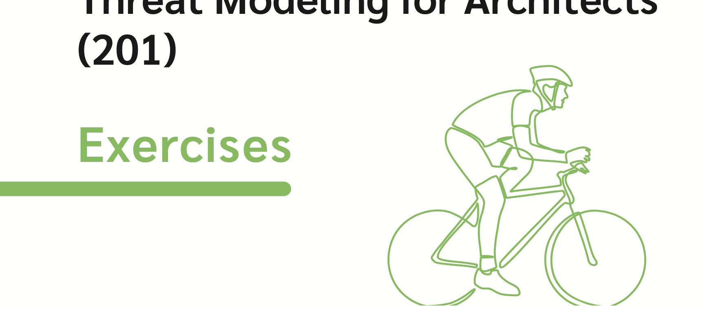
Origin of this talk
Notes:
Learn so much from students/Recent training
Why we use bikes

Slide 10
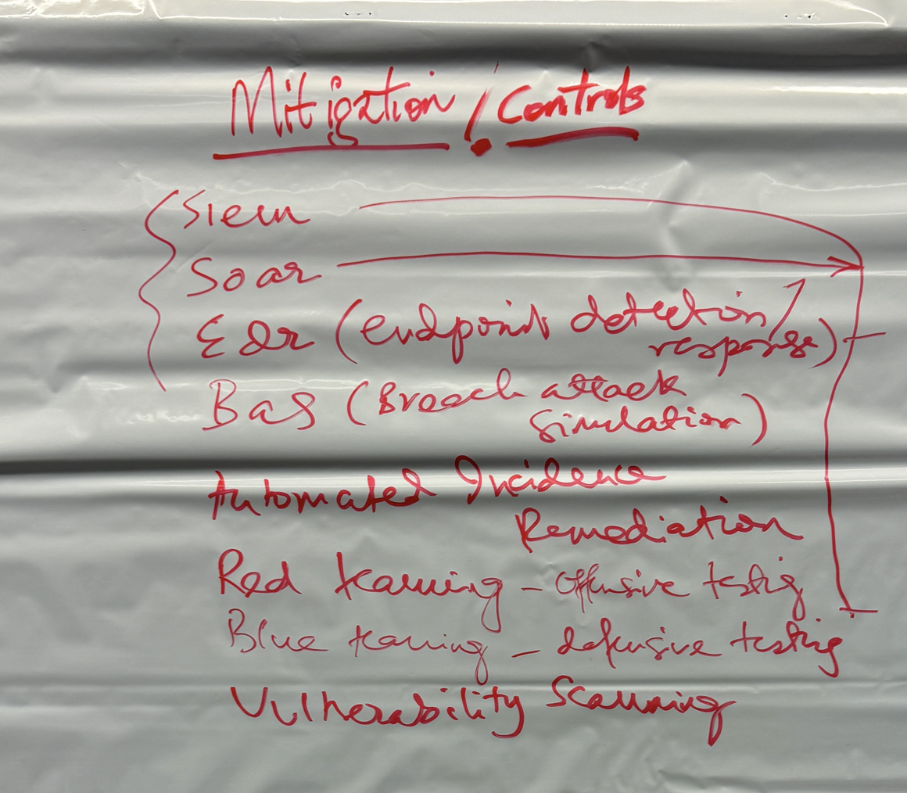
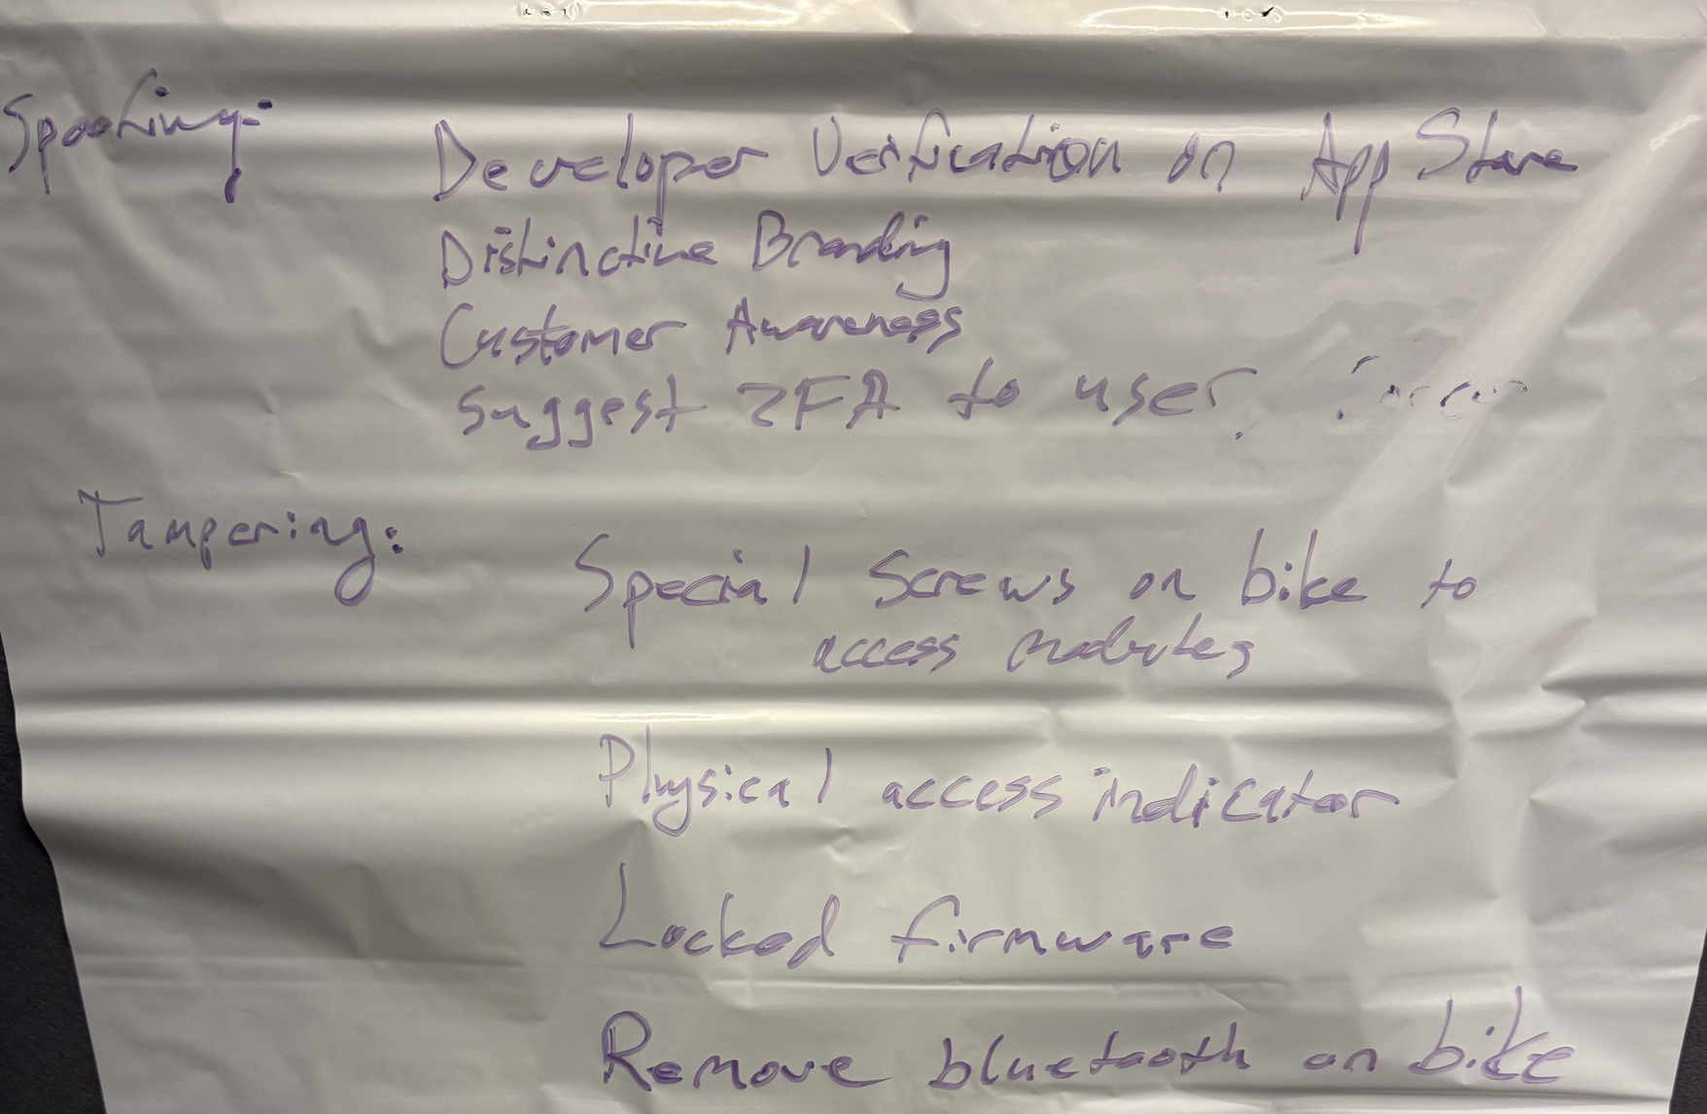
Origin story: A recent training delivery
SIEM
SOAR
EDR
BAS
...
...
Special screws on bike
Locked firmware
Remove bluetooth
...

Slide 11
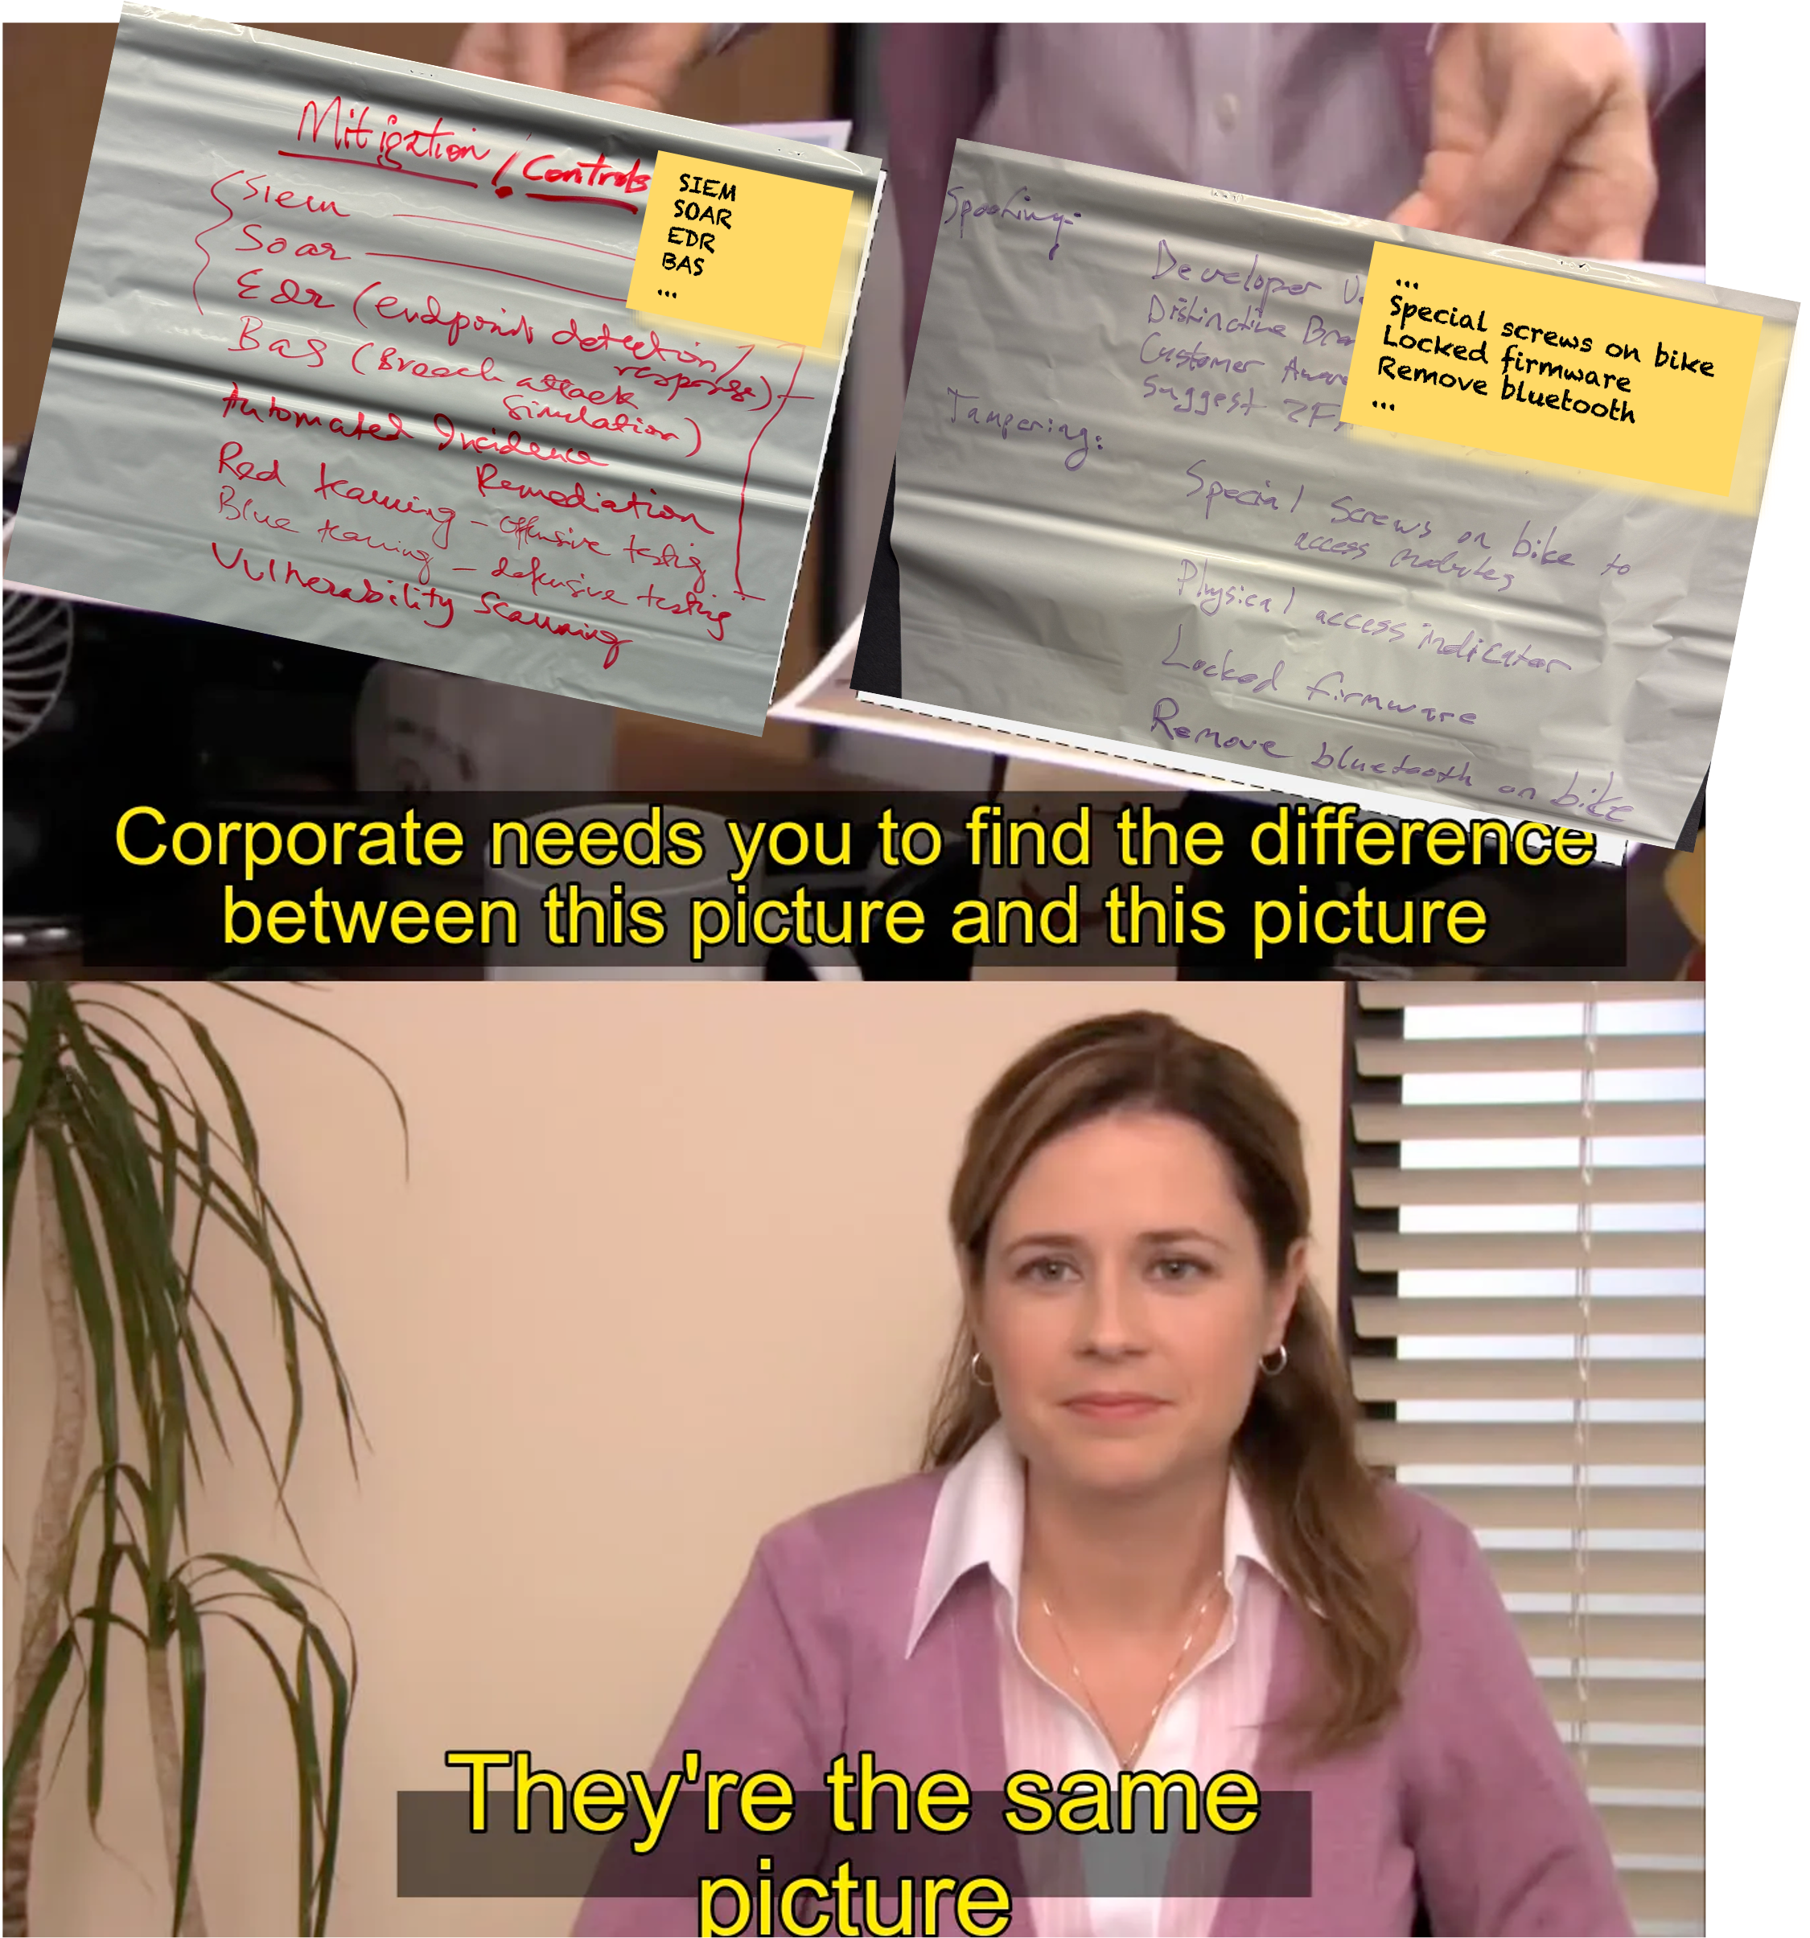
Origin story, continued
Students struggled to compare + contrast lists
Several viscerally rejected the idea they were in any way different
Pushed for their familiar strategy (“products”, “design changes”)
Talked past each other

Slide 12
Analysis
Many people have a limited toolkit of defenses
Partially obscured by the many terms we use
Diverse teams are likely to surface a wider range of options
How should we think of these?
Been using the word toolkit but that has its own issues...
Notes:
Many terms – next slide
(None of us are as smart as all of us)

Slide 13
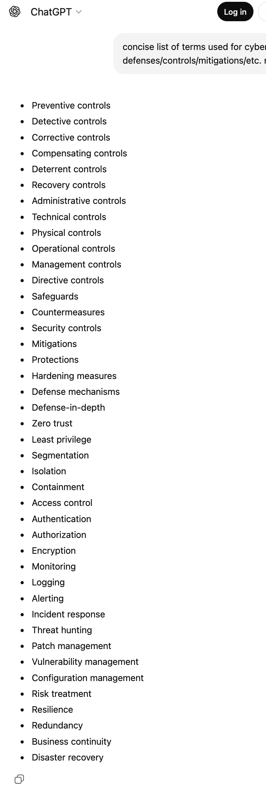
“What are we going to do?” terminology
Mitigation
Remediation
Control
Risk management
Countermeasure
Containment
Hardening
Not all are synonyms...
ChatGPT, when asked for a concise list

Slide 14
Models are part of great threat modeling
Layers are a model of defenses
Maybe mirror STRIDE’s use as a mnemonic?
STRIDE helps us discover threats
Expand choices
Generalize from “MFA” to “better authentication”
Better authentication leads to a set of answers
Working through this and want help
None of us are as smart as all of us!

Slide 15
Defenses are better than risk management
Protect, detect, respond
“People, process” are often a result of “No technology answer”
Risk management is often a result of “no good tech answer”
More defenses, less “need” for “risk management” 😇
(See my BSides Seattle keynote last year or the OWASP version
https://shostack.org/blog/owasp-keynote-available/ )

Slide 16
Possible layers of defense

Slide 17
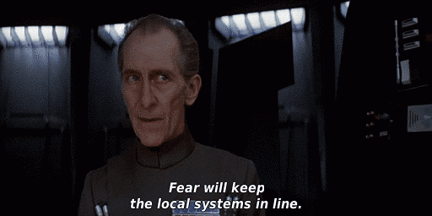
A battle station to keep the local systems in line
What are we working on?

Slide 18
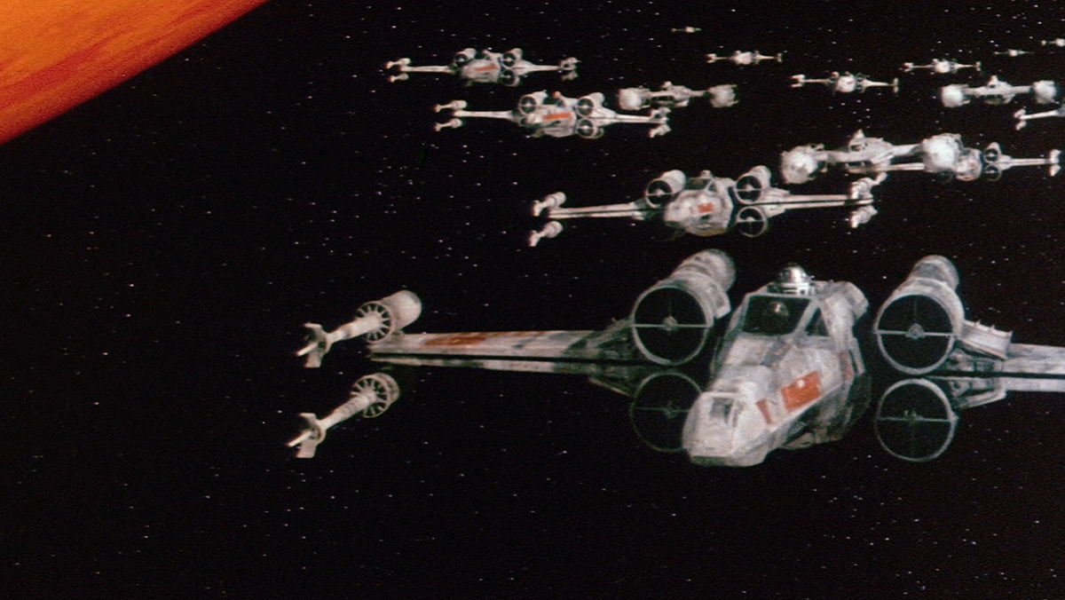
What can go wrong?

Slide 19
What are we going to do?

Slide 20
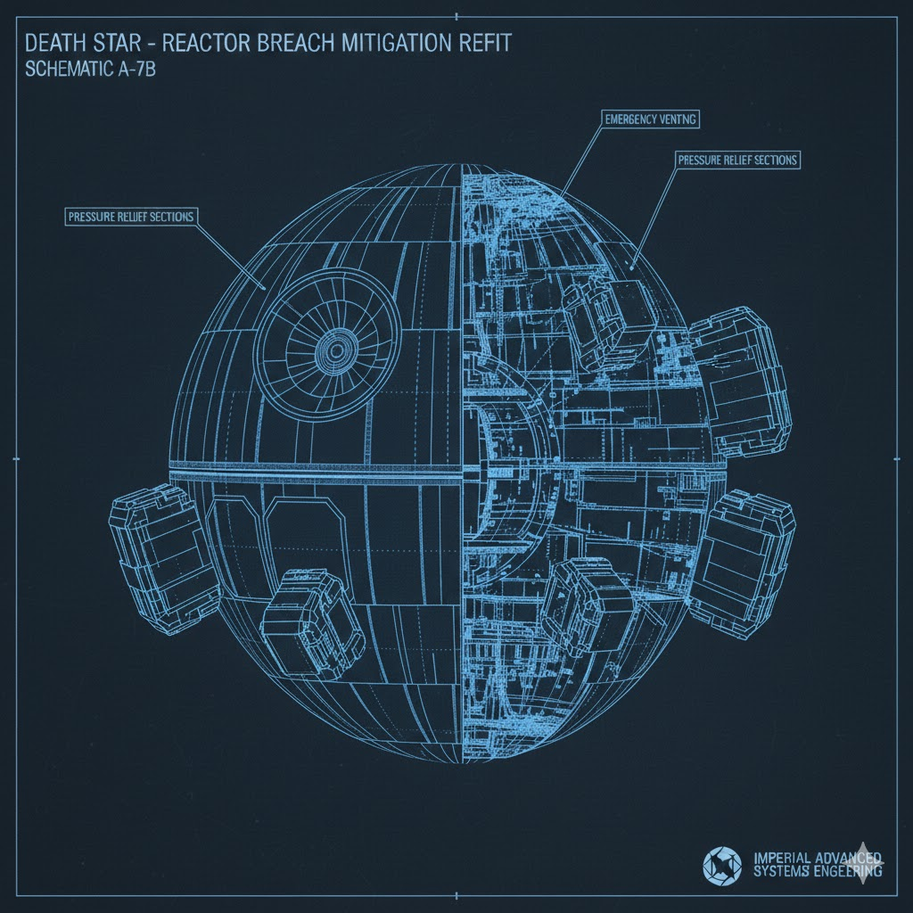
Architectural improvements: Blowout sections
Depends on requirements analysis
Hard to retrofit
High casualty levels

Slide 21
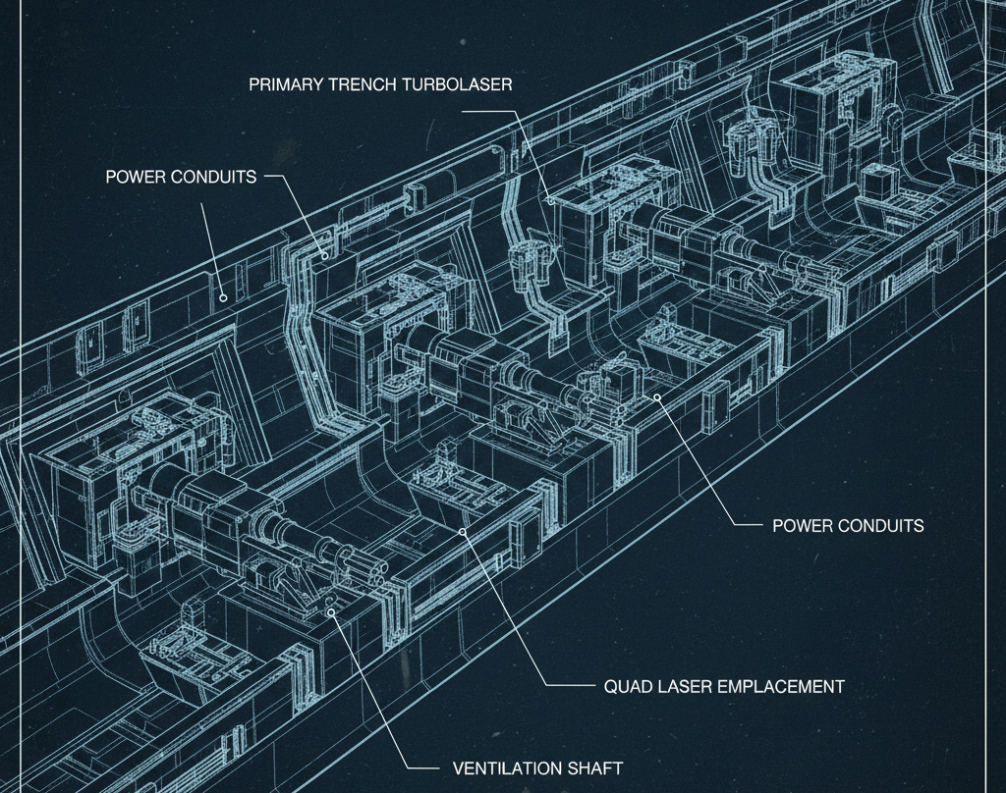
Laser cannons!
Not approved. The Empire doesn’t see a small, one-person fighter as a threat.
Also, the AI laser plans called for...
more ventilation shafts!

Slide 22
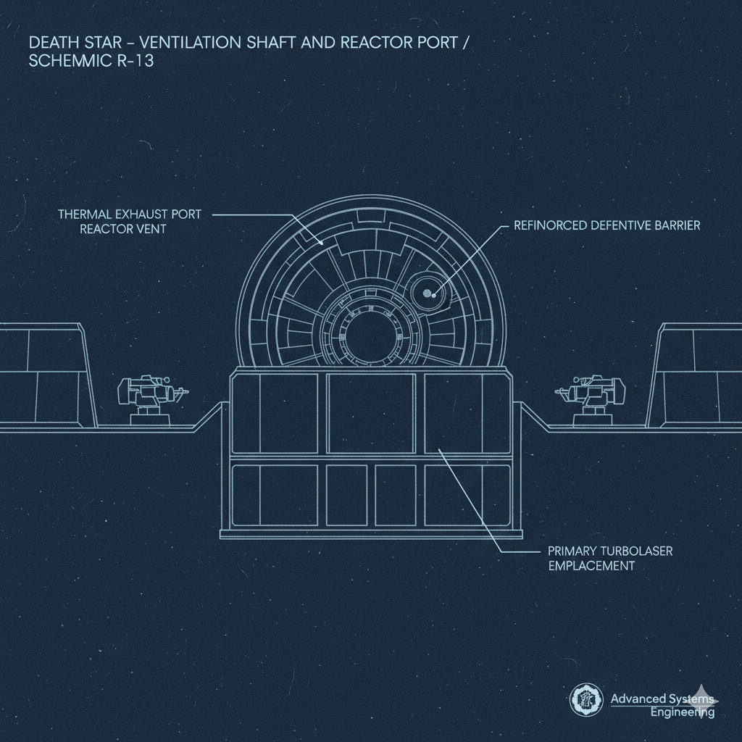
Add a steel wall
That’s one way to place a wall...

Slide 23
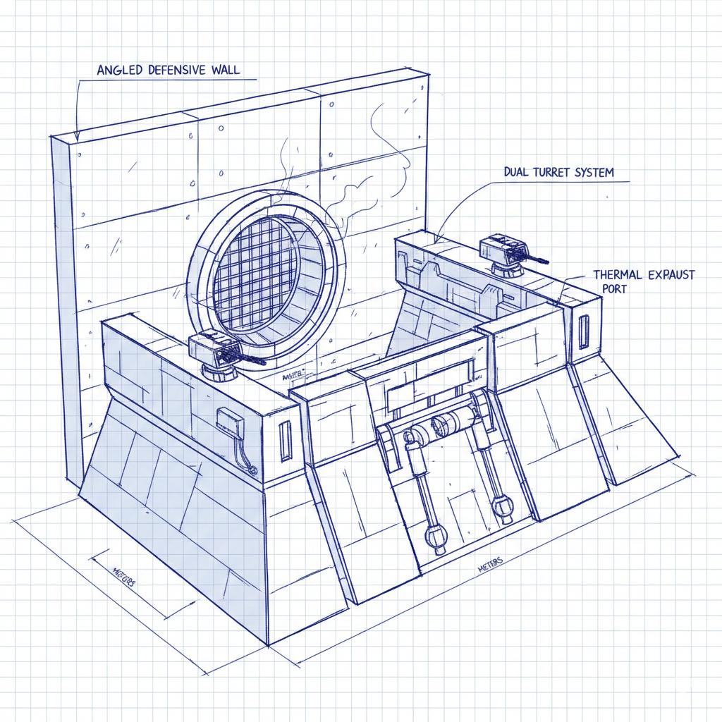
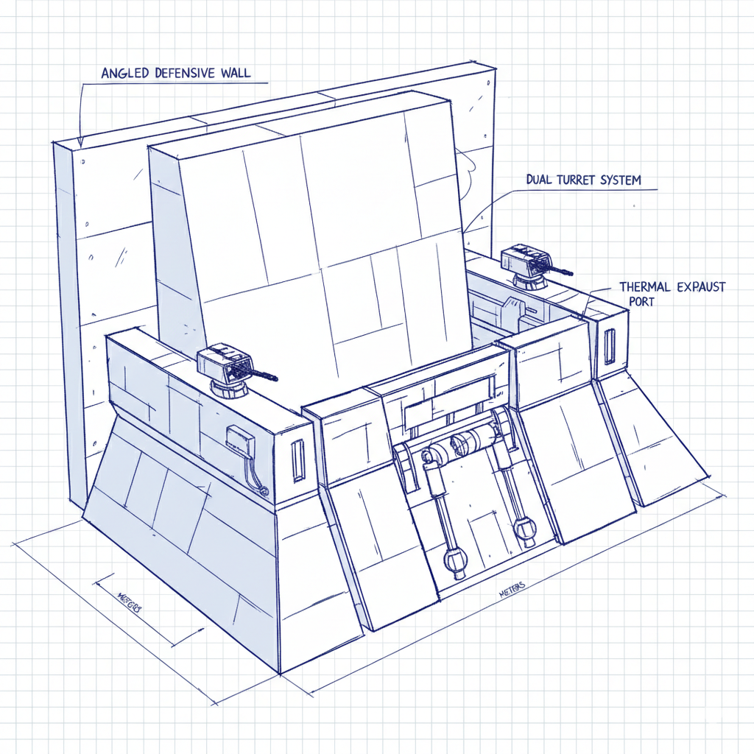
Turns out improving defenses is hard...

Slide 24
Key point:
Many ways to model improving
a small thermal exhaust port...

Slide 25
Mechanisms for threat modeling
Not “adversarial thinking,” but structure
We have DFDs, STRIDE...
What defensive models help people to:
Explore a design space?
Consider tradeoffs?
That we can train them to use in a structured, systematic way?

Slide 26
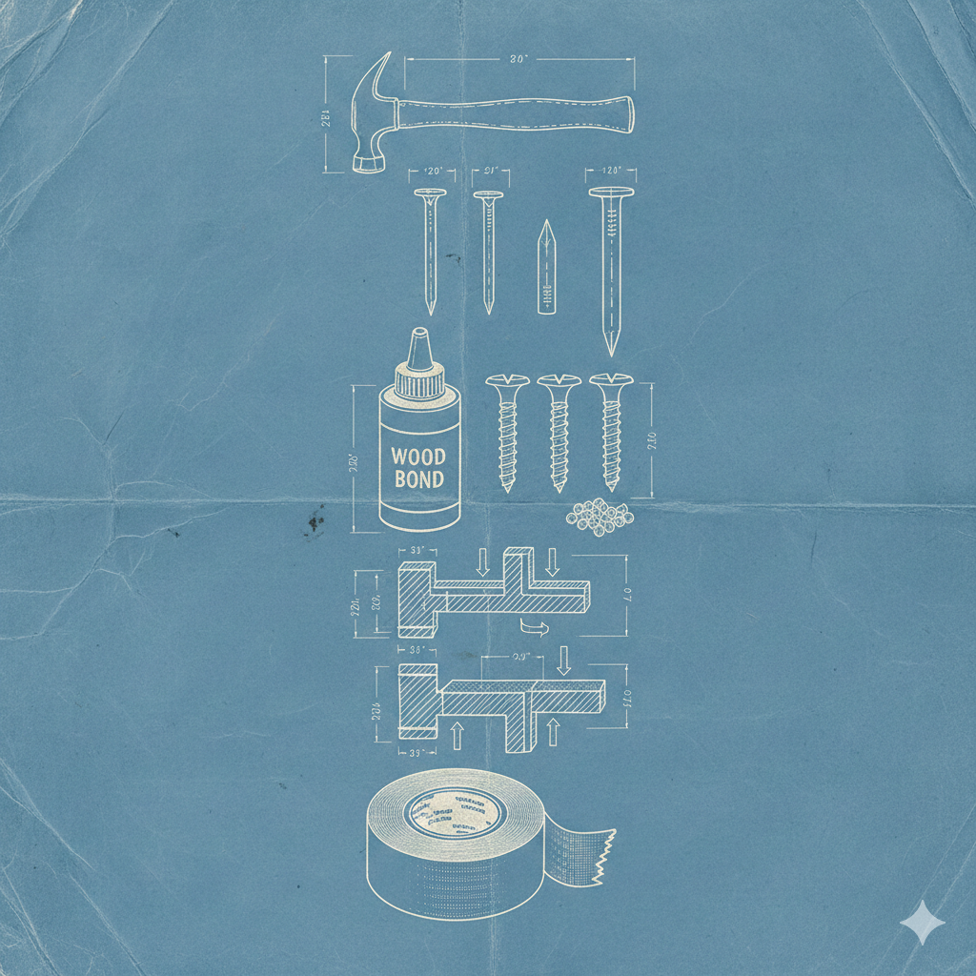
Three possible models
Toolkit
Layers
Engineering Stages

Slide 27

None of us is as smart as all of us
I’ll delve one “doubleclick” deeper into each (toolkit, layers, stages)
Two polling mechanisms
Hum
Mentimeter survey
menti.com

Slide 28
Menti quick overview: 5 questions
Which do you like best?
Is there another frame?
Is there related work Adam should go look at?
Perspective on:
Toolkit
Layers
Stages
menti.com

Slide 29
The defenses are similar however you model
Design + architecture
Defensive coding
“SRE practices”
Product protection: Firewalls, AV/EDM, RASP...
Product integration: SIEM, IAM...
Can call these a toolkit, layers... May get slightly different groups
(Is IAM a layer? It’s part of a toolkit...)

Slide 30
Option 1: “A toolkit”
Toolkit
Pros
Cons
Easy metaphor
Visuals are easy
Easy to extend
Duct tape!
Not particularly tied to tech
Unstructured
Duct tape

Slide 31

Option 2: Layers
Layers
Pros
Cons
Simplicity
More structure than “toolkit”
Cake visuals
People jumped to “in depth”
“Operations/product”
Need more layers/nuance?
(Emphasized by lack of stages)
Not very deep

Slide 32
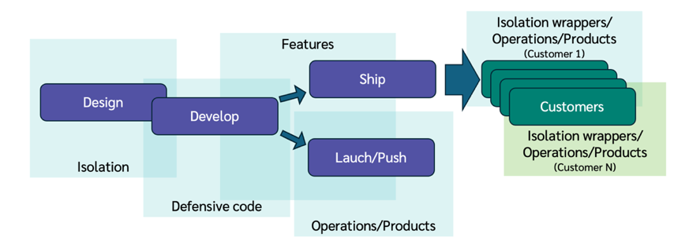
Option 3: Defensive strategy
Engineering Stages
(Semi-aligned to engineering stages)
Design isolation
Defensive code
Operational activity
Products
Isolation (wrappers)
Top row: shipped product
Bottom row: operated product
Notes:
Explain colors – Dark blue, eng stage; light blue, defenses which surround them, green @ cust

Slide 33
Option 3: Engineering stages
Engineering Stages
Pros
Cons
Ties to traditional product lifecycle
Ties to waterfall view of lifecycle, not agile
More complex
Different lifecycles across orgs
Language: DevOps/SRE/Operations/IT/…

Slide 34
Summary
Models are a tool of great threat modeling
The words we use are important
Still working through how to express this
Please contribute to discussion
LinkedIn – Shostack + Associates
Exact links will be in Shostack.org/blog after the conference

Slide 35
Thank you!

Slide 36

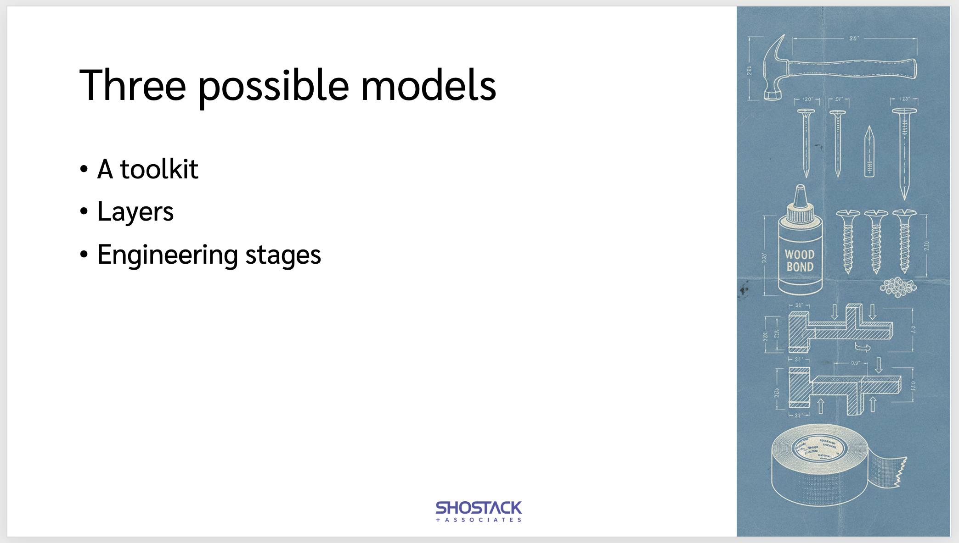
Layering Defenses: A New Hope?
Bsides Seattle 2026
Questions?
Slides:
Shostack.org/blog

Slide 37
We can help

Slide 38

Free resources
shostack.org/resources
shostack.org/blog
youtube.com/c/Shostack
Books
LinkedIn Learning
Books free at your library/various subscriptions; Linkedin Learning often available via work

Slide 39
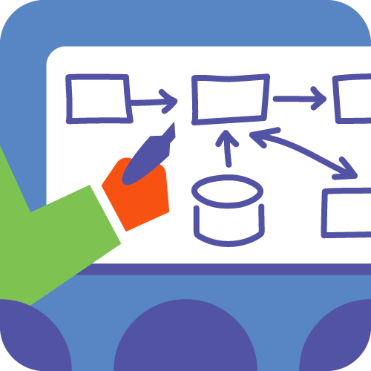

Commercial offerings
Training
From under an hour to multi-day, at all levels of learning
Live instruction or self-paced computer-based
In person or distributed
Licensing for delivery of computer-based training via corporate LMS available
Secure Design Accelerator Program
Leadership academy for your secure-by-design engineering program leaders
Includes implementation toolkit, process design, culture change support, and metrics
Threat Modeling Assessments + Analysis
shostack.org/contact
info@shostack.org

