Slide 1
Elevation of Privilege
The easy way to threat model
Adam Shostack
Microsoft

Slide 2
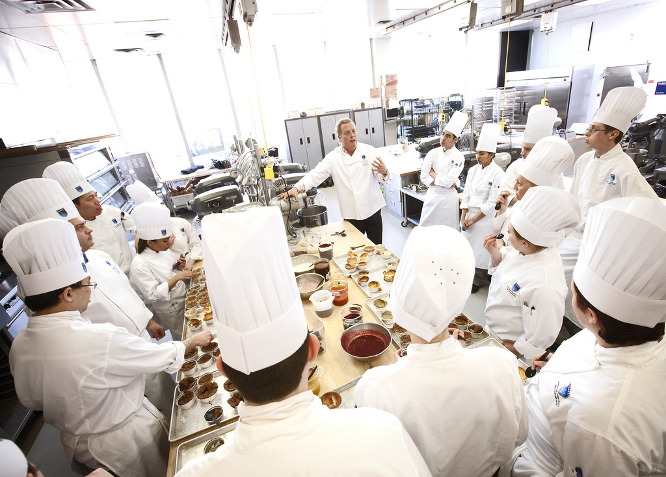
Telling most people to “Think like an attacker” is a lot like telling them to think like a professional chef. They lack context, training and understanding of what that means, even if they know how to cook.
Photo: “Chef David Adjey” by NAIT TCI Photo Dept. http://www.flickr.com/photos/nait/4438905748/

Slide 3
Threat Modeling
Really, really hard for normal engineers to do
  Requires a skillset acquired by osmosis (“The security mindset”)
  Overcome creator blindness
  Extreme consequences for errors or omissions
  Engineers know their code and how it changes
And the consequences…
Notes:
Design analysis: show me your threat model. Requirements: what’s your threat model?

Slide 4
SDL Threat Modeling Tool 3.1
SDL TM Tool makes threat modeling flow better for a broader set of users
Main Approach:
  Simple, prescriptive, self-checks
Tool
  Draw threat model diagrams with live feedback
  Guided analysis of threats and mitigations using STRIDE
  Integrates with bug tracking systems
Free at http://microsoft.com/sdl
Notes:
Bug tracking systems? That’s an odd thing to mention

Slide 5
STRIDE Framework* for finding threats
Threat | Property we want
Spoofing | Authentication
Tampering | Integrity
Repudiation | Non-repudiation
Information Disclosure | Confidentiality
Denial of Service | Availability
Elevation of Privilege | Authorization
* Framework, not classification scheme. STRIDE is a good framework, bad taxonomy
Notes:
Note that this isn’t complete, but workable

Slide 6
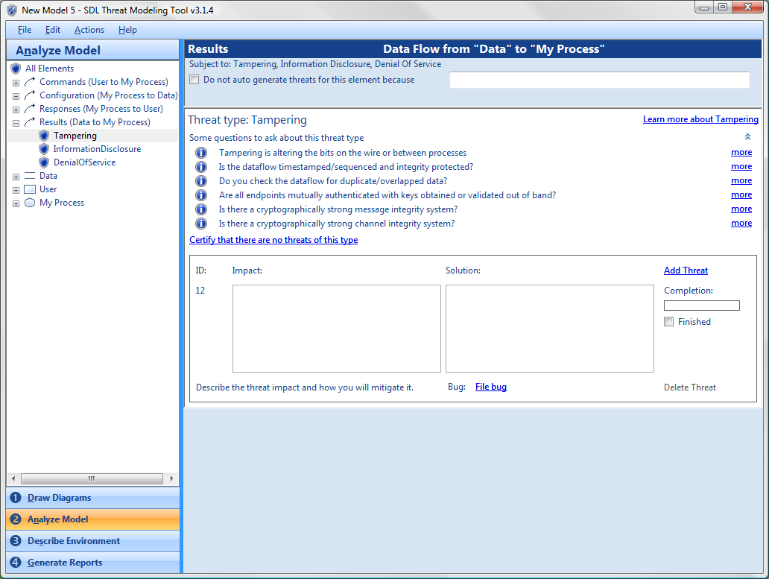
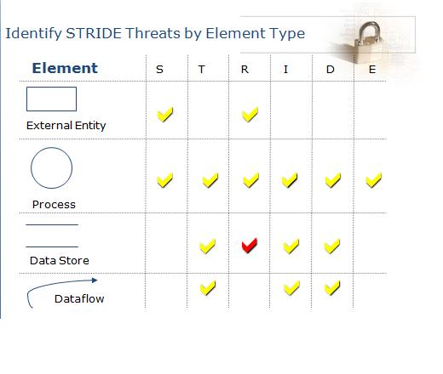
Find threats: Use STRIDE per element
Notes:
The red checkmark is a “sometimes” where if the data store is a log, then you have repudiation to worry about
Offers a balance between ability and challenge..

Slide 7
2009 TM problem statement
Even with the SDL TM Tool…
Threat models often pushed to one person
  Less collaboration
  One perspective
  Sometimes a junior person
Meetings to review & share threat models
  Experts took over meetings
  Working meetings became review meetings
Notes:
Recap: Our previous problem is that we have a 30,000 engineers (dev/test/pm), of whom most are not security experts. All of them have the ability to make design decisions, and we need to give them a prescriptive method to do some security design analysis.

Slide 8
Elevation of Privilege:
The Threat Modeling Game
Inspired by
  Protection Poker by Laurie Williams, NCSU
  Serious games movement
Threat modeling game should be
  Simple
  Fun
  Encourage flow
Notes:
Not talking about how it works

Slide 9
Approach: Draw on Serious Games
Field of study since about 1970
  “serious games in the sense that these games have an explicit and carefully thought-out educational purpose and are not intended to be played primarily for amusement.” (Clark Abt)
Now include “Tabletop exercises,” persuasive games, games for health, etc
Also includes work at Microsoft
  Windows 7 Language Quality Game
Notes:
Serious games support some business purpose

Slide 10
Elevation of Privilege is the easy way to get started threat modeling
Notes:
In the next 4 minutes I’m going to teach you what you need to know

Slide 11
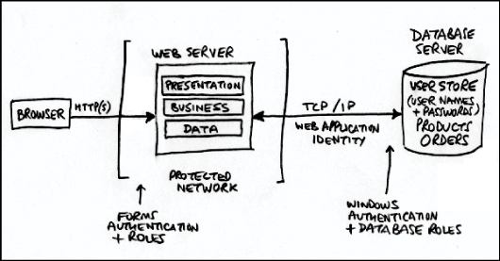
Draw a diagram
Notes:
Big complex systems that take years to write need diagrams to understand them.

Slide 12
How to play
Deal out all the cards
Play hands (once around the table)
  Connect the threat on a card to the diagram
  Play in a hand stays in the suit
Play once through the deck
Take notes:
  Player Points Card Component Notes
  _____ ____ ____ _________ ______________
  _____ ____ ____ _________ ______________
Notes:
Replaced standard suits with cards based on STRIDE
Come in a box like this
As you deal, explain the rules
Appoint a note-taker

Slide 13
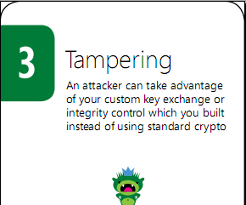
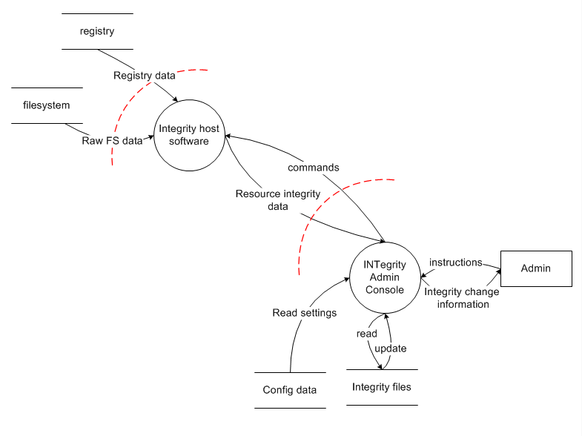
Example
Notes:
Let me explain this diagram before the cards
Alice plays 3 tampering
“An attacker can take advantage of your custom key exchange or integrity control which you built instead of using standard crypto”
As security people, we just know that’s something you don’t want to do

Slide 14
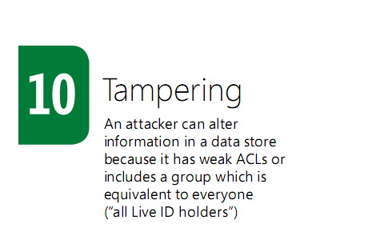
Bob plays 10 of Tampering
Notes:
Bob plays 10 of Tampering
“An attacker can alter information in a data store because it has weak ACLs”

Slide 15
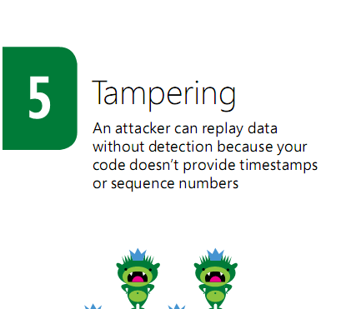
Charlie plays 5 of Tampering
Notes:
Charlie plays 5 of Tampering
“An attacker can replay data without detection because your code doesn’t provide timestamps or sequence numbers”

Slide 16
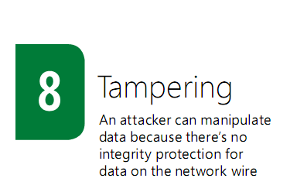
Dan plays 8 of Tampering
Notes:
Dan plays 8 of Tampering
“An attacker can manipulate data because there’s no integrity protection for data on the network”
Encryption isn’t enough! We need to integrity protect the data, too!
And so Bob wins this hand with the 10, and will start the next hand, selecting what suit to lead.

Slide 17
Rules
Must play in suit if you can
High card wins the hand
  Unless there’s a trump (elevation of privilege card)
Aces are for threats not listed on the cards
1 point for each threat, 1 for the hand

Slide 18
After you play…
Finish up
Count points
Declare a winner
File bugs
Notes:
What the winner gets
We’ve seen it work for people getting started around Microsoft and around the world

Slide 19
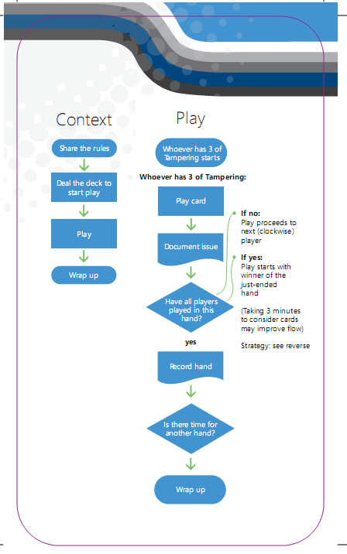
Why does the game work as a tool?
Attractive and cool
Encourages flow
Requires participation
  Threats act as hints
  Instant feedback
Social permission for
  Playful exploration
  Disagreement
Produces real threat models

Slide 20
Attributes of Effective Games
Clearly Communicate Objectives and Goals
Distributed Problem Solving
Motivate the “Crowd”
  Player vs. Player
  Player vs. Self
  Player vs. Environment
Employees Want What Gamers Want
  Fairness
  Transparency
  Feedback
Easy to Scale Activities

Slide 21


Attributes of Effective Games
 | Core Work Skills | Unique Work Skills | Future Work Skills
In-Job Behaviors
Organizational Citizenship Behaviors
Notes:
Future work skills == expanding work skills

Slide 22
Elevation of Privilege is Licensed
Creative Commons Attribution
… Go play!
http://www.microsoft.com/security/sdl/eop/
Notes:
Creative Commons attribution license allows you to do what you want with the game

Slide 23
Call to Action
Play Elevation of Privilege!
  Cards, scoresheets at http://www.microsoft.com/security/sdl/eop/
Check out the other games at Defcon this weekend
  CTF, Hide & Seek
Make your own games!
  Art of Game Design: A book of Lenses is a great resource

Slide 24

© 2010 Microsoft Corporation. All rights reserved. Microsoft, Windows, Windows Vista and other product names are or may be registered trademarks and/or trademarks in the U.S. and/or other countries.
The information herein is for informational purposes only and represents the current view of Microsoft Corporation as of the date of this presentation. Because Microsoft must respond to changing market conditions, it should not be interpreted to be a commitment on the part of Microsoft, and Microsoft cannot guarantee the accuracy of any information provided after the date of this presentation.
MICROSOFT MAKES NO WARRANTIES, EXPRESS, IMPLIED OR STATUTORY, AS TO THE INFORMATION IN THIS PRESENTATION.

Slide 25
backup

Slide 26
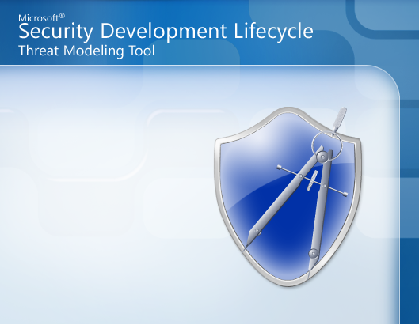
SDL Threat Modeling Tool 3.1
Problem: Threat modeling is a complex activity that only experts can do
  Threat modeling as design analysis, not requirements
Main innovation: Transform threat modeling into an activity that any software architect can perform effectively
Main Approach:
  Simple
  Prescriptive
  Self-checks
Tool
  Guidance in drawing threat diagrams
  Guided analysis of threats and mitigations
  Integration with bug tracking systems
  Robust reporting capabilities
Notes:
Design analysis: show me your threat model. Requirements: what’s your threat model? “

Slide 27
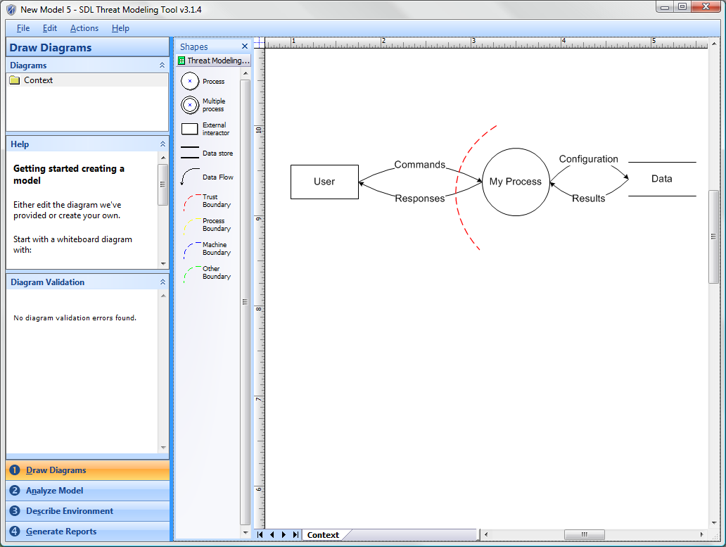
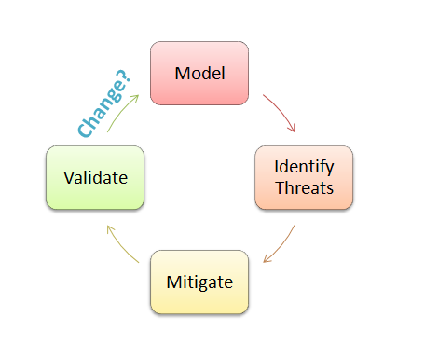
Evolved SDL Approach

