Slide 1


Threat Modeling LLMs
The PHANTOM-B Approach
Adam Shostack

Slide 2
Threat Modeling LLMs
The PHANTOM-B Approach
Blackhat USA
August 2026
Adam Shostack

Slide 3

The Emperor is most displeased with your lack of AI Progress
Notes:
This is the situation: Darth Vader wants you to ship LLMs. And if that’s not bad enough, the Emperor himself will be personally inspecting your project shortly.

Slide 4
Agenda
Threat modeling context
Threat modeling LLMs
The PHANTOM-B approach
  Why PHANTOM-B?
  What is PHANTOM-B?

Slide 5

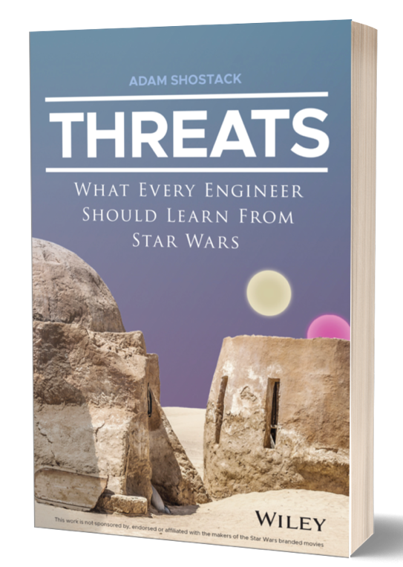

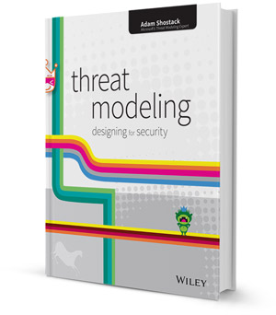






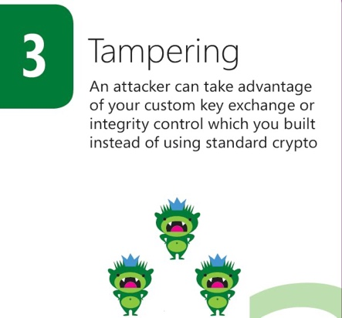
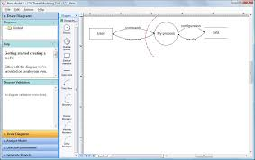



About
Don’t just understand security.
Build it in.

Slide 6
Threat modeling context

Slide 7
What is threat modeling?
Using models to help us think about security
The “measure twice, cut once” of engineering
Applies to both tech you produce or tech you operate
Applies to LLMs you train or get from Huggingface

Slide 8
How do we threat model?
Four Question Framework
  What are we working on?
  What can go wrong?
  What are we going to do about it?
  Did we do a good job?
Widely adopted: Industry + gov standard
  Anthropic, Google, Amazon, MITRE, FDA + more
Threatmodelingmanifesto.org + Shostack.org/whitepapers

Slide 9
Why bother threat modeling LLMs
“Won’t the LLM threat model?”
“My skills say only write secure code!”
“Going fast gets me promoted”
So why bother threat modeling LLMs?

Slide 10
Your executives are really scared
AI disruption is real
Maybe we’re in a bubble, maybe not?
FOMO is rampant
We have to ship AI stuff!

Slide 11
Business works better with threat modeling
Your developers + leaders don’t understand what can go wrong
LLMs change your security posture
  The posture of the code being produced
  The strengths and weaknesses of the latest models
Cognitive debt is getting worse
Change continues to accelerate
Staying focused on what we’re working on is crucial

Slide 12
Threat modeling is the security technique that best survives AI disruptions
Notes:
Not unchanged

Slide 13
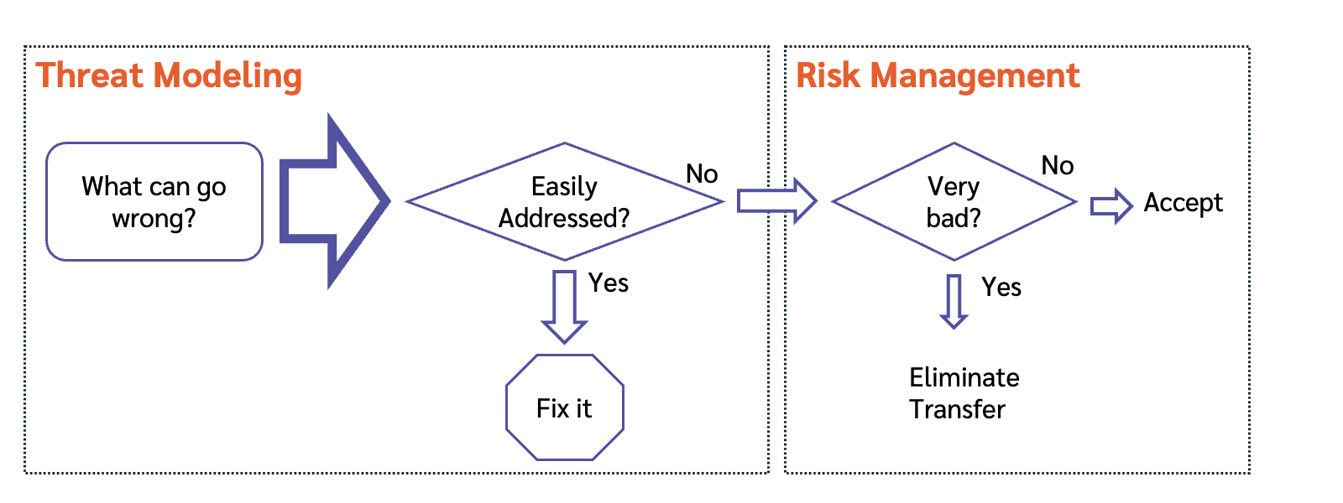
Threat modeling can drive risk management

Slide 14
LLMs also disrupt threat modeling

Slide 15
PHANTOM-B origin story (preview)
AI disrupted threat modeling in two ways
  Using AI to threat model
  Threat modeling AI systems
Clients looking for
  AI focused training
  Lower training cost (“Can we make this faster?”)
Analyzing the state of the art
  Reviewed and wrote at length about available threat catalogs

Slide 16
Threat Modeling vs red teaming
Yonton Zungler (Microsoft Deputy CISO, AI) top three security:
  Design systems, not software
  Know what can go wrong, and have a plan
  Upate your threat model continuously
“Lessons From Red Teaming 100 Generative AI Products”
  Lesson #1: “Understand what the system can do and where it is applied” and “The human element of AI red teaming is crucial”

Slide 17
Threat modeling LLMs

Slide 18
Four scenarios: Using AI in…
Offense (write me a phishing email/malware/etc)
Defense (anti-spam, Microsoft defender copilot)
Software development
Business (Today’s focus)
Offense
Defense
Software
Business

Slide 19
What are we working on with AI?
Adding an LLM to our business
  Chatbots
  Document processing
  Search
  Decision making
We should ask “what can go wrong?”

Slide 20
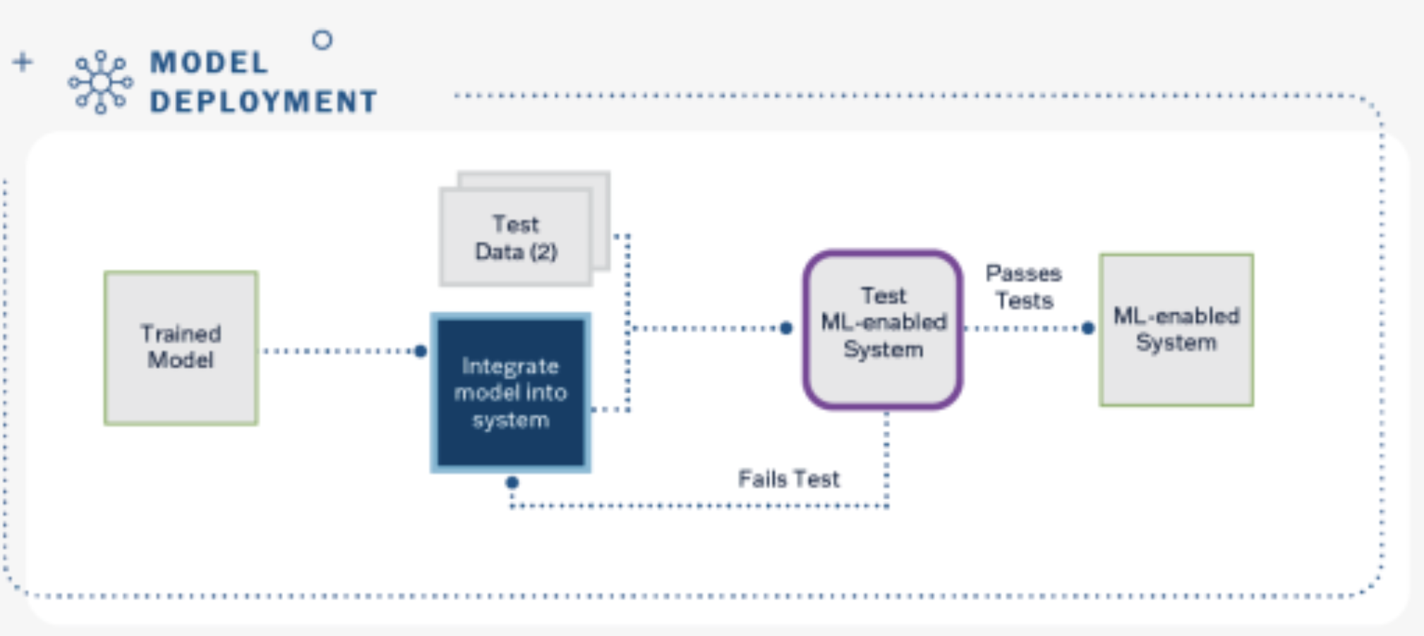
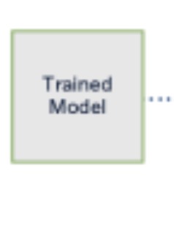
You are here
Huggingface
Not Here

Slide 21
What can go wrong with AI?

Slide 22
Lots of sweeping talk about AI
Threat
Catalogs
Laws
(EU AI Act)
(Harms, Risks)
Frameworks
(NIST AI RMF)
(“Risks”)

Slide 23
What are WE working on?
Executives
Laws
(EU AI Act)
(Harms, Risks)
Frameworks
(NIST AI RMF)
(“Risks”)
Threat
Catalogs
Engineers

Slide 24
Many AI threat catalogs —
Ways to answer “what can go wrong”
Berryville’s ML + LLM Risk Analyses
OWASP Top 10 LLMs
OWASP AI Exchange
MITRE ATLAS
NIST AIML E2025
Google SAIF
…
Threat
Catalogs
Structured ways to answer
“What can go wrong”
More organized than ”We’ll red team it”

Slide 25
The PHANTOM-B Approach

Slide 26
Why PHANTOM-B?

Slide 27
The alternatives suck
All models are wrong,
some models are useful.

Slide 28
What goes wrong with TM structures?
(Each “for some users”)
High training cost (learning is hard)
Hard to use (even after training)
Not LLM/AI focused
Duplicative/overlaps other frameworks/security work
Raises threats which are irrelevant/can’t fix/won’t fix
  “Academic”
Low return on investment
Require software support

Slide 29
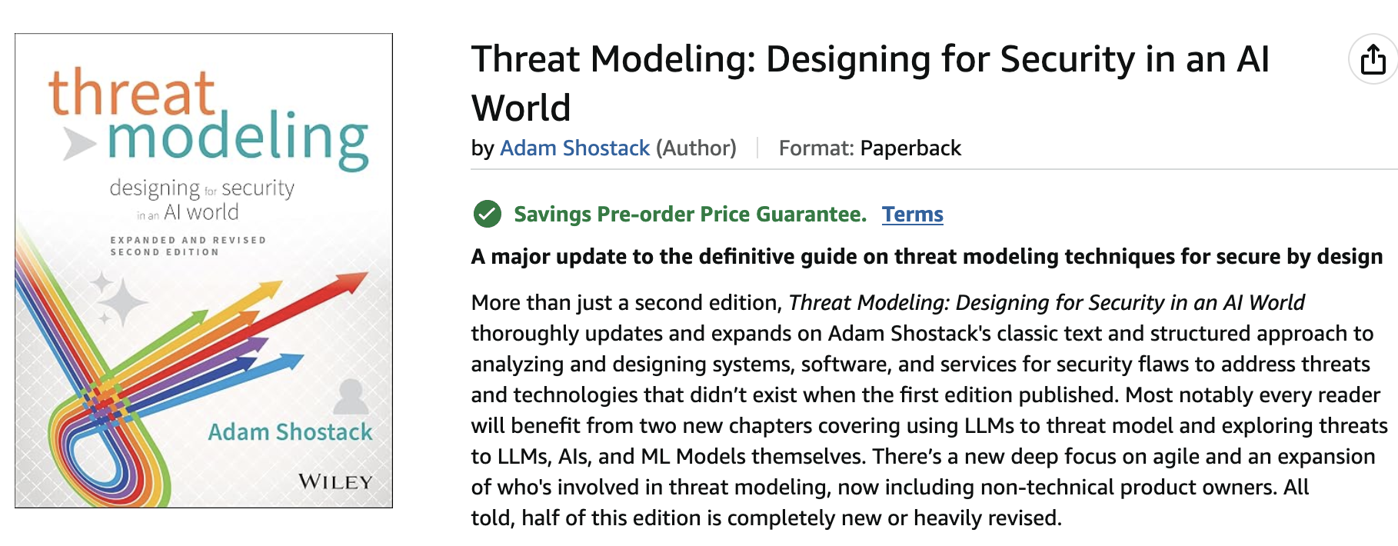
PHANTOM-B origin story (1/2)

Slide 30
PHANTOM-B origin story (2/2)
Built and iterated over several versions
  On our own projects
  With hyperscalers, globally significant banks and others
Earlier versions didn’t meet our release quality bar
  TRAPHOME
  PHANTOMED

Slide 31
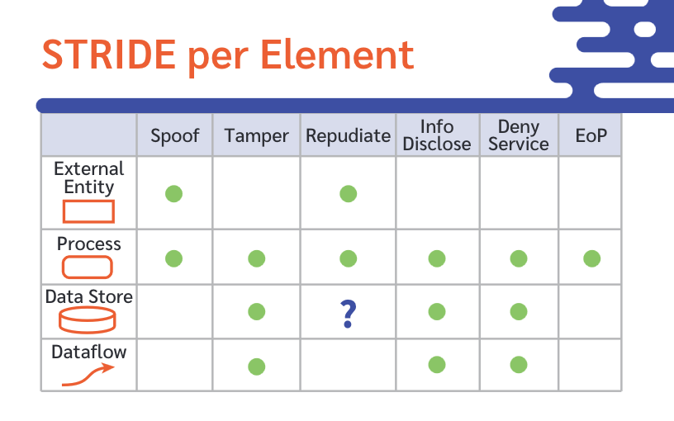
PHANTOM-B is inspired by STRIDE
[Spoofing, Tampering, Repudiate, Info disclose, DoS, Expand Authority]
Time-tested + durable mnemonic from Kohnfelder + Garg
STRIDE remains broadly applicable
Notes:
Expansion of authority is the modern replacement for Elevation of privilege – see the Threats book for a chapter-long explanation

Slide 32
PHANTOM-B identifies:
“What can go wrong deploying AI?”
Prompt injection
Hallucination
Anthropomorphization
Non-explainable
Training issues
Over-reliance
Missing security engineering
Bias
Free to use (CC-BY)
Memorable
100% threat-focused
Fits on a wallet card

Slide 33
Focused on using/calling LLMs
Under your control (on your GPUs or Amazon Bedrock)
  “Downloaded from Huggingface”
An LLM provider offers, such as ChatGPT or Claude
  Via the API
  (Not useful for “using chatgpt.com in a browser”)

Slide 34
Prompt injection
Controlling LLM behavior via input
  Code/data confusion
More than just funny stories
  Bypasses your controls and gets the LLM to violate rules
  Unlike SQLi, no deterministic, proven defenses exist
Notes:
https://www.nist.gov/news-events/news/2026/06/nist-mathematical-proof-supports-transition-continuous-monitor-and-update

Slide 35
Hallucination
The LLM makes stuff up
The LLM makes up stuff we don’t like:
  Bad code
  False citations

Slide 36
Anthropomorphization
Means treating the LLM as a human
This is great product design
  Use of language and “I” are a facade
LLMs are token generators
  Not concept models
  Not thinking beings
“Don’t do X” for humans and token generators
No guilt, no learning, no desire to improve

Slide 37
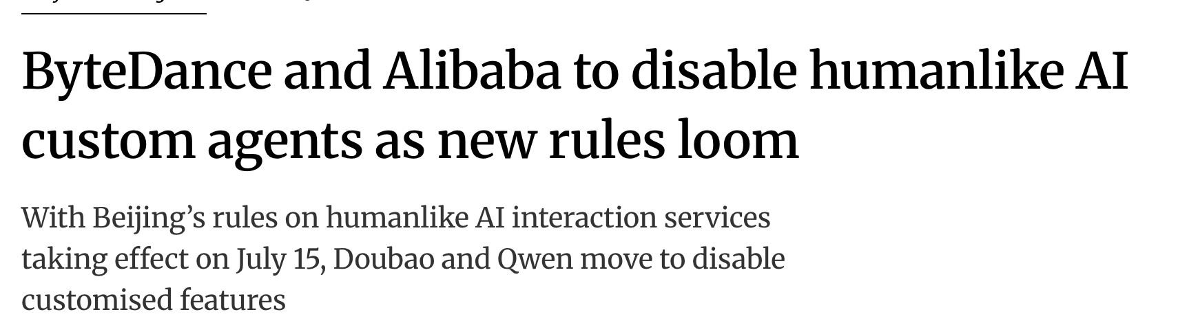
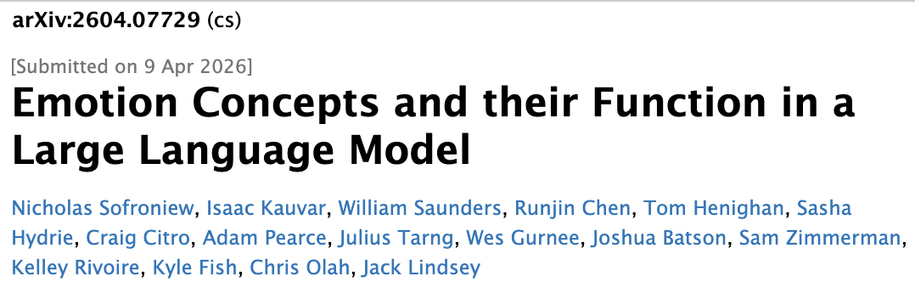
Chew up tokens!
Notes:
https://www.scmp.com/tech/big-tech/article/3359482/bytedance-and-alibaba-disable-humanlike-ai-custom-agents-new-rules-loom
https://arxiv.org/abs/2604.07729

Slide 38
Non-explainable
We can’t tell why we got important results
Explainability as “why did it actually do that?”
Not asking “why did you do that?”
  LLMs produce plausible answers, not accurate ones
More important as LLM makes decisions
Explainability for various audiences
  Data scientists
  End users (eg, medical LLM explaining — accurately — to patients + doctors)
  Courts

Slide 39
Training issues
LLMs do better as we give them more data
So your LLM was probably trained on Stack Exchange, Reddit + Twitter
Good luck finding that in the model card!
Data poisoning is “scale invariant” with 250 documents
Souly, et al, Poisoning Attacks on LLMs Require a Near-constant Number of Poison Samples, 8 October 2025,
https://arxiv.org/abs/2510.07192

Slide 40
Over-reliance on the LLM
We trust the LLM and don’t pay close attention
LLMs generate a lot of text / code
  Hard to focus on
  Often okay
Hard to remain vigilant
Your code, your brand 🤷
Making decisions about hiring, college admissions, arrests… 🤯

Slide 41
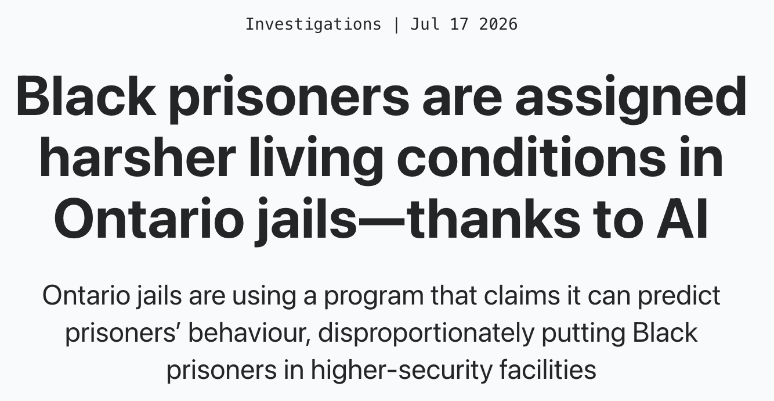
Notes:
https://breachmedia.ca/black-prisoners-are-assigned-harsher-living-conditions-in-ontario-jails-thanks-to-ai/

Slide 42
Missing security engineering
We assume you still have software security, this ties to it
LLMs are software
  All software has bugs
  Some bugs are security-relevant
PHANTOM-B augments STRIDE, kill chains, SDLs
PHANTOM-B was aggressively de-duped
  For example, MCP has lots of spoofing and expansion of authority issues
  Not included in PHANTOM-B because you have other security engineering

Slide 43
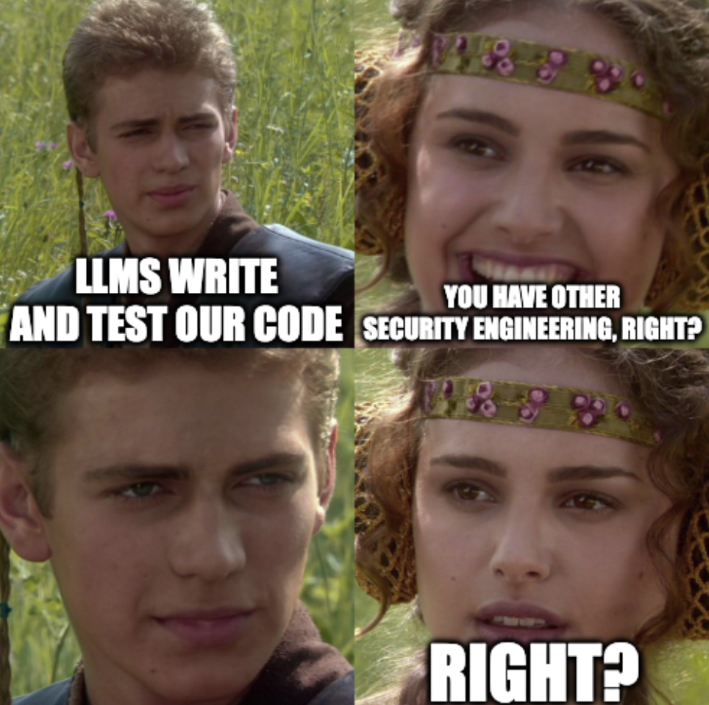

Slide 44
Bias
Does the LLM treat groups unevenly?
Does it display the board of directors as white men?
  How about the janitorial staff?
Inherited from data pipeline
  Bias in the data, cleaning, training, tuning processes
  You can’t remove it, but you can understand it
Often in the eye of the beholder
Defined by law. Certain decisions have “protected groups”
Notes:
https://arxiv.org/abs/1609.07236 On the (im)possibility of fairness

Slide 45
PHANTOM-B identifies:
“What can go wrong deploying AI?”
Prompt injection
Hallucination
Anthropomorphization
Non-explainable
Training issues
Over-reliance
Missing security engineering
Bias

Slide 46
Using PHANTOM-B
“What can go wrong”
Many broader than “the math”
Product-manager or exec suite

Slide 47
PHANTOM-B illustrates why TM matters
Engineering requires tradeoffs between unsatisfiable constraints
  Features, reliability, speed, cost, quality ... and security
  Building security in is better than bolting-on controls
Before you write (or vibe) a line of code, consider what can go wrong
  Threat modeling lets you do this via the Four Questions
  PHANTOM-B lets you do this for LLMs
This gives you the most options for what are we going to do

Slide 48
Summary
Threat modeling enables strategic views of security
What can go wrong with LLMs requires innovative approaches
PHANTOM-B balances coverage + accessibility

Slide 49
Bonus!
Today: Book signing – bookstore, Breaker Rooms @ 12:45
Thursday: AI Threat Modeling Community meetup
  Noon tomorrow “The Convergence, Business Hall”

Slide 50
Thank you!

Slide 51

PHANTOM-B approach to LLM TM
Blackhat USA August 2026
Questions?
Slides:
Shostack.org/blog
adam@shostack.org
Wallet cards, book signing at
Bookstore, 12:45 PM today
Meetup, The Convergence,
Noon tomorrow

Slide 52
Shostack + Associates
Supporting Materials
Don’t just understand security.
Build it in.

Slide 53

Free resources
shostack.org/resources
shostack.org/blog
youtube.com/c/Shostack
Books
Linkedin Learning
Books free at your library/various subscriptions; Linkedin Learning via work

Slide 54
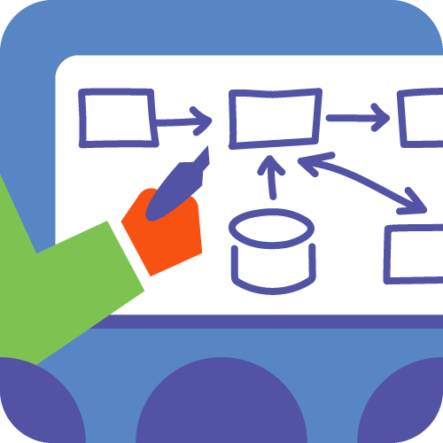

Commercial offerings
Training
  From under an hour to multi-day
  Live instruction or computer-based
  In-person or distributed
  Private corporate courses
Accelerator
  Culture change, process design
Assessments + analysis

Slide 55

info@shostack.org shostack.org/contact

Slide 56
backup

Slide 57
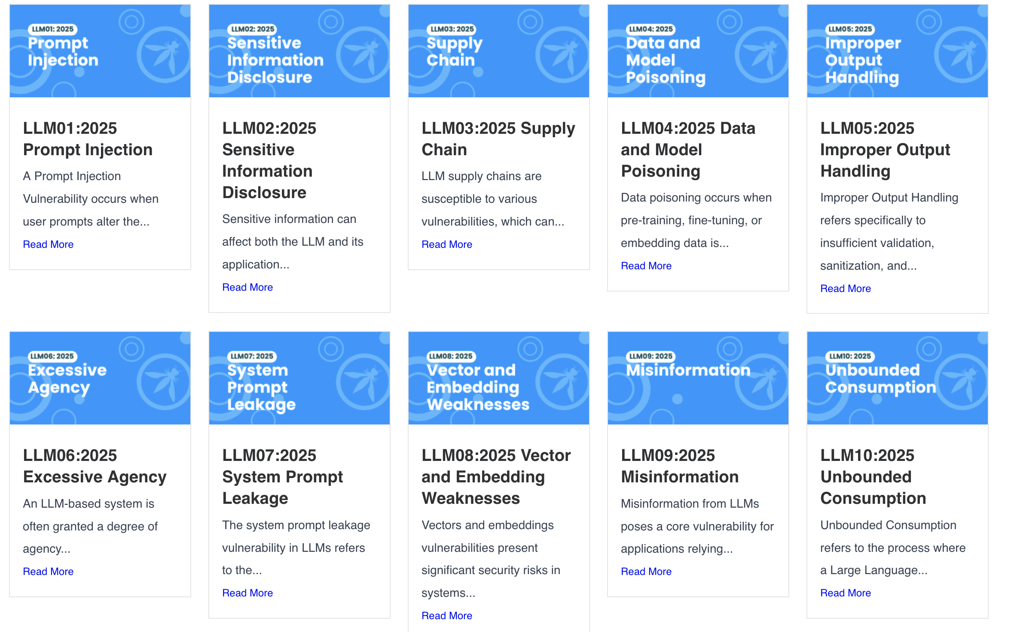
https://genai.owasp.org/llm-top-10/

Slide 58
X
X
X
https://genai.owasp.org/llm-top-10/
X
X

Slide 59
Berryville Institute of Machine Learning
Think tank of security + ML experts studying machine learning sec https://berryvilleiml.com/
Taxonomy of threats (2019)
  Manipulation of input, data, models
  Extraction of input, data, models
Architectural Risk Analysis of a generic ML system (2023)
ARA for LLM (2024)
Elevation of ML card deck!
Annotated bibliography
https://agilestationery.com/collections/security/products/elevation-of-machine-learning-security-card-game

Slide 60
