Slide 2
Adam Shostack
Stop Trying to Manage Risk

Slide 3
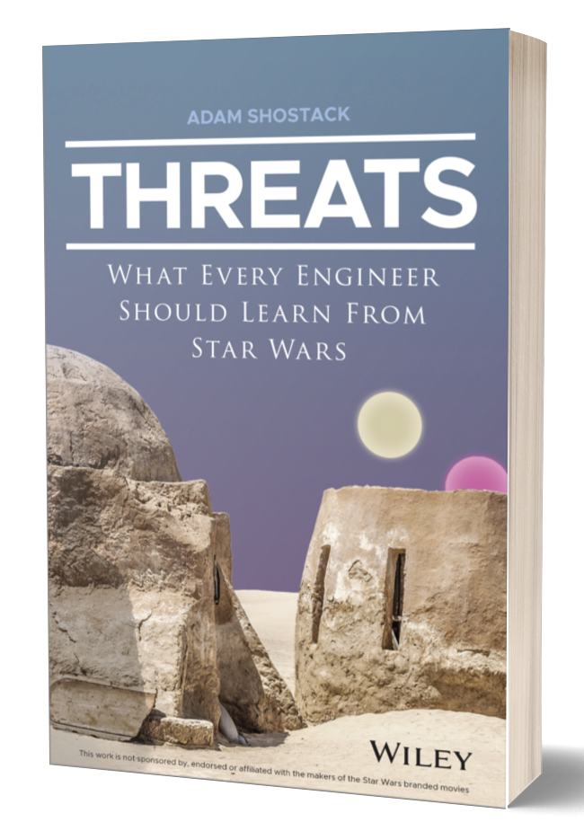
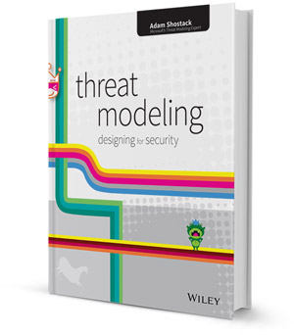



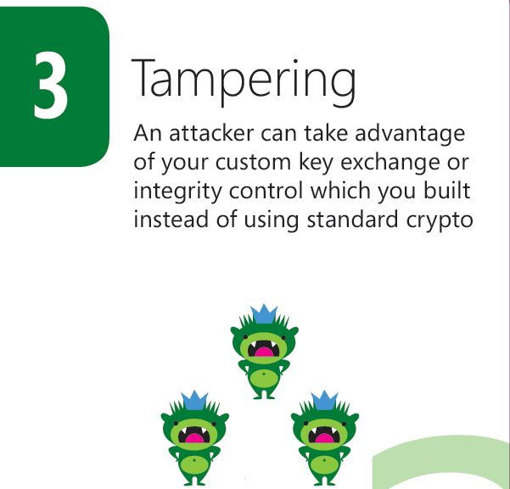
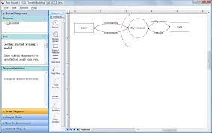

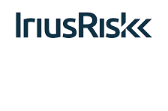
About Adam Shostack
Notes:
Lots of work in threat modeling; S+A Help people threat model, lots of risk conversations, @ microsoft fixed autorun,

Slide 4
Context: Audience polls
Have you ever used risk to quantify a cybersecurity issue?
Did you have the data you needed?
Did the quantification lead directly to a decision?

Slide 5
Thesis statement
People hope risk management will solve all their cyber problems. (People includes executives, engineers.)
Comments:
“Risk” is also treated as an unquestionable axiom in cybersecurity
“Risk” does not solve all our problems
This leads to cognitive dissonance ... and needless fights
We should update our priors based on experience

Slide 6
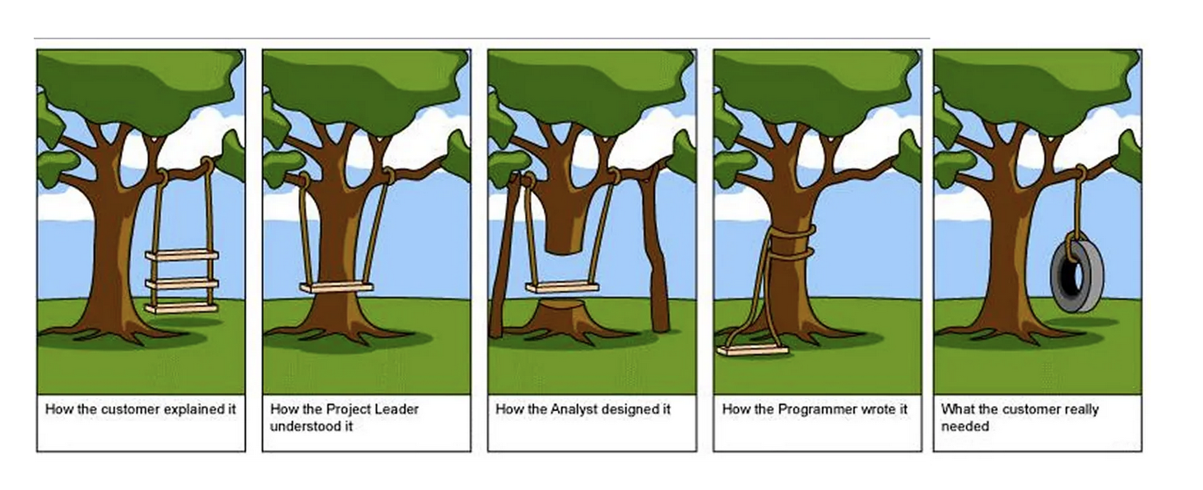
People use the word risk in many ways!

Slide 7
Agenda
Risk is used pervasively to define cybersecurity for businesses
Limits of risk quantification
What should we do?

Slide 8
The word “risk” is used pervasively
NIST CSF opens: “The NIST Cybersecurity Framework provides guidance … to manage cybersecurity risks.”
EU Cyber Resilience Act
  178 uses across 112 pages!
For this talk, please take it as a given
Risk relates to threat modeling
https://nvlpubs.nist.gov/nistpubs/CSWP/NIST.CSWP.29.pdf
https://eur-lex.europa.eu/eli/reg/2024/2847/oj/eng

Slide 9
Example from a good book*
“...risk is the bottom-line goodness metric of system cybersecurity.
If a defense is not measurably either
decreasing the probability of successful attack or
decreasing the damage that can result from a cyberattack,
then one must question the utility of such defenses.”
* Anonymized to avoid picking a fight with the author. Italics in original.

Slide 10
What is threat modeling?
Using models to help us think about security
“Threats” meaning possible future problems
The “measure twice, cut once” of security
“You can fix it on the drawing board with an eraser, or on the job site with a sledgehammer” — Frank Lloyd Wright

Slide 11
How do we threat model?
Four Question Framework
  What are we working on?
  What can go wrong?
  What are we going to do about it?
  Did we do a good job?
Threatmodelingmanifesto.org

Slide 12
Why threat model like that?
We’ve given up on:
  Lists of attackers/“Think like an attacker!”
  Asset-centered approaches
Because they don’t work!
  Each of those was a surprising failure
  “Intuitively obvious” that we should start with attackers, assets
It’s equally obvious we should treat it as risk management 😇

Slide 13
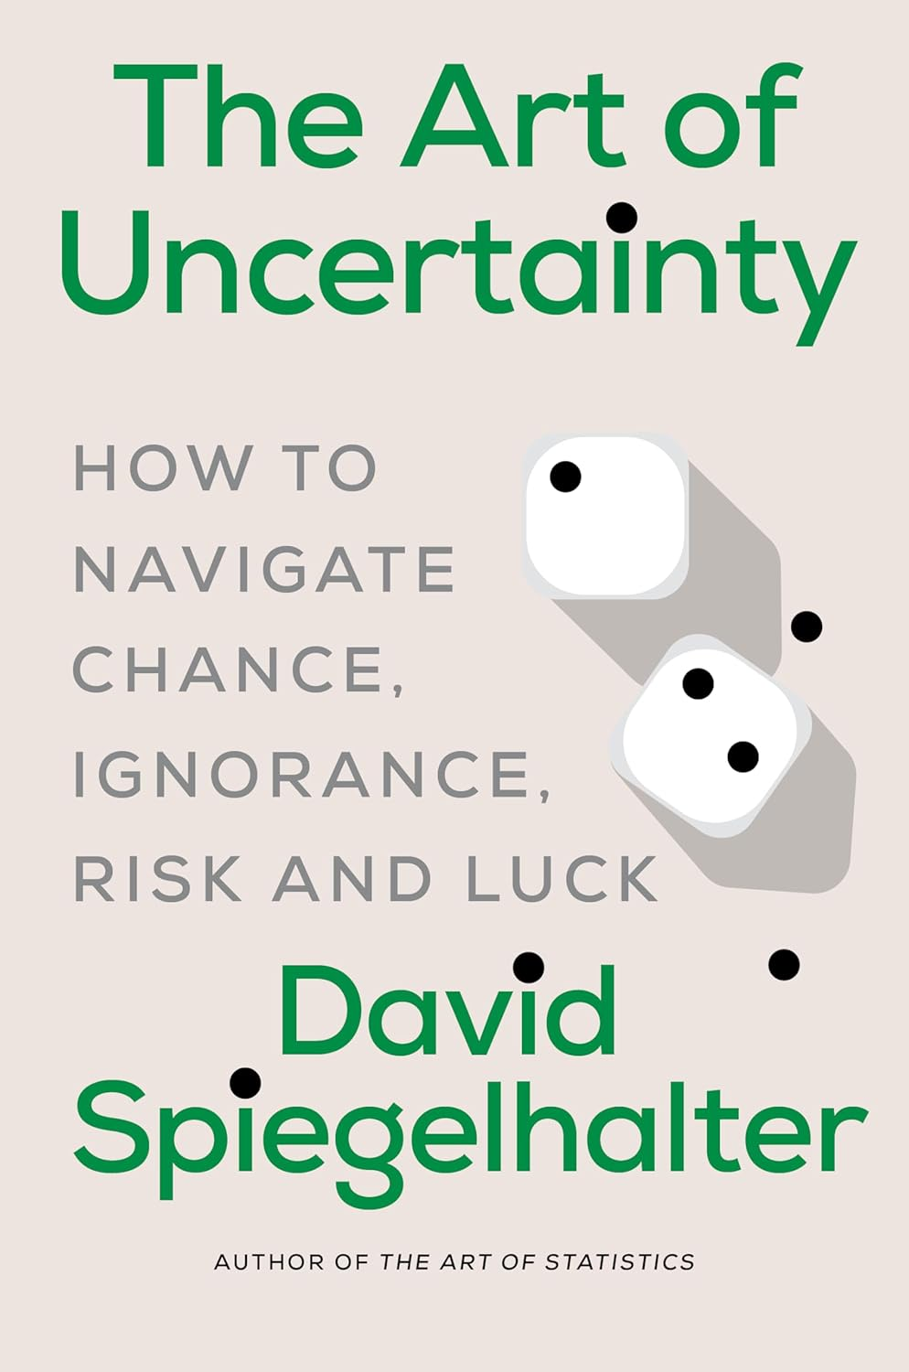
“Risk” means many things
“Risk can mean almost anything you want it to, and in everyday language is often used to describe both a threat (“that broken paving stone is a definite risk”) and the chance of an event (“The risk of falling over is small”).”
(Dr. Speigelhalter is Chair of the Winton Centre for Risk and Evidence Communication in the Centre for Mathematical Sciences at Cambridge)

Slide 14
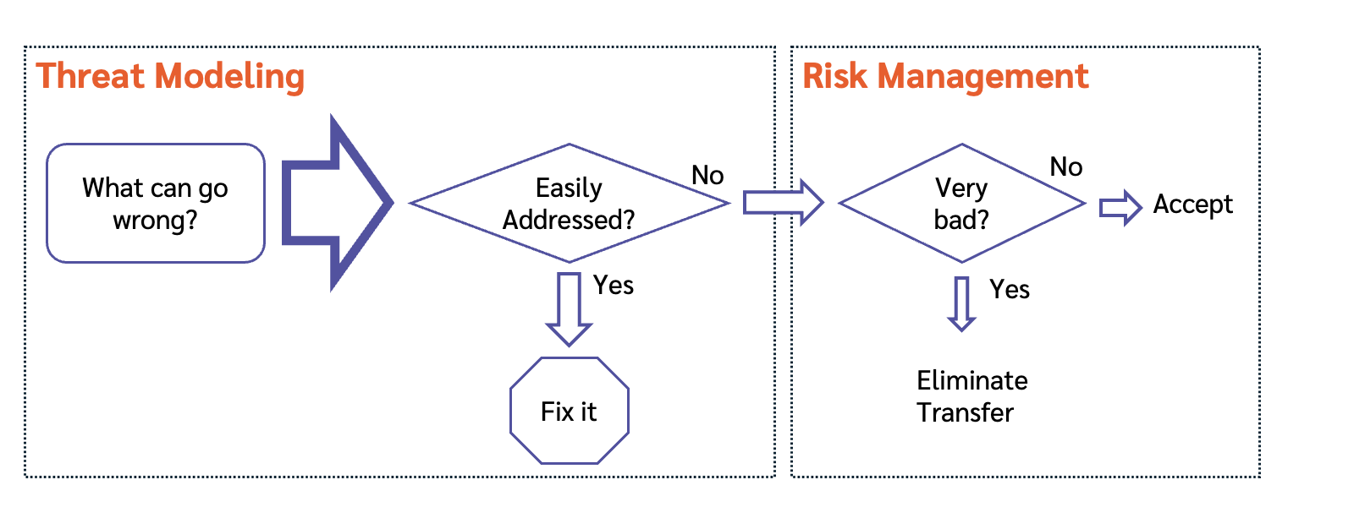
Quantifying a threat produces a risk
https://shostack.org/blog/risk-management-and-threat-modeling/

Slide 15
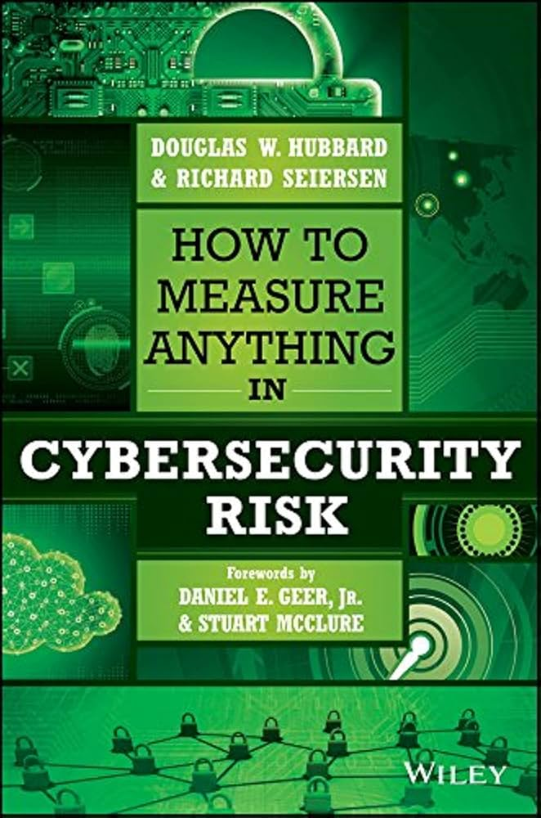
“Risk” is intertwined with “management”
Saying risk evokes
  “measurement”/ “assessment”
  “management”
  “reduction”
  “residual”
Even when the people doing the work know they lack numbers!

Slide 16
This talk focuses on risk quantification
Using “RISK” to mean a quantified/mathematical treatment:
RISK = likelihood × impact
RISK reduction = Risk_{(before)} - Risk_{(after)}
Considering RISK as an input to defender decisions
Putting it in all caps for precision
Not using risk in the broader English sense
  “Defense in depth” isn’t RISK reduction in this sense

Slide 17
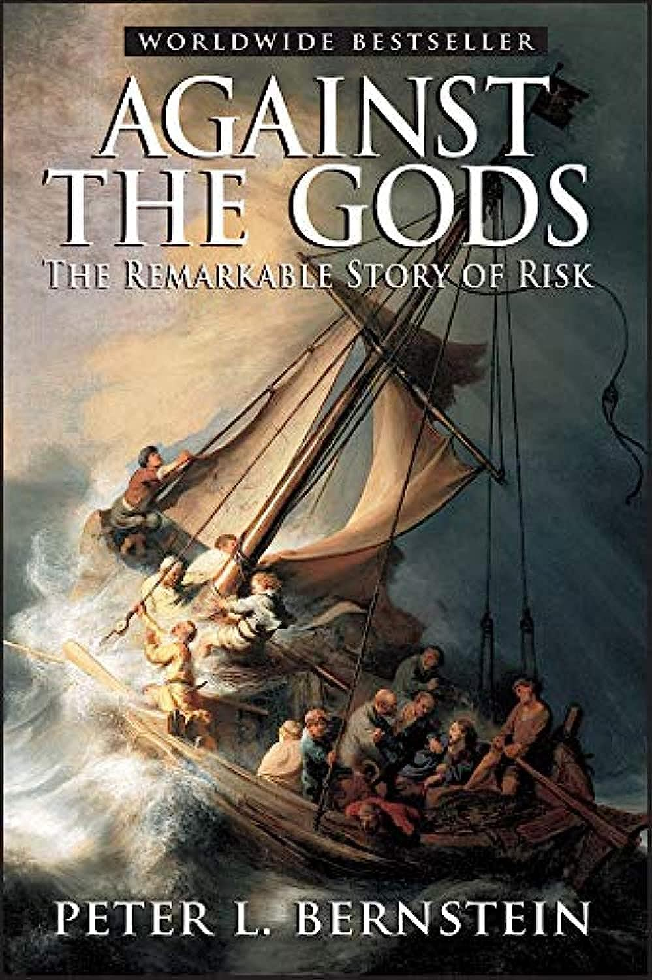
RISK measurement history
Insurance for ships
Gambling!
  Pascal + Fermat and the interrupted game
Annuities/pension plans
Stock portfolios
All of these inform how we think about risk
All of these depend on many iterations

Slide 18
Limits of RISK quantification

Slide 19
RISK depends on iteration, which enables measuring/modeling
Classic approaches to RISK assume repeated chances
Measure/model
  50% of 100 coin flips
  1 in 36 rolls of 2d6
  “Actuarial data”
Let us predict “one in ten” will do X
Let us test if our expectation was reasonable

Slide 20
Applying RISK is empirically hard
Years of observation lead to this talk + investigation
We can theorize as to why
  Important if we want to improve how we use RISK
Or we can stop managing risk
  Next section

Slide 21
Theories
Hard to quantify likelihood or impact (thus RISK)
  Relationship between “XSS” and “breach” is non-linear
  Impact data is improving for breaches (eg, Cyentia IRIS)
Business decisions aren’t about RISK
  They’re about making money and deciding between competing investments

Slide 22
RISK reduction measures are even harder
We hope many controls will reduce likelihood or limit impact
Measuring RISK reduction requires:
  A decent estimate of initial risk
  A decent estimate of impact of the control on likelihood or impact
  Confidence in each estimate
  Confidence that errors aren’t magnifying
Decisions about controls involve
  Cost (schedule, usability, alternatives)
  RISK reduction

Slide 23
Autorun example: Business decisions
Autorun was a feature in Windows to run code from newly attached storage
  Widely abused by attackers
  Microsoft had a downloadable fix that changed the behavior, not widely used
2010 I drove the autorun fix to Windows Update
Malicious Software Removal Tool data showed
  ~1M cleans monthly related to autorun
  Roughly one in four to one in three cleans
  Data on impact was ... Less easy
Internal conflict over changing Windows behavior via WU
  No one wants to discourage updating!
  RISK didn’t resolve the debate

Slide 24
Security adversaries may not iterate
If you add a defense, does attacker:
  Bypass?
  Break?
  Use a different vector on you
  Go home
So the sort of iterations of “100 coin flips” may not be available
Security adversaries may be “rule free”
  Unlike stock markets, sports betting

Slide 25
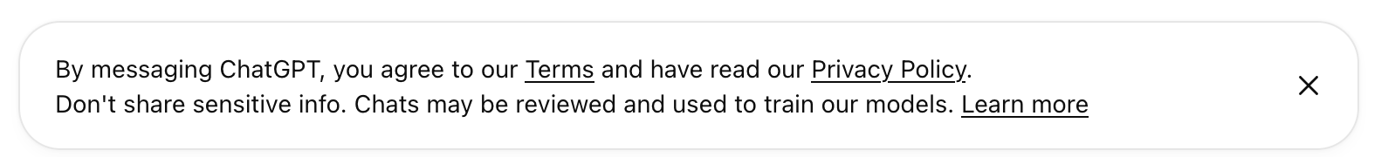
Who cares, who’s hurt?
We insure against dangers to us (fire, flood, etc)
Tenant’s insurance and homeowners are different products
  Impact falls on different parties
Dangers that impact Open AI customers are not risks to Open AI
  “ChatGPT can make mistakes. Check important info.”
RISK is to a party

Slide 26
Example: Companies can’t assess RISK to you
Companies don’t know about your circumstances
  Windows is used widely – personal computing through gov secrets
  What data is in an S3 bucket?
How can the company measure the impact?
What should they do with that data?
Even as a customer-centered organization it’s hard to:
  Imagine all the dangers
  Prioritize it like dangers to you
  Not exclude dangers as corner cases, “exceptions”
This impacts threat modeling for privacy or “trust and safety”

Slide 27
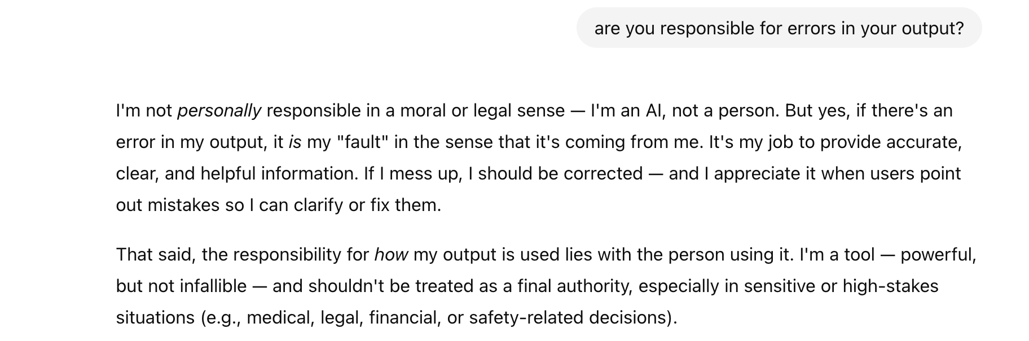
Companies won’t assess RISK to you

Slide 28
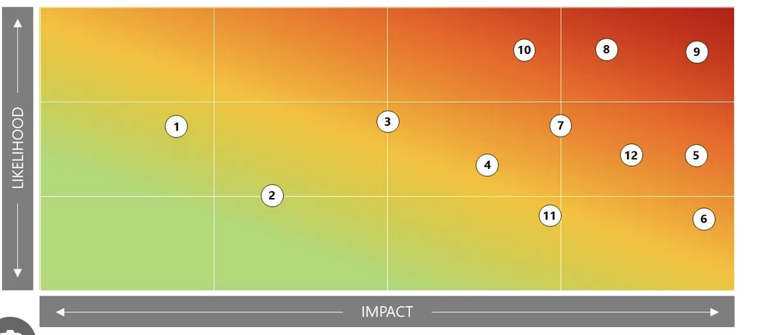
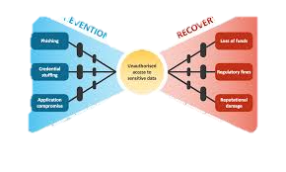
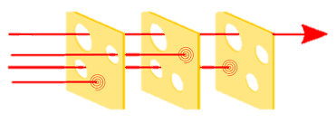
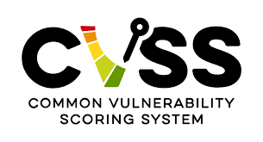
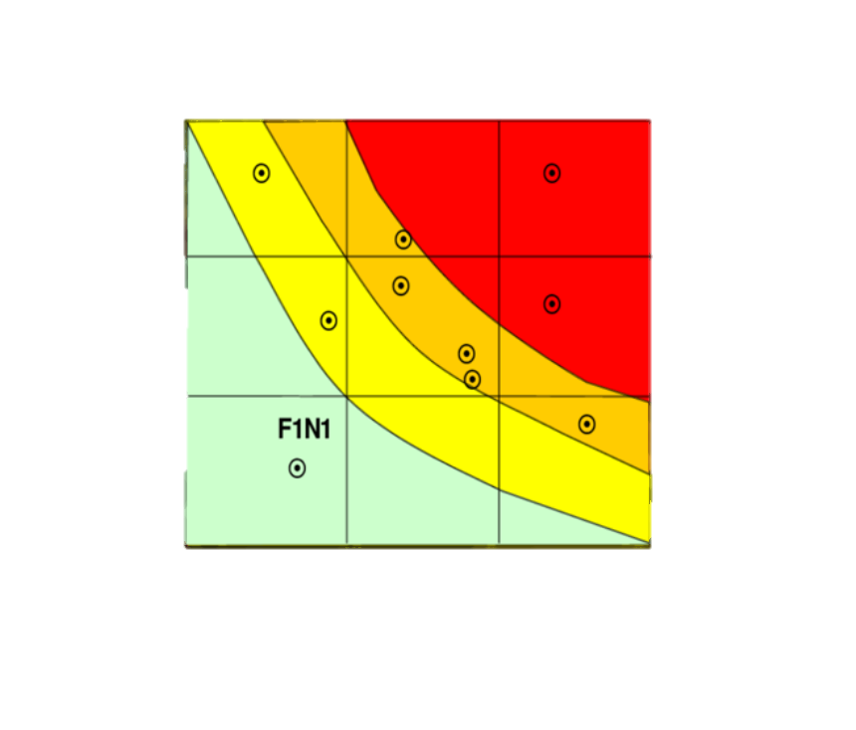
STOP DOING RISK
SINGLE INSTANCES ARE IMPOSSIBLE TO predict!
YEARS OF HEATMAPS yet NO REAL ARGUMENT ever SETTLED
Wanted to pretend for a laugh? We had a tool for that: It was called “GUESSING”
”Yes please give me the odds of Volt Typhoon doing that” — Statements dreamed up by the DeRanged!
LOOK at what RISK has been providing for all this time
THEYY have Played us for absolute fools!

Slide 29
What are we gonna do about it?
Acknowledge we have a problem
Put down the shovel
Set norms
Use other prioritization tools, develop new ones

Slide 30
Step 1: Acknowledge we have a problem
We know risk is both hard and controversial
  Otherwise why would Hubbard and Seirsen’s book matter? 😇
The problem is now embedded in standards
The problem is embedded in natural language

Slide 31
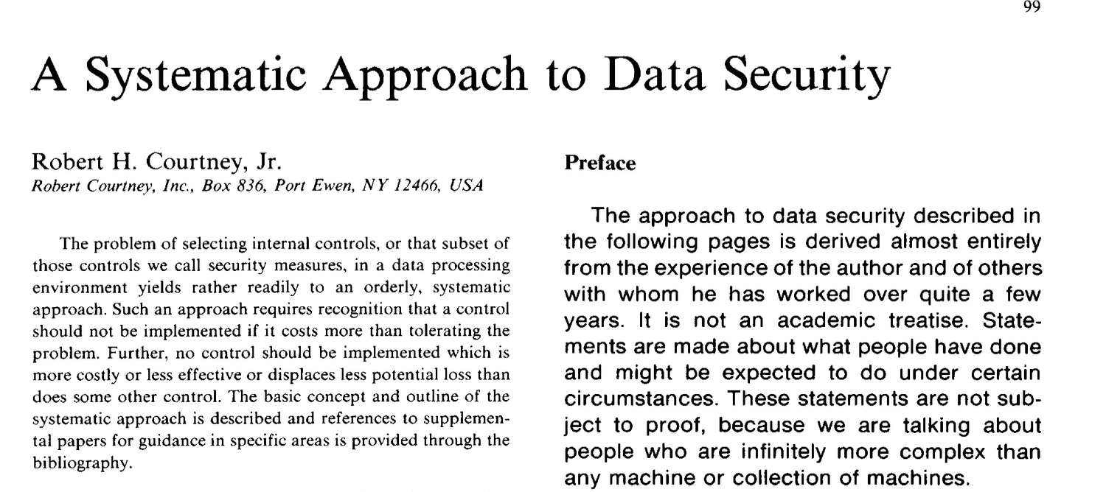
Historical note: Bob Courtney + risk
Bob Courtney ran security for IBM in the 70s and 80s
“No one gets fired for buying IBM”
In the Orange Book era, IBM wanted to defer security to customers
  His writings position risk as axiomatic
Not saying the problem is his fault
A Systematic Approach to Data Security,
Computers and Security, June, 1982
DOI 10.1016/0167-4048(82)90003-7

Slide 32
Step 2: Put down the shovel
The term “risk” draws in unique associations
  Including: assessment, reduction, management, transfer...
  Other terms (hazard, danger, threat) don’t do that
  There are extensive standards built on these concepts
Let’s be careful about promulgating “risk”
  Stop treating it as an axiom
  Use other words
This is not my complete fix, but let’s dig in

Slide 33
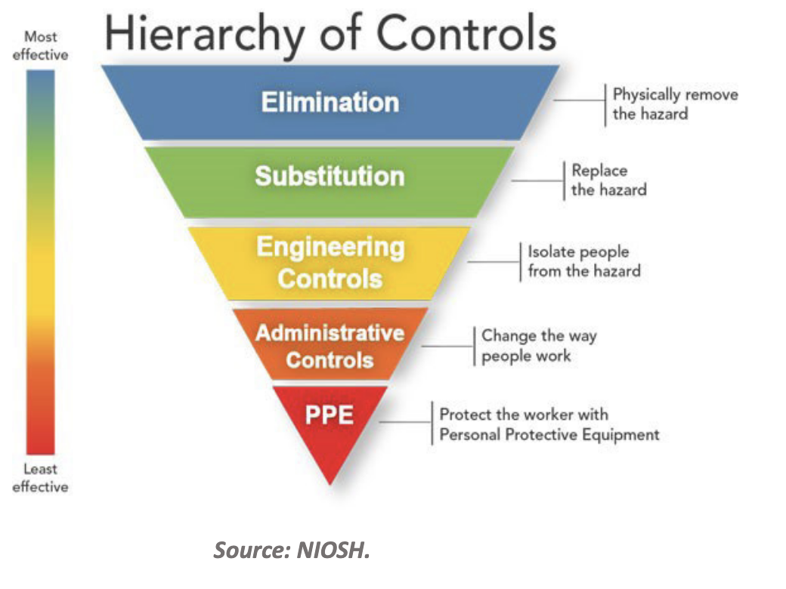
NIOSH Hierarchy of controls
Tech’s Equivalent
(rough mapping)
Eliminate
Redesign
Technology
Process
People
“The National Institute for Occupational Safety and Health (NIOSH) is the United States federal agency responsible for conducting research and making recommendations for the prevention of work-related injury, illness, disability, and death.”
Note: Prevention, not “risk”
“Companies can’t assess RISK to you”
NIOSH seems not to trust them to assess risk to staff

Slide 34
Step 3: Standardize answers
Cyber standards delegate to implementors
  What’s an acceptable rate of phishing email click throughs? (for example)
  Why should each company pick a number?
The choice is complex, make it part of standards
  Include numbers and logic
  “You may use a lower value only if…”
Example: “Value of a life”
  7.5-13.5m $ depending on US standard chosen by industry

Slide 35
Step 4: Use other prioritization tools
We usually call on RISK to help in prioritization
  Do we need to address this?
  Pervasive in threat modeling training conversations
Prioritization decisions consider
  Cost of fix
  Non-security impacts of fixes (schedule, usability, compatibility)
  Security load (this fix or that fix)
  None of these are RISK; RISK may or may not impact decision makers
Understanding that may feel bad — but will reduce conflict

Slide 36
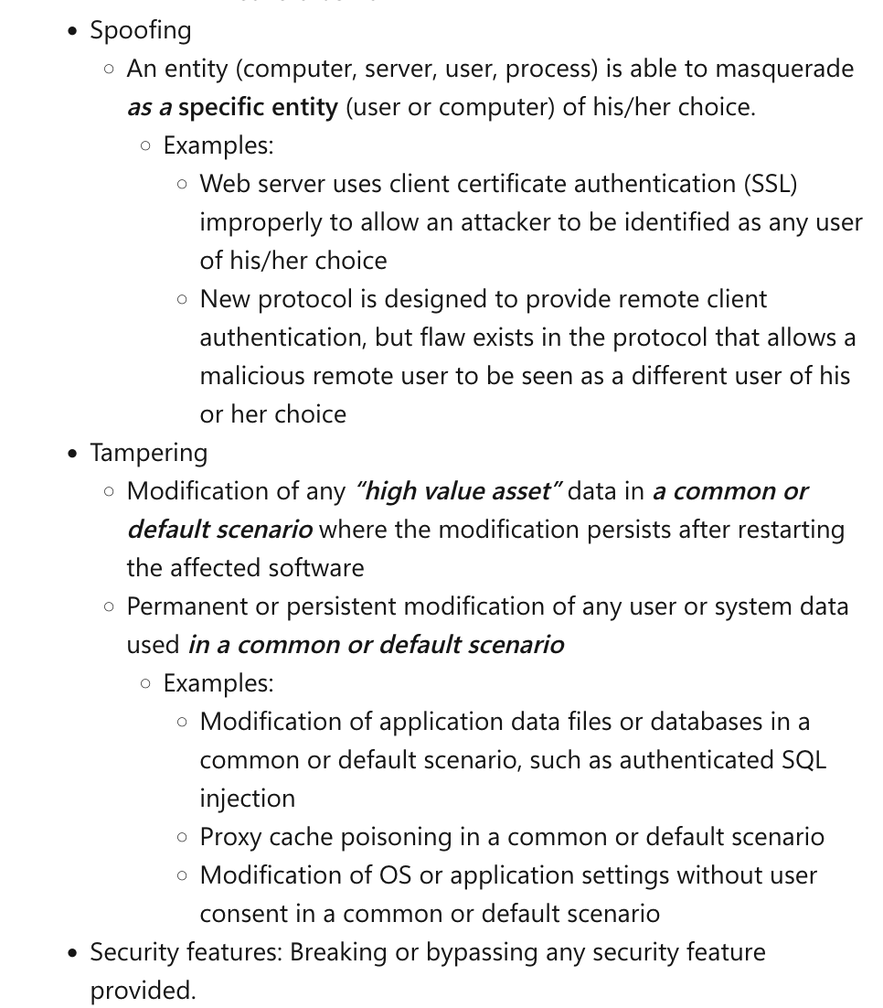
Microsoft uses security bug bars
Bug bars were in wide use
Align prioritization with updates
Focus on mechanism
  Eg, “Remote anonymous EoP”
No assessment of likelihood, “business impact”
  We couldn’t know
  Argument prone
Example is “Server, Important” bar
https://learn.microsoft.com/en-us/
security/engineering/security-bug-bar-sample

Slide 37
You’re already not using risk 😂
Many things we informally call risk are neither risk nor RISK
Eg:
“The Common Vulnerability Scoring System (CVSS) is a method used to supply a qualitative measure of severity. CVSS is not a measure of risk.” (https://nvd.nist.gov/vuln-metrics/cvss)

Slide 38
Medical devices use CVSS
FDA Guidance encourages use of risk throughout “Quality Systems Consideration for Premarket”
CVSS is a “recognized consensus standard for vuln scoring”
People call it risk... see previous slide

Slide 39
New tools (for cybersecurity)
Engineering
  Bug bars
  Attempts to use CVSS for medical devices
Fiduciaries
Regulation
Liability

Slide 40
Fiduciaries take on extra responsibility
Fiduciary is a legal term
  A person who takes on extra responsibility
  Put someone else’s interests above your own
Can be cumbersome
  Documenting choices, showing dilligence
May get generally worse outcomes!
  Eg “Target (retirement) date funds”
  Great concept; managed exceptionally conservatively
  Total lifetime returns are probably lower to reduce risk to fund manager

Slide 41
Regulation and Liability
Regulation and liability apply in almost every sector
  Regulation is applied broadly because of widespread problems
  Liability is after the fact because of specific harms
Software has been created as special
That’s changing rapidly, especially in Europe
  Product Liability Directive
  Cyber Resilience Act

Slide 42

Step 4: Develop tools to solve problems
Design standards that acknowledge RISK management is hard
  Set acceptable levels in the standards, not by company
  Define acceptable levels (eg, how many phishing clicks per 1,000 is ok?)
  Define the reasons for acceptability, allow variation
  Duplicating impossible work only serves the standards authors
See Usenix version of this talk for research ideas
  https://shostack.org/blog/risk-is-not-a-hammer-usenix-enigma/
Usenix version

Slide 43

Step 4A:
Non-RISK frames may serve us better
Engineering
  Building bridges starts with “we need a span with these properties”
  Feynman’s personal appendix to the Challenger report
    Explains why RISK is hard for space exploration
    Comments on the extreme variance in estimates
Public health
  Measure outcomes that we want to minimize
  Measure rates (incidence, prevalence)
  Measure interventions
https://shostack.org/
resources/
cyber-public-health
Notes:
Feynman’s personal appendix to the Challenger report considers RISK for space exploration (small # of launches)

Slide 44
In conclusion
We use the word risk a lot
It creates problems
There are better alternatives today and on the horizon
If — and only if — we show courage

Slide 45
THANK YOU!

Slide 46
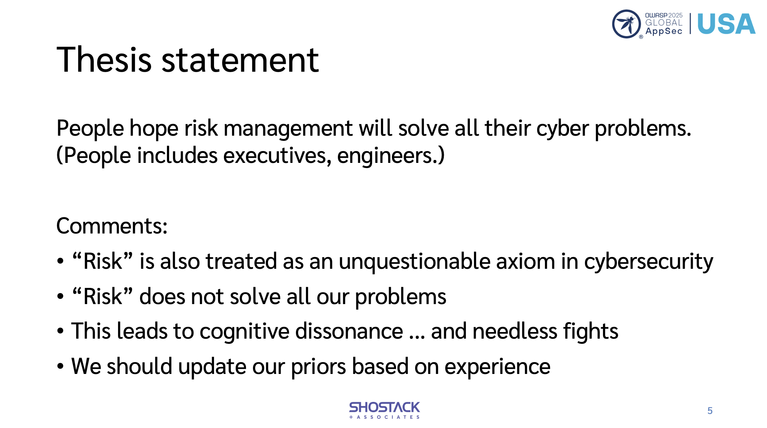

Stop Trying to Manage Risk
Adam Shostack, OWASP Appsec Global, Nov 7, 2025
Questions?
Email me:
adam@Shostack.org
Slides at
Shostack.org/blog

Slide 47
Research Opportunities + Implications

Slide 48
Opportunities
What does the broad risk literature teach for security?
What are the unique properties of cyber that influence how we use RISK concepts?
Could other frames help us more than RISK?
Outcomes: Papers, better practice, better standards
Broad literature
Unique to Cyber
Other frames

Slide 49
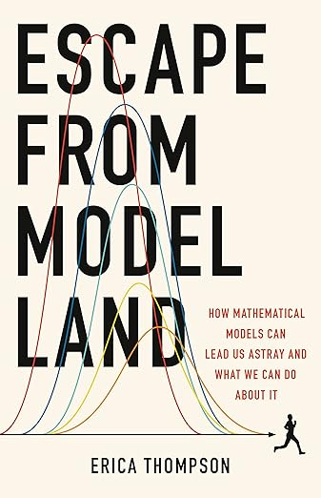
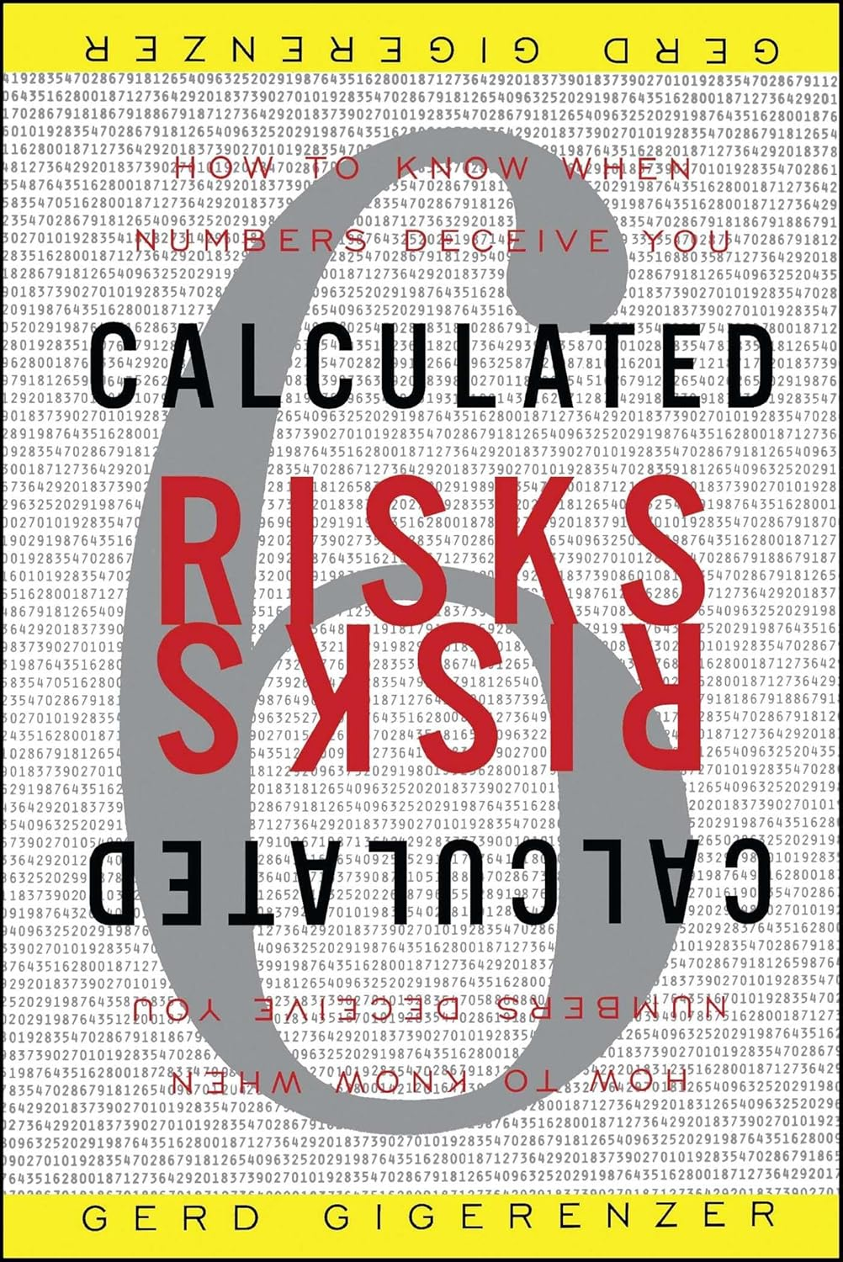
Broad risk literature
The limits of risk as a frame (Speigelahlter, 2025, Thompson 2022)
Limits of risk communication (eg, Gigerenzer, 2003)
How do these known issues apply to cyber?
Broad literature
Unique to Cyber
Other frames

Slide 50
Property: Uncertainty
Kay & King Radical Uncertainty: Decision-making for an Unknowable Future (The Bridge Street Press, 2020), quoted in Simpson, Into the unknown: the need to reframe risk analysis, J Cybersecurity, 14 November, 2024
Inputs that are not known
  Resolvable: Amicable to being looked up
  “Radical uncertainty has many dimensions: obscurity; ignorance; vagueness; ambiguity; ill-defined problems; and a lack of information that in some cases but not all we might hope to rectify at a future date”
Adaptive behavior by attackers seems different than “uncertain”
How does this apply to cybersecurity?
  Where’s the line between vagueness a lack of information?
Broad literature
Unique to Cyber
Other frames

Slide 51
What’s unique about cyber?
Do we have iterations? What are they?
  “Phishing” vs “this email with these defenses”
  What levels of abstraction have what tradeoffs?
What are the theory, applied limits of adversary freedom?
Can we overcome the myriad problems with data gathering, sharing, creating “actuarial data”? (No)
Broad literature
Unique to Cyber
Other frames

Slide 52
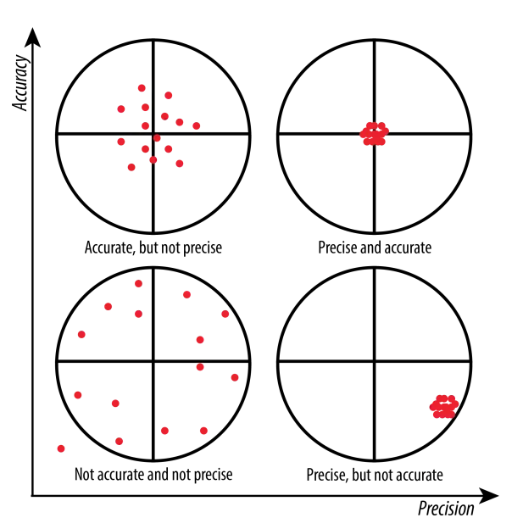
What’s achievable in cyber at what cost?
Unique to Cyber
How much accuracy/precision are needed?
  Accuracy: how close measures are to truth
  Precision: how close they are to each other
What goals are served?
Cost: what does it take to achieve either?
Image from https://wp.stolaf.edu/it/gis-precision-accuracy/

Slide 53
We could measure accuracy, precision
Unique to Cyber
Precision
  Have many people quantify some threat
  Measure reliability (inter-, intra-rate), measure spread
  Can be measured without knowing “the” real value
Accuracy
  Requires(?) iterations
  Every failure gives you data
  Many security failures are very costly
  Near misses give us data (shostack.org/lessons)
But we don’t, and standards don’t set requirements

Slide 54
Property: Defender Cost
Unique Cyber
Effort to produce RISK measurement
Recording the measurement and inputs
Vigorous debate
  (The debate may add value)
Cost relates to “return on investment”
  “Return” may be hard to measure
  “Investment” is entirely left out when we calculate risk
  That leads to that vigorous debate
NASA Risk Management Handbook (2014)

Slide 55
Is RISK worth the investment?
Unique Cyber
Many security improvements are not very sensitive to risk numbers
Other factors dominate the decision
  Cost of fix
  Impact on schedule
  Impact on other features, usability, testability, etc
This can be very frustrating
  Especially because security is told RISK drives prioritization

Slide 56
An approach to evaluating RISK methods
Unique to Cyber
Measure precision + cost?
Seems unsatisfying?
Are we comparing real RISK management systems to aspirational ones?

Slide 57

About Adam Shostack

