Slide 1
A Failure is a Terrible Thing to Waste:
The Case for Breach Transparency
[CSO-M03]
Adrian Sanabria
Adam Shostack
Founder and Principal Researcher
The Defenders Initiative
https://www.linkedin.com/in/adrian-sanabria/
President
Shostack + Associates
https://shostack.org
Notes:
Adam

Slide 2
Disclaimer
Presentations are intended for educational purposes only and do not replace independent professional judgment. Statements of fact and opinions expressed are those of the presenters individually and, unless expressly stated to the contrary, are not the opinion or position of RSA Conference LLC (“RSAC”) or any other co-sponsors. RSAC does not endorse or approve, and assumes no responsibility for, the content, accuracy, or completeness of the information presented.
Attendees should note that sessions may be audio- or video-recorded and may be published in various media, including print, audio, and video formats without further notice. The presentation template and any media capture are subject to copyright protection.
© 2026 RSA Conference LLC. All rights reserved.

Slide 3
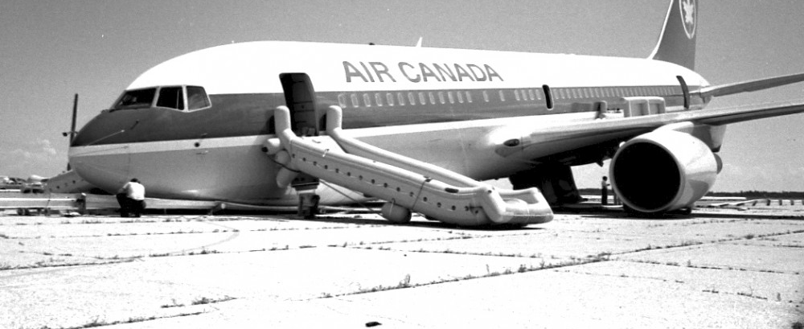
Story Time: The Gimli Glider
Notes:
Clocked this version of the story at 1min 13sec
The Gimli Glider was an aviation accident that occurred back in 1983
The Boeing 767 was just 2 years old
It was an entirely metric aircraft
But Canada still hadn’t fully shifted from imperial units to metric
A problem with the aircraft led to falling back to manual fuel measurements
The fuel truck used imperial, the pilot measured the fuel assuming metric
The result? Not enough fuel for the journey.
Ran out of fuel mid-flight and had to glide into an old military base
No one died, the plane was a little banged up, but there were a TON of lessons to learn from this

Slide 4
Immediate Air Canada changes
Simplified fuel depth reading calculation
Clarification around fueling roles and responsibilities
Easier to understand technical terminology
Updates to flight operations manuals
Additional training provided
More spare parts
Improved log book formats
Automatic uplift cross-check

Slide 5
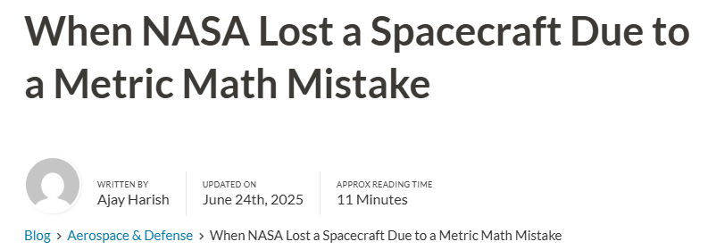
Air Canada Fleet Recommendations
Standardized units of measurement across the fleet
Establishment of a flight safety organization
Re-evaluate flight crew training
Re-evaluate maintenance personnel training
Re-evaluate flight attendant training
Establish improved fueling procedures
Standardize manuals
Status of the MEL
Limit persons in cockpit
Equipment improvements
Improved accident investigations
Re-evaluate certification procedures
Increase number of resident airworthiness inspectors
Establish flight operations inspectorate
Procedural recommendations
Communication improvements

Slide 6
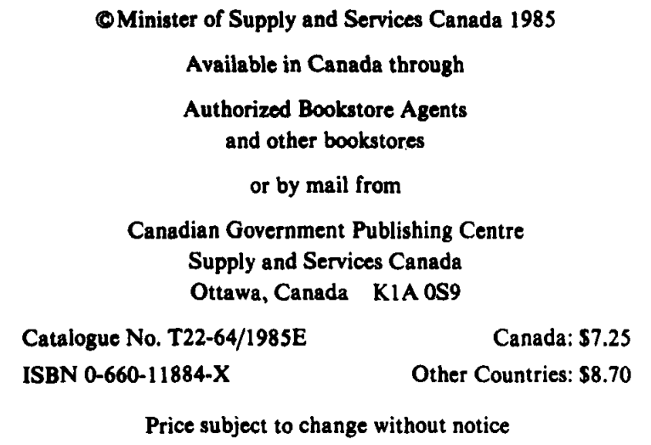
How do we know all this?
You could buy the public report at a bookstore for $7.25 CAD

Slide 7
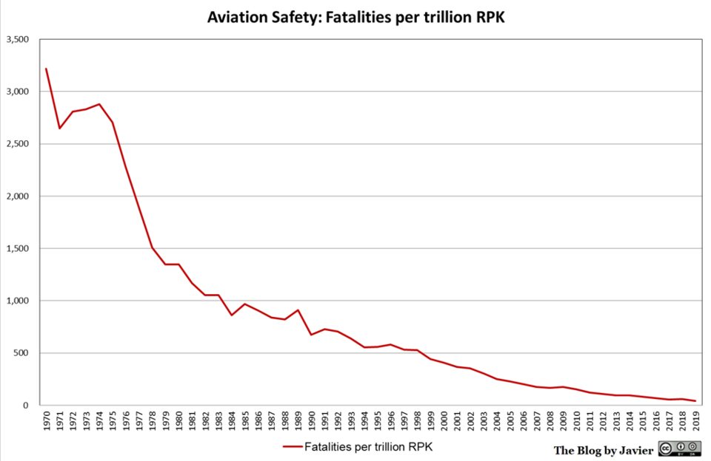
“Per trillion revenue passenger kilometers (1970-2019)”

Slide 8
Lesson learning systems beyond aviation
Maritime (MAIB, NTSB, IMO)
Rail & Transit (FRA, NTSB, RAIB)
Automotive (NHTSA, Euro NCAP)
Occupational (OSHA, CSB, HSE)
Healthcare (MAUDE, Eudamed)
Energy (NRC, INES, CSB/API)
Consumers (CPSC, Rapex)
Space (NASA Mishaps, ESA Anomalies)
Civil Engineering (NTSB Bridge Collapse, ASCE Failure Case Studies, NIOSH FACE, HSE, RAIB/MAIB, Dam Safety, Post-Earthquake, etc)

Slide 9
What we hope you take away from this
1: Failure should guide us
3: Breach transparency is critical
Breach reports exist
We will provide some resources
We need your help to find more!
2: Lesson learning systems are crucial
Not “I learned in the hallway track”
Not “I’ve read 32 articles...”
We need more data!
More data = better understanding
Better understanding = better focus
Better focus = less waste, better outcomes

Slide 10
Lesson Learning Systems

Slide 11
Learning takes many forms
How it works
What it studies
Informal to very structured
Small group to society
Within a firm to broad lessons
Incidental data to investigation
  FAA ASIAS collects, anonymizes and compares data from the flights you took to be here.
  Contrast NTSB accident investigations
Normal operations and deviation
Near misses
Accidents
Deaths
Catastrophes

Slide 12
Learning takes few forms in security
How it works
What it studies
Informal to very structured
Small group to society
Within a firm to broad lessons
Incidental data to investigation
  Verizon DBIR, Cyentia IRIS
Normal operations and deviation
Near misses
Accidents
Deaths
Catastrophes
What would make a good headline?

Slide 13
Breach details as a form
Why don’t we share?

Slide 14
Reasons to keep breach details secret
Fear of litigation
Fear of regulation
Embarrassment; shame
Fear of reputational damage
Notes:
Note that these reasons are all emotionally driven, not logic or fact-driven.

Slide 15
In reality
Fear of litigation
  In healthcare, a lack of transparency results in more litigation, not less
Fear of regulation
  Government regulation is a response to an inability to self-regulate
Embarrassment; shame
  If you try to hide the details, it looks much worse if they come out anyway
Fear of reputational damage
  Customers consistently praise transparency and honesty
Notes:
Note that these reasons are all emotionally driven, not logic or fact-driven.

Slide 16
The state of breaches

Slide 17
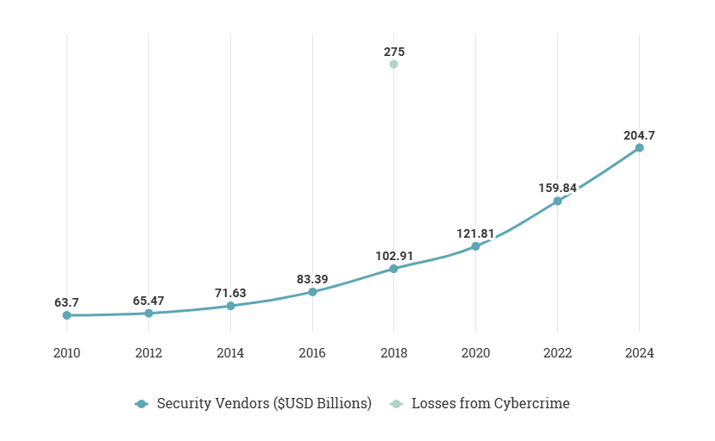

CyberSecurity Market
ESTIMATING CYBERCRIME LOSSES IS TRICKY (LONG STORY)
Growth Projection = Crazy
But it's clear that even just direct losses are huge and steadily increasing year by
year ($275B number from RAND's Estimating the Global Cost of Cyber Risk paper)
Winning
Criminals
Vendors
Resellers
Consultants
MSSPs/MDRs
Failing
Defenders

Slide 18
2025 Verizon DBIR Statistics
Confirmed Security Incidents
  22052
Confirmed Data Breaches
  12195
13%

Slide 19
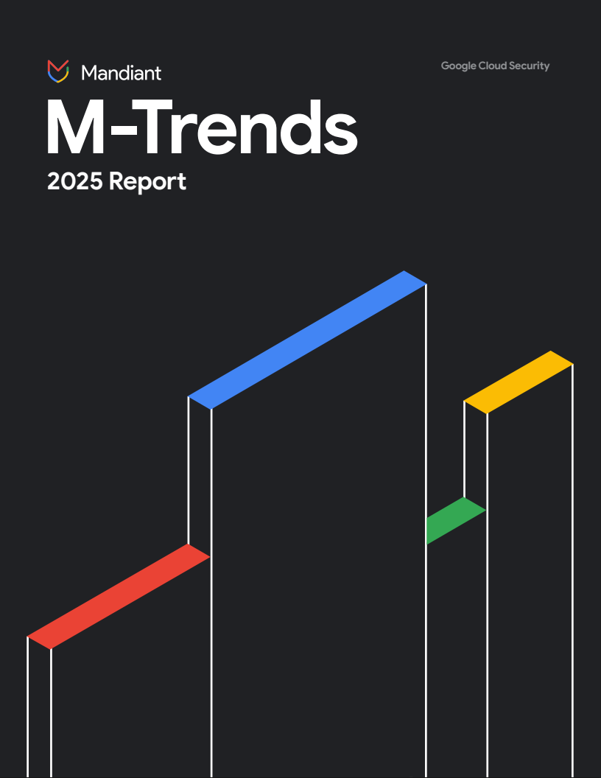
Dwell Time – Metric of Madness
The median breach is done in 5 days
Median internal detection is 10 days
But it used to take us months!
Is this an improvement?
Can you fail ‘less hard’?
Notes:
It would be like NASA saying the median time to detect a fatal issue with a spacecraft is now 10 minutes after everyone dies instead of 1 hour after everyone dies. Everyone is still dead. I wouldn’t brag about it.

Slide 20
Cybersecurity is a Wicked Problem

Slide 21
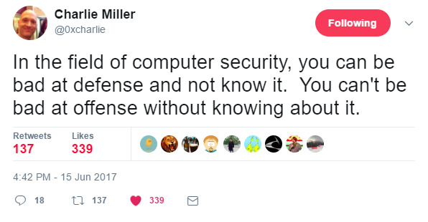
Are we even doing the right things?

Slide 22
How most orgs manage controls
Choose Control
Implement Control
Implement Control
Choose Control

Slide 23
How they should be managed
Choose Control
Improve Control
Implement Control
Measure Control
Test Control
Monitor Control
Notes:
We don’t know if the control works
We don’t know how to measure efficacy
There’s no process improvement

Slide 24
Choosing Controls or “Best Practices”
What’s driving these choices?
What should be driving these choices?
Notes:
Sometimes, the fact that a new product exists is reason enough to purchase and implement it.
It should be the reverse: identify a need, a gap, a shortcoming. THEN consider building or buying a solution.

Slide 25
An inflection point in cybersecurity
We don’t have to guess.
We have data now.

Slide 26
What changed in the past 10 years?
Attacks changed
  Breach quantity and severity increased
  Ransomware, BEC, Infostealers
Which gave us more data on breaches
  More breach details became public
  Not just surface details like, “CVE-2021-1234 wasn’t patched”
  Interviews, what it was like to work there, quality of communication, did employee’s training requests get approved or denied, etc
  Now, we know control failure reasons: technology, people or processes
Notes:
Need to clean up this slide; make it less death by bullet point

Slide 27
Case Study: Equifax
Notes:
I think maybe we take this section out

Slide 28
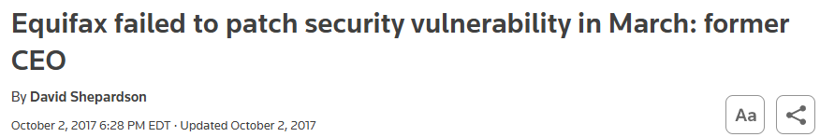
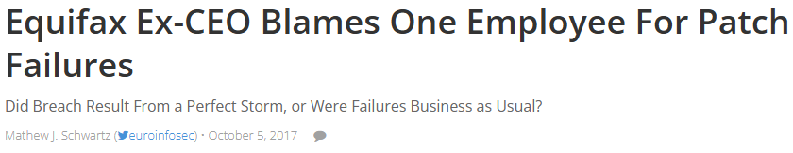
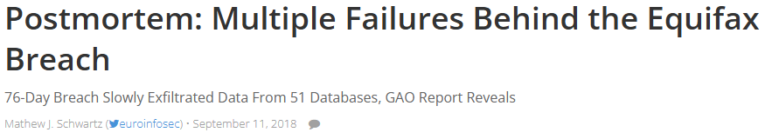
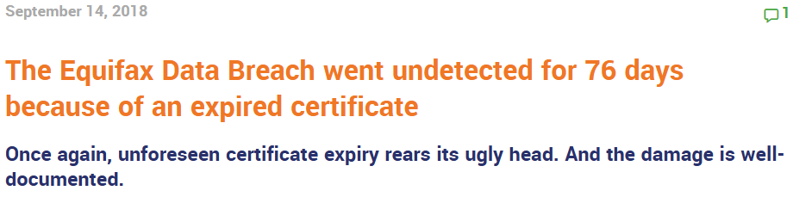
Why did Equifax get breached?
Notes:
How do YOU remember it?

Slide 29
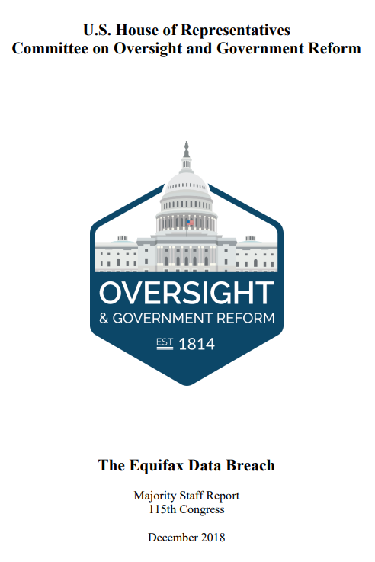
USGov releases a comprehensive report
Released December 2018
15 months after breach announced
96 pages
Context
Interviews
Technical details
Management comms
Company culture

Slide 30
Equifax Control Failures
No asset inventory
No software inventory
No file integrity monitoring
No network segmentation
Neglected SSL Inspection (SSLV) Appliance
Neglected SSLV failed open
SSLV lacked certs for key systems
SAST failed to find Struts due to user error
No anomaly detection on web servers
Custom snort rule didn’t work
Custom snort rule wasn’t tested
Vulnerability scanner didn’t find Struts
Failed to detect webshells
Failed to detect interactive activity
Admins stored cleartext creds in open shares
Least privilege principles not followed for database access
Adhoc database queries not restricted
No database anomaly monitoring
No field-level encryption in databases
No data exfiltration detection
DAST scanning failed to detect vulns
Ineffective IR plan/procedures
No owners assigned to apps or databases
Comms issues due to corp structure
Lack of accountability in processes
No followup on patching status/results
Old audit findings were not addressed
Insecure NFS configs
Logs retained for less than 30 days
Nonexistent or ineffective IR testing
Notes:
Notice that there’s no “failed to patch” control here. They never got that far. The next slide explains it more plainly.

Slide 31
Equifax Control Failures
Identify
Protect
Detect
Respond
Recover
1, 12, 28, 29 | 26, 28 | 29
2, 8, 21, 23, 29 | 26 | 3, 9, 13, 14
 | 4, 5, 6, 7, 16 | 10, 11, 20
15, 23 | 16, 17, 19 | 17, 18, 20
22, 25, 30 | 27 |  | 22, 24
Devices
Applications
Tech Oriented Control Failure
Networks
People Oriented Control Failure
Data
Process Oriented Control Failure
Users
Cyber Defense Matrix courtesy of Sounil Yu, https://cyberdefensematrix.com/
Notes:
8. Equifax specifically scanned for vulnerable Struts on local systems using a SAST tool and found nothing. This failure was due to not using the recursive flag on the SAST tool
10. Emerging Threats group created a snort rule to detect attacks against this Struts vuln. It didn't work.
11. Countermeasures team installed the Snort rule. They didn't test it. Otherwise, they would have known that it didn't work.
15. One of these application servers had a mounted file share, where attackers found cleartext creds. Why did it have a mounted file share?!
16. ACIS app only needed access to 3 databases, but could access 45 additional databases (lack of segmentation and least privilege)
23. Equifax did not have a list of asset owners for databases and applications.
26. No redundancy or follow-up to ensure patching would occur

Slide 32
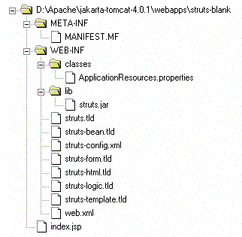

Why didn’t they patch it?
They couldn’t find it.
They didn’t know how to find a small java library in a large corporate environment
Notes:
They didn’t fail to patch Struts, because they never FOUND it.
And they tried! Employees were looking for Struts. Some even came close to finding it but used tools incorrectly.
Also, you don’t just patch Struts. It’s not an application that’s installed like a software program on your phone or laptop.

Slide 33
How many companies learned this lesson and acted upon it?
Can the average enterprise today quickly locate a small java library in a large corporate environment?
Notes:
Here’s an excellent example that we should have learned from not one, but TWO major incidents: Equifax, and Log4Shell.
The lesson was that we need to be able to quickly locate vulnerable libraries.
Have we, as an industry learned from this lesson? Can the average organization do this quickly today? What about the G2000? The F100? F50?

Slide 34
Conclusions

Slide 35
Learning from failures focuses us on what matters
We’re spending time on the wrong things
We need perspective and focus
Studying failures helps with strategic and tactical planning
Not just OUR failures – other industries have things to teach us
Notes:
Strategic: where do I need more/less labor? What tools do my teams need? What should they be focused on? How can I build a roadmap for maturity? What KPIs/metrics create the right incentives? What controls need to be added to avoid the same fate as our peers’ latest breach?
Tactical: which detections do we build first? Which vulnerabilities do we remediate? What should our next penetration test focus on?

Slide 36
Great ideas from other industries
The Gimli Glider report looked closely at how other airlines operate
  Particularly notable was that only two major Airlines worldwide mixed imperial and metric aircraft within their fleet
This is something the CSRB also did when investigating Microsoft
  They looked at how AWS, GCP, and even Oracle clouds were managed

Slide 37
Consuming Breach Data
Where do we find it?
How do we analyze breach data?
FTC complaints
Government investigations
SEC filings
Legal filings
Voluntary reporting
Attackers boasting
Look for missing or broken processes
Lack of training
Failure to use tools correctly
Communication issues
Corporate culture shortcomings
Tools to help with analysis:
  Cyber Defense Matrix
  SebDB
  MITRE ATT&CK

Slide 38
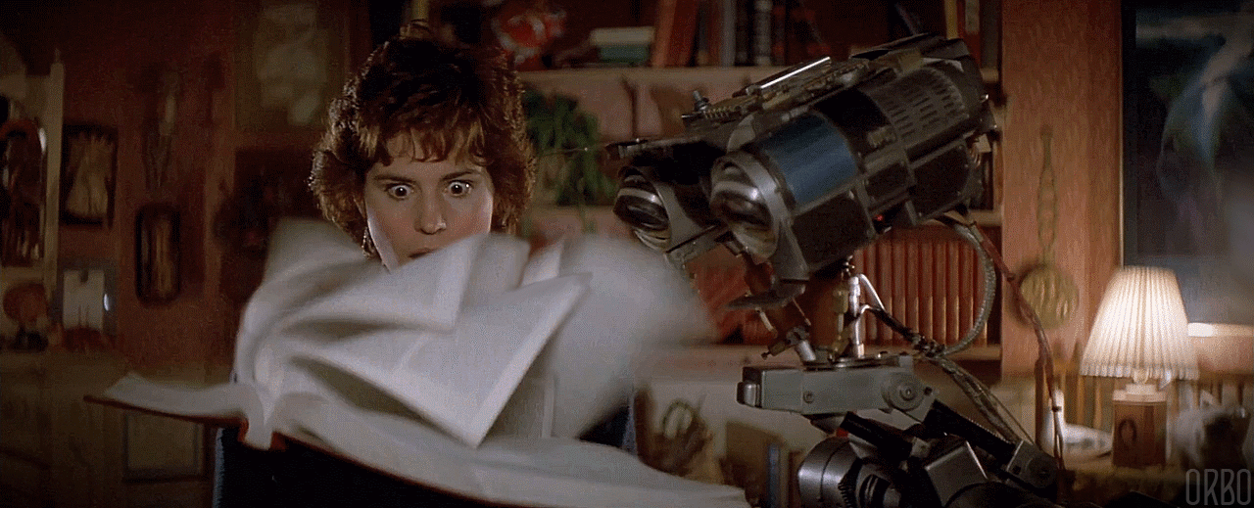
Our industry needs more data
Consider sharing breach details
Consider sharing near misses
Consider sharing breach prevention
Even if anonymous, any data helps

Slide 39
Operationalizing breach data
“We have visibility across 91% of active attack TTPs”
"We are 100% protected against the Powerschool breach”
"We are 75% protected against the Capital One breach, but have 100% visibility across it”
"If the 2013 Target breach happened to us today, we’d fail”
Notes:
Shouldn’t we be expected to understand other breaches and learn from them? As a customer or consumer, I’d certainly expect a company to be able to defend against a breach that took down a similar company one year ago.

Slide 40
“Apply” Slide
Within the next week, you should:
  Select an applicable breach case study to run a tabletop on
Within the next 3 months, you should:
  Run a tabletop on this breach case study
  And apply lessons learned from it
Within the next 6 months, you should:
  Have a penetration test focused on the lessons from this breach
  Continue to apply lessons learned as necessary before moving on to next breach case study

Slide 41

References
Check out Bob Lord and Wendy Nather’s talk on near misses!
  Less Blood, More Bits: Learning from “Near Misses” in Cybersecurity
  Tomorrow at 8:30am
Adam: https://shostack.org/resources/lessons
Adrian: https://defendersinitiative.substack.com/
Slides:
Shostack.org/blog

