Slide 1
50!
25 Years in AppSec
Looking Back, Looking Forward
Adam Shostack
//shostack.org

Slide 2
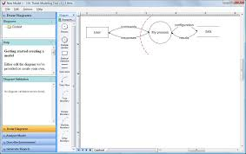
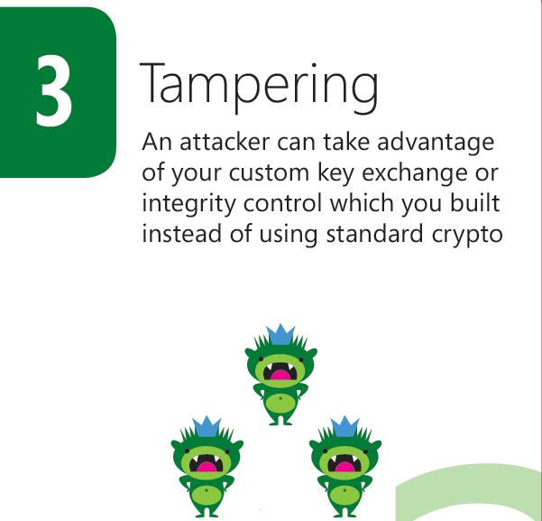
About Adam Shostack
Notes:
20 years of threat modeling
From startups to Microsoft

Slide 3
Agenda
Past
Present
Future

Slide 4
Past

Slide 5
My start in firewall code review
Contractor for Fidelity in 1995
Reviewing code that went into a firewall
Competition to provide access to accounts and trading
[Not speaking on their behalf]
Conflict led to a set of guidelines
Got ok to share the guidelines in August 1996
Maintained until about 2000
Thank you, Steve MacLellan & team

Slide 6
Rough architecture
DMZ
TCP stops here
Backend Systems
Browsers
Proxies
Firewalls

Slide 7
Rough architecture
DMZ
TCP stops here
Backend Systems
Browsers
Custom code here
Firewalls

Slide 8
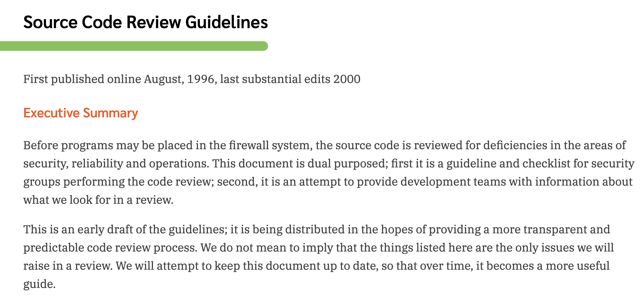
The Guidelines
Guidance for the security team
Guidance for development teams
https://shostack.org/files/essays/review.html

Slide 9
The guidelines: the technical details
Architecture, including data flows
Logging
Some specifics like chroot
Check your inputs
Dangerous functions
C, C++, Perl

Slide 10
The guidelines: perspective on 1996
Things we didn’t have
Tooling — Predates static analysis, fuzzing
Books — Predates McGraw’s Building Secure Software, Lincoln Stein’s Web Security
Consultants
Pen testers (under that label)
Structured threat modeling
Attack trees were in Amaroso’s Fundamentals (1994)
Business conflict and need for support

Slide 11
Perspective from 1996
Smashing the Stack for Fun and Profit
Phrack 49, 1996-11-08
Mailing lists and usenet
Bugtraq, firewalls, and cypherpunks lists existed
Security community, not appsec community
Books
Cheswick & Bellovin’s Firewalls & Internet Security
Spafford & Garfinkel Practical Unix & Internet security

Slide 12
Frames from 1996

Slide 13
25 Years Go By Fast: AppSec
OWASP
Microsoft’s Trustworthy Computing memo & SDL
Commercial tooling
Bug bounties; jobs in bug hunting, pen testing
Rise and fall of bug classes like SQLi, PHP‡
Breach reporting
‡ Ok, technically, PHP is not a bug class in and of itself. ☺

Slide 14
25 Years In Development
Agile Manifesto
Devops
Cloud, virtualization and infrastructure as code
iPhones & Android
Notes:
(Salesforce launched in 1999 as a very early SaaS model)

Slide 15
Present

Slide 16
Technical progress - security
Security properties/features in more of the stack
Not something only provided by OS/bolt-ons
Languages with security goals (Rust)
Frameworks with security properties (React)
Security chips (Apple’s T2, Win 11 needs a TPM)
Formal proofs (TLA+)
Langsec frames security of new languages
Compartments in iOS & Android

Slide 17
Government progress
1996
Orange book/rainbow series
Crypto export restrictions
2021
Executive Order on security
Breach reporting
SBOM advancing (so sorry, npm!)
FDA recommending threat modeling
NIST Secure Software Development Framework, Software Verification Guidelines

Slide 18
Insecure Design makes the Top 10!
https://owasp.org/www-project-top-ten/

Slide 19
Insecure design: Why now?
What has gone wrong?
Issues like injection have been hard to fix
Design is a dirty word
Threat modeling as “think like an attacker”
How are we addressing ?
STRIDE by Kohnfelder & Garg
4 Question Framework
Elevation of Privilege & Cornucopia
Books
TM Manifesto

Slide 20
Future

Slide 21
“Predictions are hard,
especially about the future”

Slide 22
The more things change…
State and trends will continue
Kernels will be written in C
The trend towards better security properties will continue
(Attacks at the seams will grow)
Better isolation
Ransomware
From encryption to really evil
Profit motive
Paying customers will remain privileged

Slide 23
Appsec will change in many ways
We’ll see a shift from attacks on systems to attacks through systems
What problem are we solving?
Abuse, conflict and harm
Privacy
Demonstrating trustworthiness
AI will grow in importance in many ways
More data driven as a field
The frame is going to matter

Slide 24
AI as problem solver (1)
In 25 years, application security will be a lot more mature.
We will have a lot more tools and a lot more people who know how to use them.
We will have a lot more people who know how to use them.
— Open AI’s GPT-3

Slide 25
AI as problem solver (2)
Code review
Bug detection and remediation
Composition analysis

Slide 26
AI as problem area
Security of AI/ML systems
Threat models – BIML, Microsoft
AI/ML problems aren’t just security!
Explainability
Transparency
Privacy
Environmental costs
Bias & fairness

Slide 27
Bias and fairness – Read this paper
To design fair systems, we must agree precisely on what it means to be fair.
One such definition is individual fairness: individuals who are similar (with respect to some task) should be treated similarly (with respect to that task).
Simultaneously, a different definition states that demographic groups should, on the whole, receive similar decisions. …
“ We present two such worldviews and will show they are fundamentally incompatible.”
Sorelle A. Friedler, Carlos Scheidegger, and Suresh Venkatasubramanian. 2021., The (Im)possibility of fairness: different value systems require different mechanisms for fair decision making. Commun. ACM 64, 4 (April 2021), 136–143. DOI: https://doi.org/10.1145/3433949

Slide 28
AI as problem creator
Technical bug hunting
“Ransomware is just a pen test whose terms you negotiate after the report’s delivered”
Or a bug bounty…
DARPA Cyber Grand Challenge was 2016
Human vulnerability exploiter
Deepfake/voice clone/text fake
Phishing

Slide 29
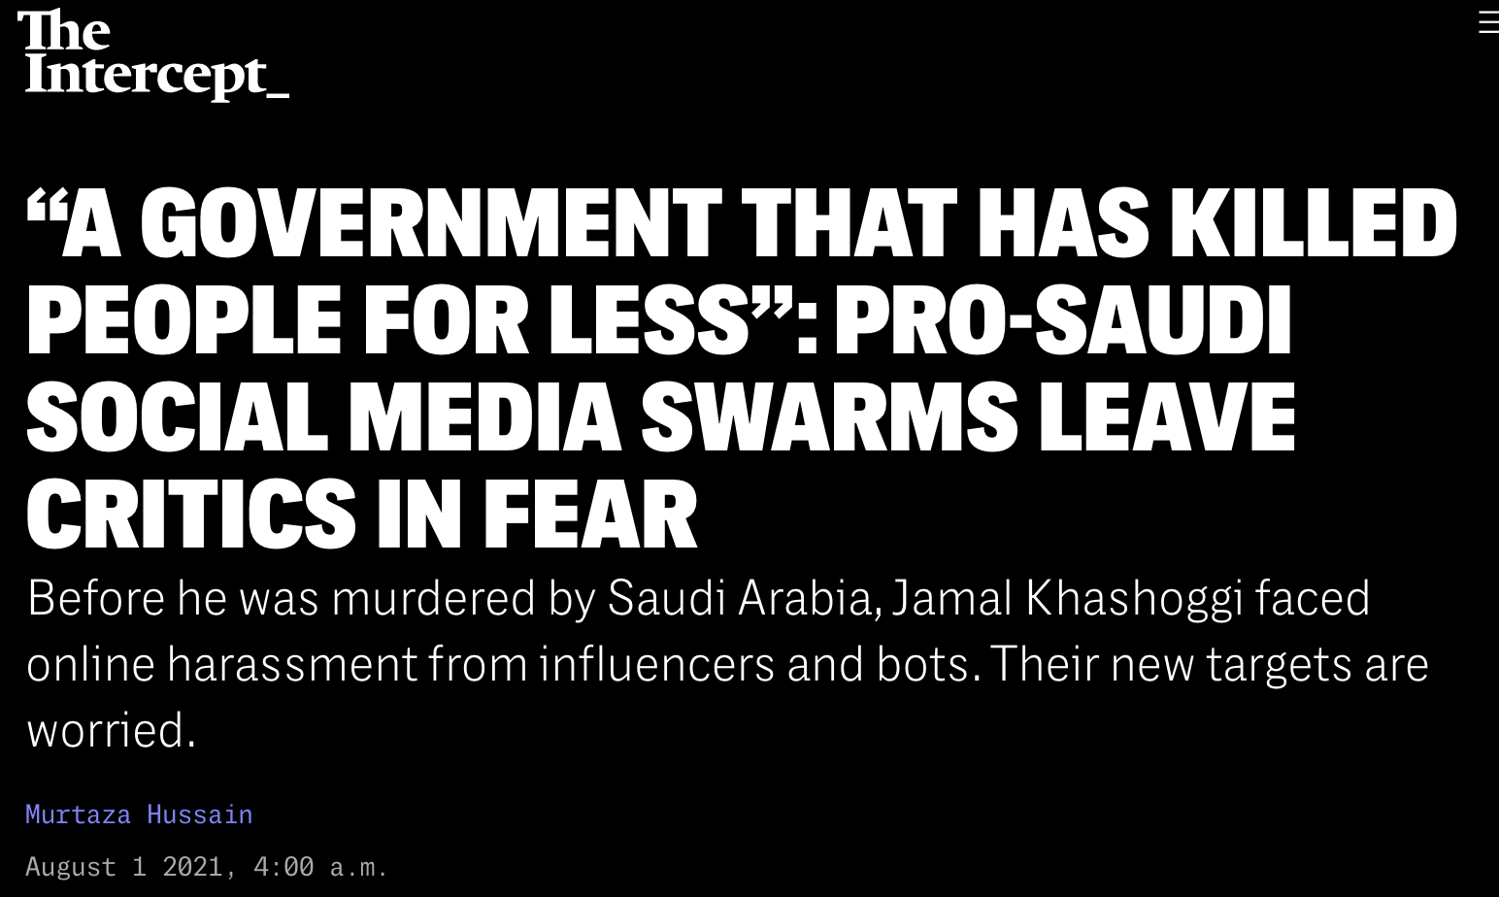
Abuse, conflict and harm
Stalkerware, intimate image abuse, IoT
Trolling, swatting & the internet hate canon
Khashoggi example
Election manipulation is cheap
AI will play on both sides of each
Abuse of protection tools
False reports to site safety
Copyrighted music to keep video off youtube
https://theintercept.com/2021/08/01/saudi-arabia-twitter-harassment-jamal-khashoggi/

Slide 30
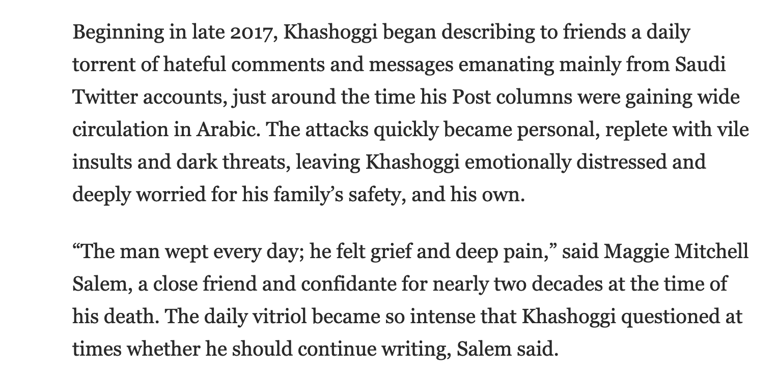
Khashoggi as abuse victim
https://www.washingtonpost.com/national-security/records-shed-light-on-online-harassment-of-jamal-khashoggi-before-his-killing/2020/09/07/1811c100-eed5-11ea-b4bc-3a2098fc73d4_story.html

Slide 31
Further reading
People doing good work on threat modeling abuse include
Diana Freed
Karen Levy
Julia Slupska
Leonie Tanczer
Papers include
Digital Technologies and Intimate Partner Violence: A Qualitative Analysis with Multiple Stakeholders https://doi.org/10.1145/3134681
Threat Modeling Intimate Partner Violence: Tech Abuse as a Cybersecurity Challenge in the Internet of Things https://www.emerald.com/insight/content/doi/10.1108/978-1-83982-848-520211049/full/html
https://www.nytimes.com/2018/06/23/technology/smart-home-devices-domestic-abuse.html
Github.com/adamshostack/conflict/

Slide 32
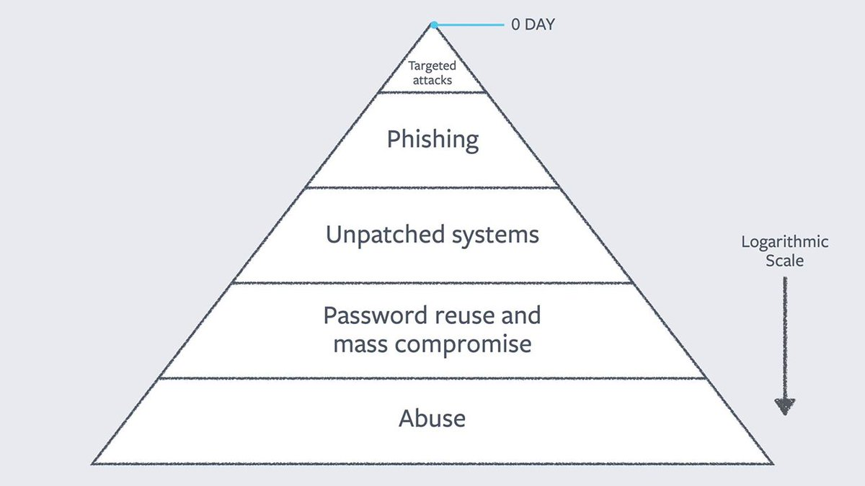
What problem are we solving?
Alex Stamos (Blackhat 2017):

Slide 33
What problem are we solving?
You are here?

Slide 34
Demonstrating Trustworthiness
Techniques (from Kress-Gazit et al)
Testing
Monitoring
Formal verification
Synthesis – from specification
Consider synthesis more broadly - composition
Hadas Kress-Gazit et al, Formalizing and guaranteeing human-robot interaction. CACM (September 2021) https://doi.org/10.1145/3433637

Slide 35
Composition
Synthesis is about “from specification”
Composition is “from components”
libc to npm
Emergence of more secure components
Composition is shellshockingly hard problem
Specification is also really hard
Will AI help?

Slide 36
All these problems
How to measure?
How to prioritize?
How to assess progress?

Slide 37
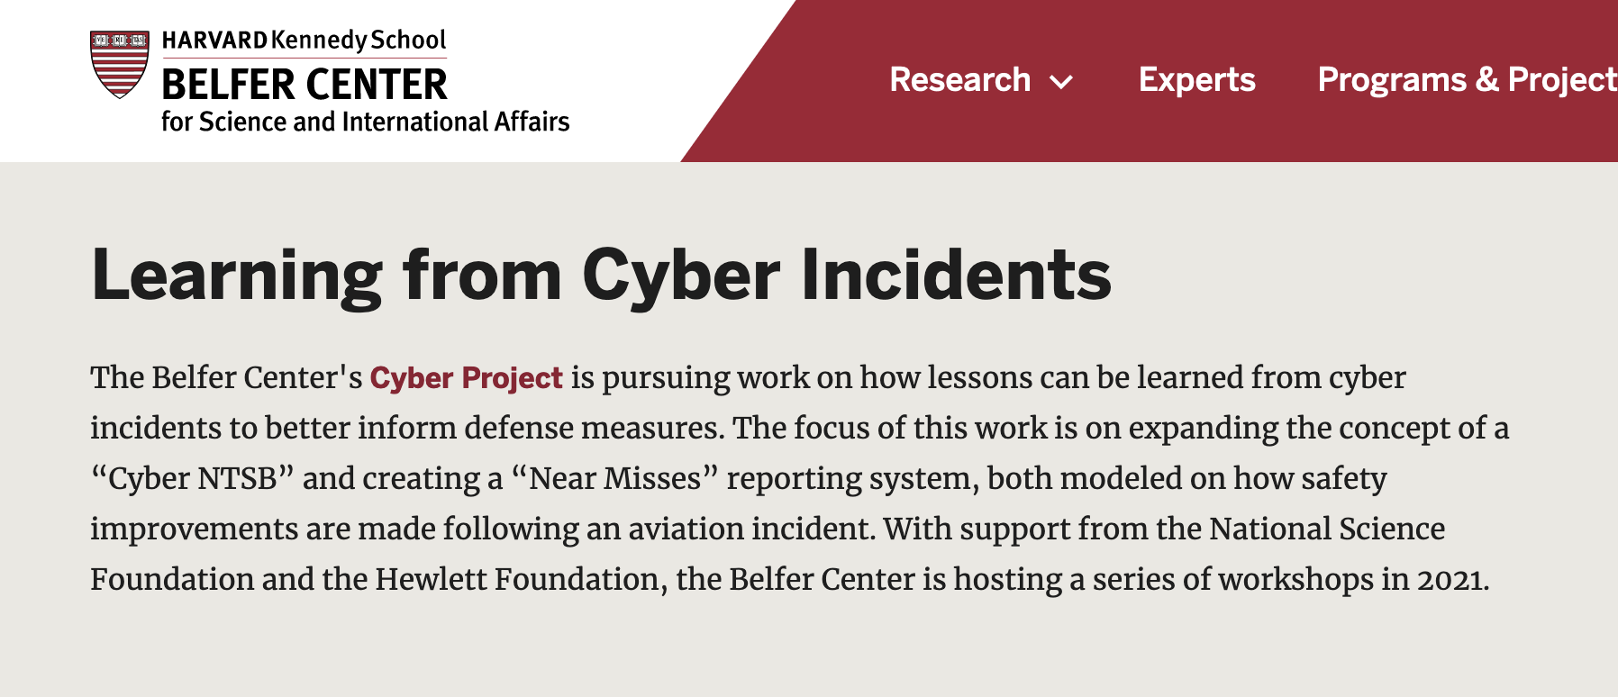
Learning systems
https://www.belfercenter.org/learning-cyber-incidents

Slide 38
Notification & Learning
Faster timelines are today’s trend
We’ll get more value from more data, less quickly
Notes:
https://thehill.com/policy/cybersecurity/580330-senators-move-to-include-72-hour-timeline-for-cyber-incident-reporting

Slide 39
So what can we do?
“The best way to predict the future is to invent it”
Opportunities abound
Synthesis and composition
Many AI challenges
Threat modeling + appsec practices for conflict
Threat modeling frames for end users

Slide 40
The Frame Matters
How do we think of security?
Cyberwar, cyber espionage
Cyber criminals & hacktivists
Threat hunting/bug hunting?
Compliance
Appsec
November 11

Slide 41
The frame matters (2)
Conflict is real, and not going away
We need castles, not sandcastles
Appsec can help us build these defenses

Slide 42
Going forward
We are not at the beginning of the end,
but the end of the beginning
Opportunities abound

Slide 43
Thank you!

Slide 44
Questions?
adam@shostack.org
Slides: shostack.org/blog

